Slide 1
the eta_c1-tilde analysis using genetic algorithm
Áron Kripkó for the panda collaboration
A. G. Brinkmann

Slide 2
Exotic charmonium
For hybrid charmonium states the ground state is expected to be 1⁻⁺ spin-exotic
Lattice QCD calculations predict its mass to be around 4290 MeV with a width of 20 MeV
Flux-tube model calculations predict for a hybrid state of this mass suppressed decays to open charm with respect to hidden charm decays
An OZI-allowed decay to hidden charm would be the transition to χc1 with emission of light hadrons, preferable scalar particles
The lightest scalar system is composed out of two neutral pions in a relative s-wave
One of its possible decay channel is used as a benchmark channel in the TDR

Slide 3
The Decay tree
$$γ$$
$\sqrt{s}$: 5 GeV
$$η$$
$$γ$$
$$γ$$
$$p\overline{p}$$
$$π^{0}$$
~
$$γ$$
$$η$$
c1
$$γ$$
$$π^{0}$$
$$γ$$
$$ⅇ^{+}$$
J/$ψ$
$$χ_{c1}$$
$$ⅇ^{−}$$
$$γ$$

Slide 4
Cross-section and branching fractions
39.41%
98.823%
$$γ$$
$$η$$
$$γ$$
$$γ$$
$$p\overline{p}$$
$$π^{0}$$
12.348 GeV antiproton momentum
~
$$γ$$
$$η$$
c1
$$γ$$
$$π^{0}$$
$$γ$$
$$ⅇ^{+}$$
J/$ψ$
33 pb
$$χ_{c1}$$
$$ⅇ^{−}$$
$$γ$$
Unknown:100%
34.3%
6%

Slide 5
Dedicated background
$$p\overline{p}$$
$$χ_{c1}$$
$$π^{0}$$
$$π^{0}$$
$$η$$
$$p\overline{p}$$
$$χ_{c1}$$
$$π^{0}$$
$$π^{0}$$
$$η$$
$$π^{0}$$
$$p\overline{p}$$
$$χ_{c1}$$
$$π^{0}$$
$$η$$
$$η$$
$$p\overline{p}$$
J/$ψ$
$$π^{0}$$
$$π^{0}$$
$$η$$
$$π^{0}$$

Slide 6
Simulation and reconstruction
100000 signal
100000 x 4 dedicated background channel
1000000 DPM events
During the event generation the PHSP model was used - all spins of particles in the initial and final state are averaged
The reworked EMC clustering algorithm was used for the reconstruction
Better neutral reconstruction
Available in the new PandaRoot release

Slide 7
Genetic Algortihm
Inspired by natural selection
Used when the evaluation of the fitness function takes many time
Individual: represents a parameter set
Mutation: randomly modify a parameter with a few percent
Cross-over: generate new individuals by taking parameters from 2 or more individuals
Selection: Delete the worst individuals

Slide 8
Different analysis methods
3 different analysis methods were tested
Straightforward with genetic algorythm
Reconstructed TDR analysis
Genetic algorythm based on the TDR analysis

Slide 9
Straightforward Method
$$γ$$
$$η$$
$$γ$$
$$γ$$
$$p\overline{p}$$
$$π^{0}$$
~
$$γ$$
$$η$$
c1
$$γ$$
$$π^{0}$$
$$γ$$
$$ⅇ^{+}$$
J/$ψ$
Combine 2 photons
Put mass cuts on these candidates around pion and η mass with 0.03 and 0.5 GeV widths respectively
Combine all muon candidates and apply a vertex fit with a mass constraint at J/ψ mass
Combine these with a photon and apply a mass constraint fit at χc1 mass
Finally combine these with an eta and 2 pion candidates and perform a fit constraining the 4-momentum at the 4-momentum of the original -system
Feed the χ² cut values of the fits and the mass cuts on the charmonium and -system to a genetic algorythm
$$χ_{c1}$$
$$ⅇ^{−}$$
$$γ$$
$$p\overline{p}$$
$$p\overline{p}$$

Slide 10
TDR analysis
$$η$$
$$p\overline{p}$$
$$π^{0}$$
~
$$η$$
c1
$$π^{0}$$
J/$ψ$
$$χ_{c1}$$
$$γ$$
Two photon candidates are combined and accepted as pion and η candidates if their invariant mass is within the interval 115-150 and 470-610 MeV respectively
Combine all muon candidates and accept them as J/ψ if their mass is within 2.98-3.16 GeV and apply a vertex fit with a mass constraint,
Combine these with a photon and accept them if their mass is within the range 3.3-3.7 GeV
Then reconstruct the initial system and perform a 4-constraint fit and accept only those ones which have a probability > 0.1%
Apply a stricter mass cut on the remaining χc1 and η candidates (3.49-3.53 GeV and 530-565 MeV)
Perform mass constraint fits on all intermediate states except the charmonium and a new 4-constraint fit on the system created from the fitted states - a probability > 0.1% is required at every step

Slide 11
Genetic algorythm based on the TDR
The same procedure as previously until the first 4-constraint fit
But the stricter χc1 and η mass cuts and all the probability cuts are determined by the genetic algorythm

Slide 12
Results
 | Genetic TDR | TDR analysis | Genetic algorythm | Simulated
Background 1 | 59 | 62 | 18 | 100000
Background 2 | 1 | 41 | 3 | 100000
Background 3 | 20 | 43 | 10 | 100000
Background 4 | 122 | 84 | 19 | 100000
All background | 701 | 659 | 379 | 400000+comb.
Signal | 241 | 125 | 79 | 100000
Significance | 7.8522 | 4.4643 | 3.6914 | FTM/√Reconstructed
DPM Background | 0 | 0 | 1 | 1000000

Slide 13
Charmonium mass
Extracted mass: 4.304 +/- 0.001 GeV
Extracted width: 220 +/- 1 MeV
Szöveg beírásához kattintson ide
Reconstructed after the first 4C fit
FTM after the first fit
Reconstructed with optimized cuts
FTM with optimized cuts

Slide 14
More Background
4 · 1 million simulated dedicated background events
Background suppression:
1: 6.5 · 10⁻⁴
2: 3.1 · 10⁻⁵
3: 2.8 · 10⁻⁴
4: 6.3 · 10⁻⁴
DPM: less than 10⁻⁶

Slide 15
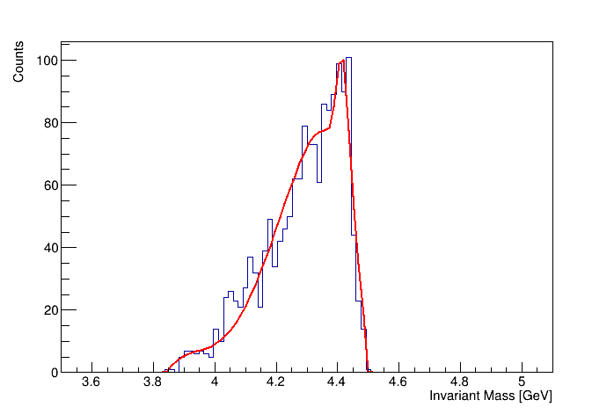
More Background
Fit the total background with the sum of a 4th-order polinomial and a Gaussian

Slide 16
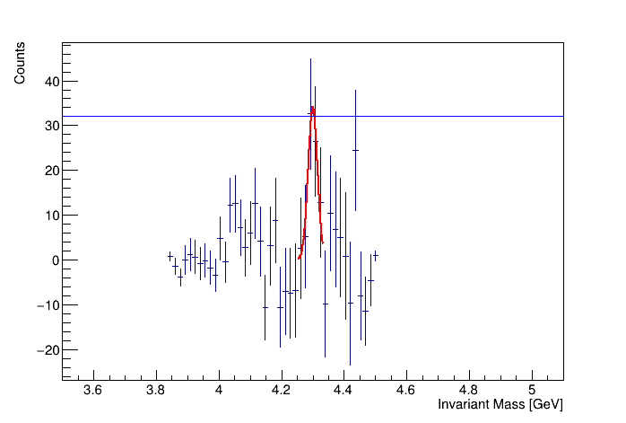
Detectability
The signal can be detected with 5 σ if the signal-background cross-section ratio is better than 1:307.7

