Slide 1
Changes in Emc Clustering
Áron Kripkó for the panda collaboration
A. G. Brinkmann

Slide 2
Split Offs
In some cases a secondary maximum is created a few crystals away from the impinging point of the primary photon
The currently used algorithm usually reconstructs these events as individual photons - wrongly

Slide 3
Online algorithm [1]
Online Clustering for PANDA
Same results as the original, but faster – different loop structure:
First it lists all neighboring digis for each digi
Based on that list it assigns a cluster number to every digi
Finally creates the PndEmcCluster objects, using that list
Deletes all clusters below a certain energy
[1] Marcel Tiemens – Online Cluster-Finding Algorithms for the PANDA Electromagnetic Calorimeter

Slide 4
OnMer algorithm (Online + Merging)
Based on the Online - faster
Added a cluster threshold
Can be turned off
The value can be set
It searches for split-off-like clusters
Merges them to the closest cluster (smallest angle)
Can be turned off

Slide 5
Measures of the reconstruction
Number of events in the peak – not accurate, depends on the window
Use the MC information for cluster definition: if a track created a digi, then all digis created by this track or its daughter tracks should be in one cluster and no other digis
Count the number of digis with the same ID to determine the clusters ID
Measures:
The difference between the numbers of created and reconstructed clusters - event
Purity: number of digis with other IDs in the cluster - cluster
Completeness: number of digis with the same ID in other clusters - cluster
Uniqueness: number of clusters with same ID – event
The smaller the better

Slide 6
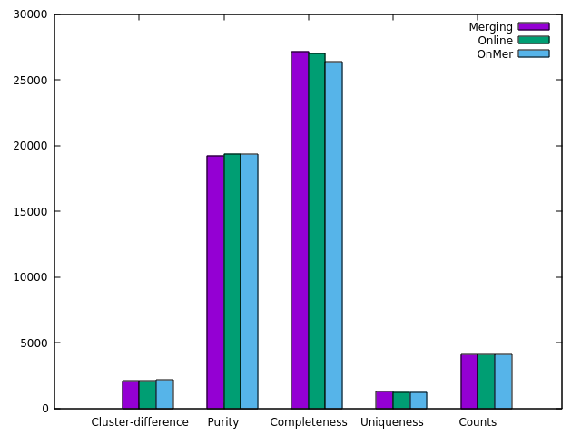
Online and merging OnMer algorithm
Use the merging algorithm together with the Online algorithm - OnMer
It looks like, that it is just a small improvement
But when applying it to resonances, this is the best
1 GeV

Slide 7
Decays
$$γ$$
$$π^{0}$$
$$γ$$
$$γ$$
$\sqrt{s}$: 2.98 GeV
$$p\overline{p}$$
$$η$$
$$η$$
c
$$γ$$
$$γ$$
$$π^{0}$$
$$γ$$
$$γ$$
$$π^{0}$$
$$γ$$
$$γ$$
$$ⅇ^{+}$$
J/$ψ$
$$η$$
$$p\overline{p}$$
$$γ$$
$$K^{−}$$
$$χ_{c2}$$
$$ⅇ^{−}$$
$$p\overline{p}$$
$$γ$$
~
$$D^{0}$$
$$π^{+}$$
$$η$$
c1
$$π^{−}$$
$${\overline{D}}^{0∗}$$
$${\overline{D}}^{0}$$
$\sqrt{s }$: 3.556 GeV
$$K^{+}$$
$\sqrt{s}$: 5 GeV
$$γ$$
$$π^{0}$$
$$γ$$
$$γ$$
$$π^{0}$$
$$γ$$

Slide 8
$$ⅇ^{+}$$
J/$ψ$
$$p\overline{p}$$
$$χ_{c2}$$
$$ⅇ^{−}$$
$\sqrt{s}$: 3,556 GeV
$$γ$$
Significance = Full truth match / √Reconstructed

Slide 9
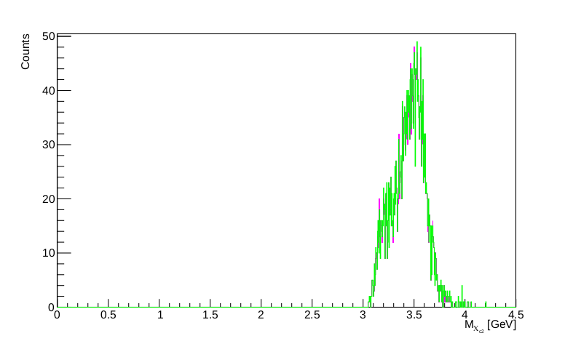
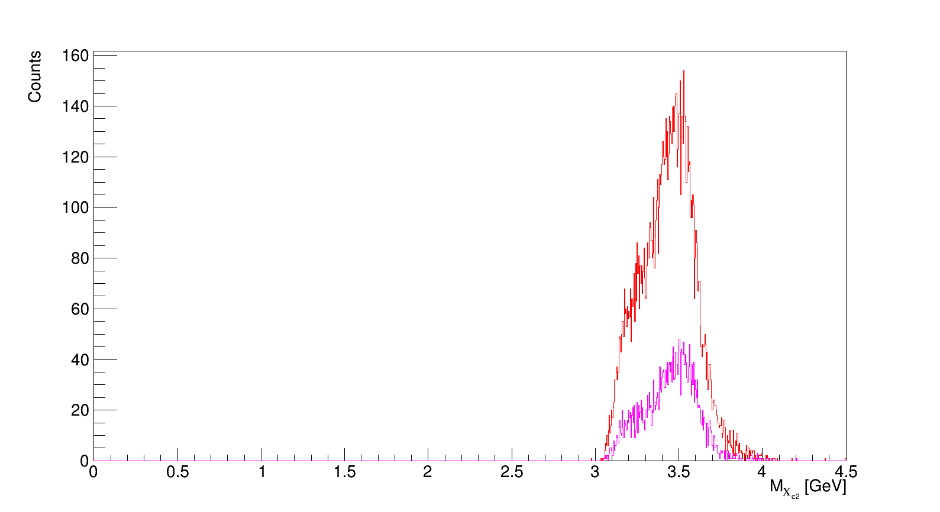
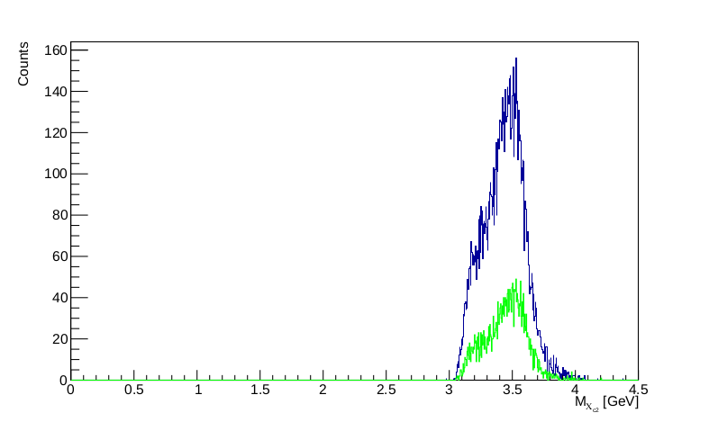
60000 events
Default, Default – FTM, OnMer, OnMer – FTM
Reconstructed
Full truth match
Default algorithm
OnMer algorithm
Significance: 30.49
Significance: 30.62

Slide 10
$$γ$$
$$π^{0}$$
$$γ$$
$$γ$$
$\sqrt{s}$: 2,98 GeV
$$p\overline{p}$$
$$η$$
$$η$$
c
$$γ$$
$$γ$$
$$π^{0}$$
$$γ$$

Slide 11
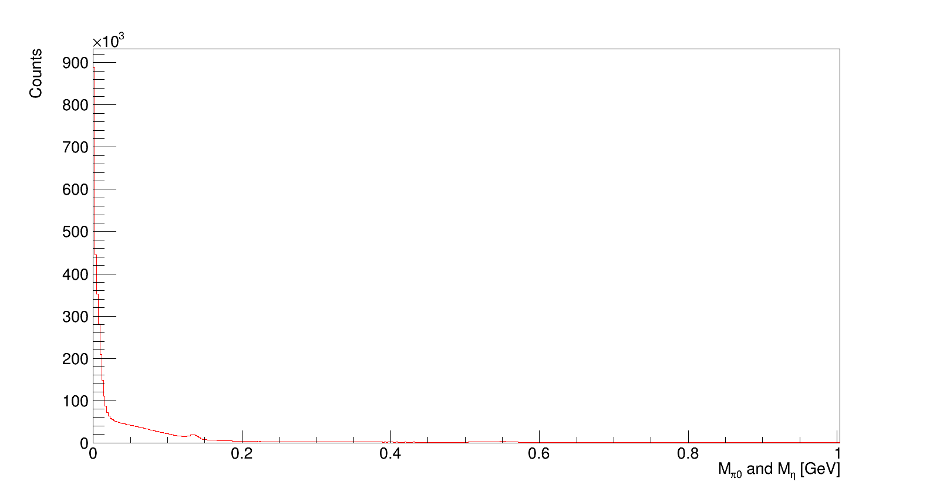
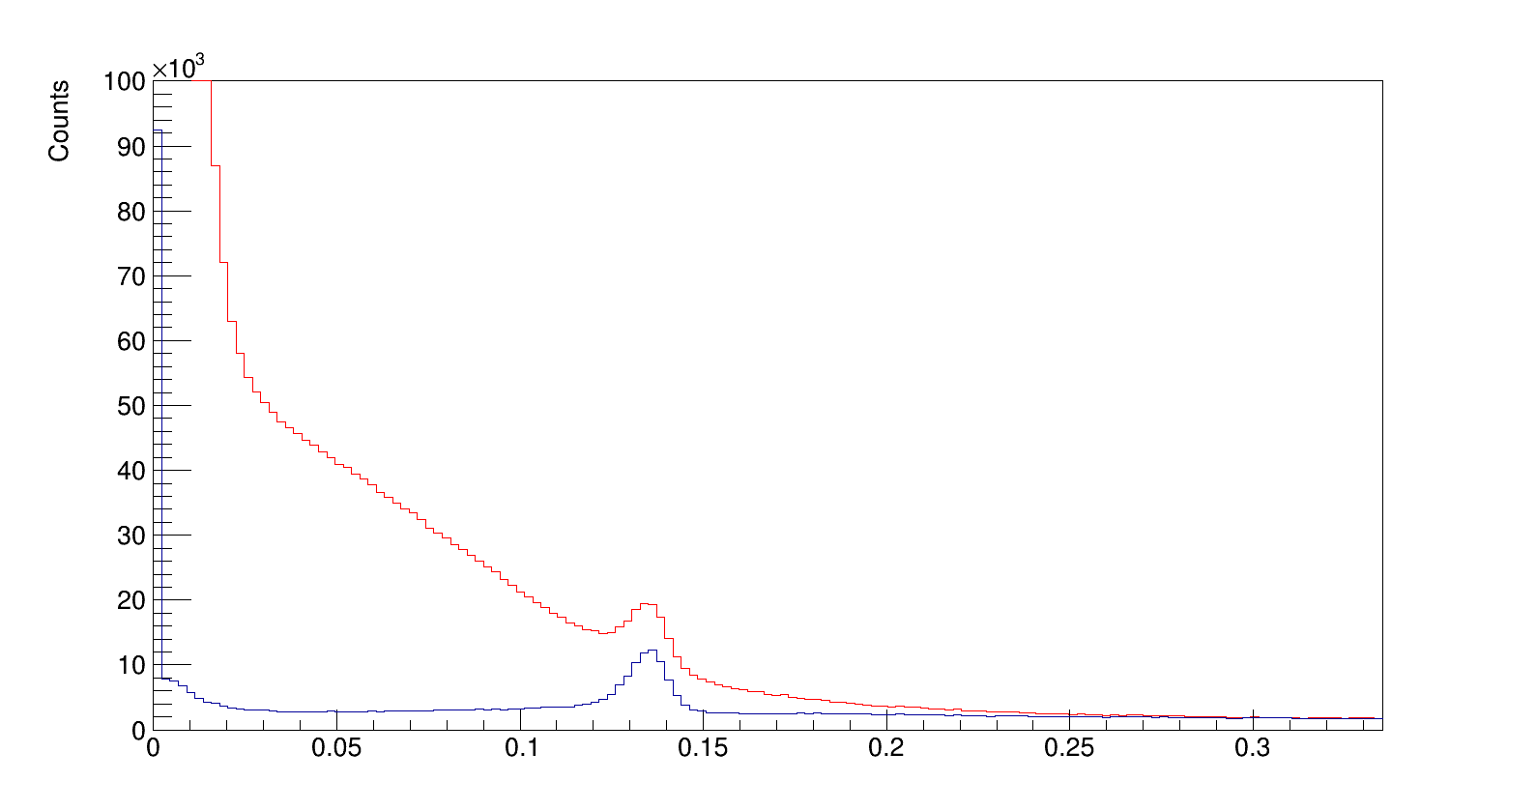
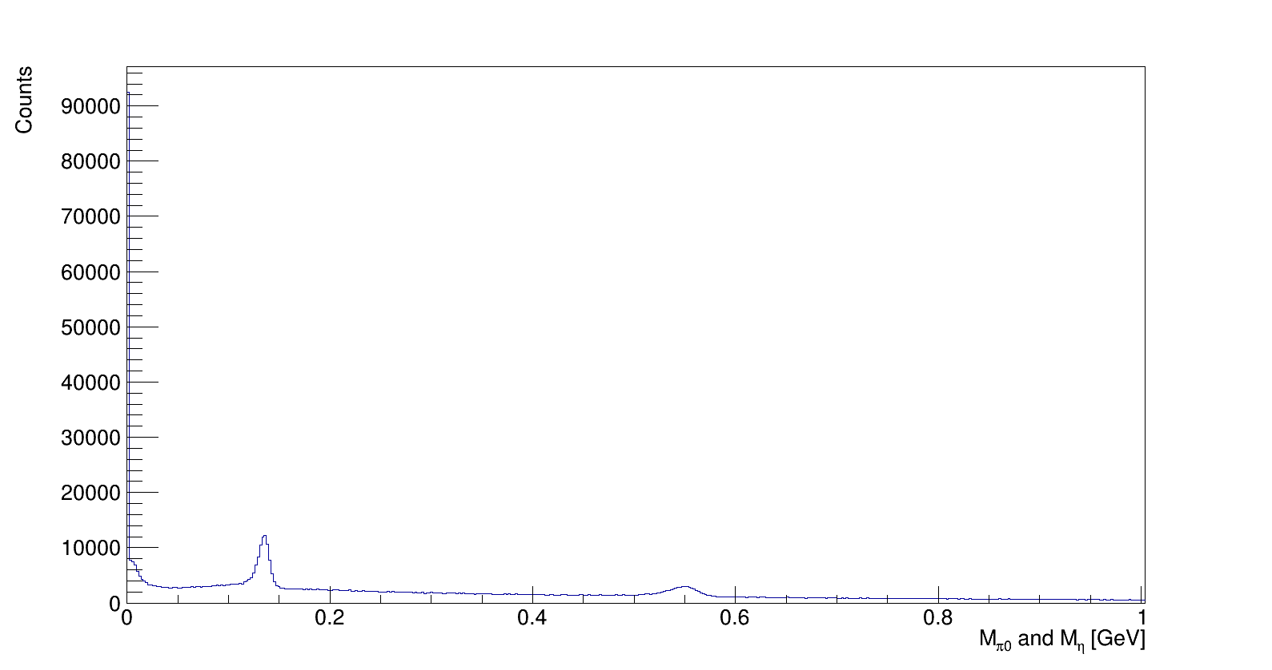
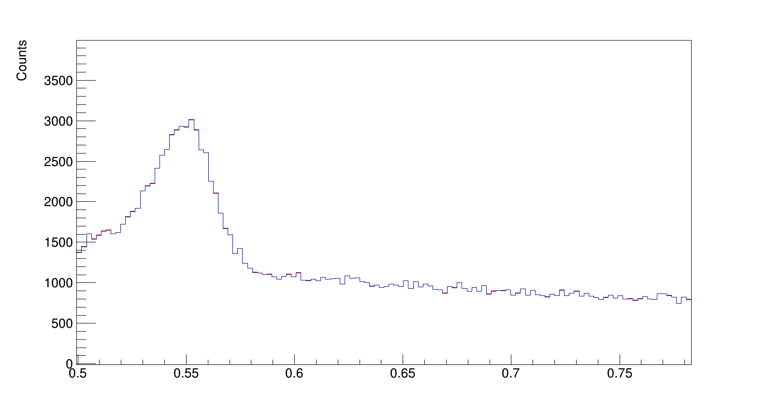
Reconstructed and mass
$$γ$$
$$π^{0}$$
$$γ$$
$$γ$$
$$η$$
$$η$$
c
$$γ$$
$$π^{0}$$
$$γ$$
$$π^{0}$$
Default
$$γ$$
$$π^{0}$$
$$η$$
OnMer
$$η$$

Slide 12
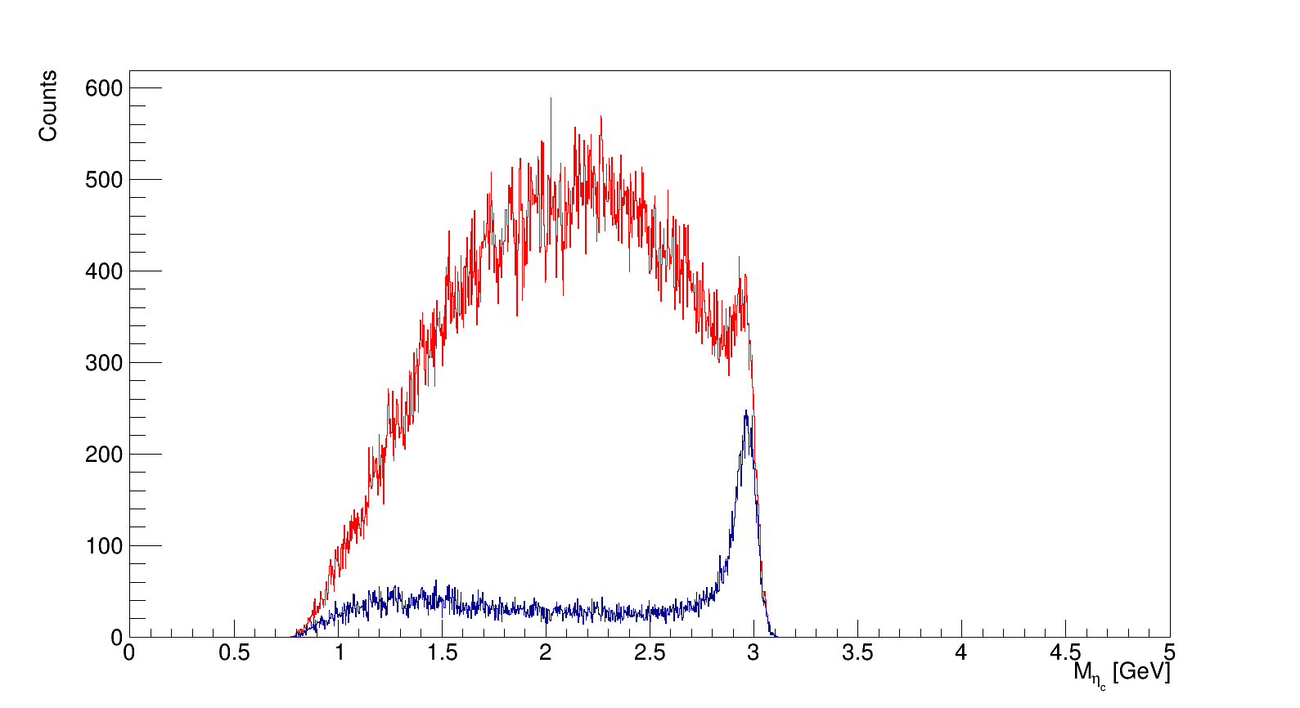
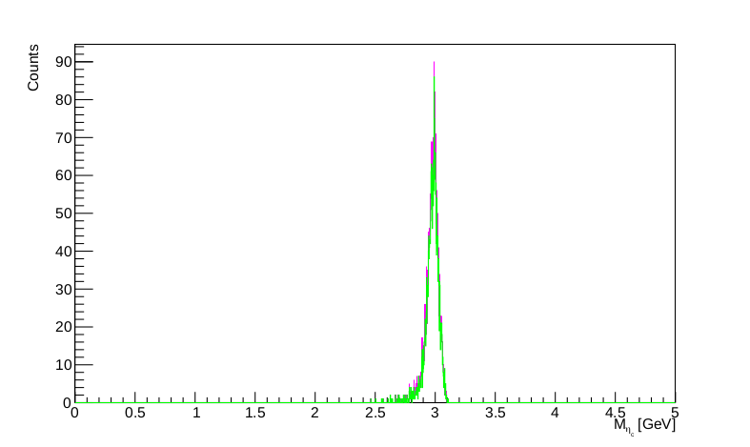
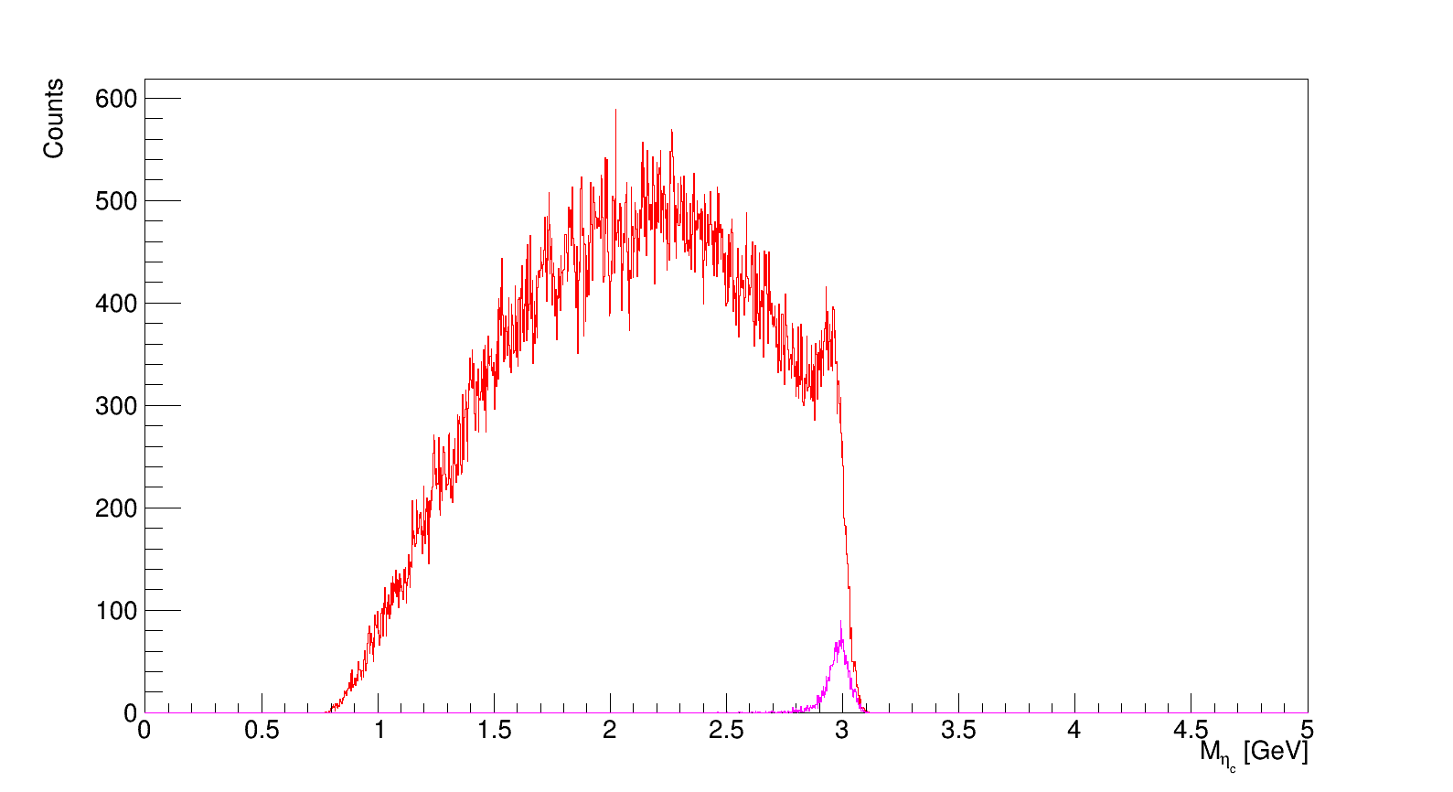
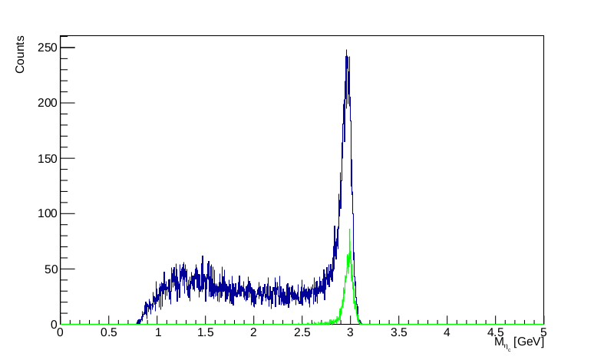
60000 events
Default, Default – FTM, OnMer, OnMer – FTM
Reconstructed
Full truth match
Default algorithm
OnMer algorithm
Significance: 16.68
Significance: 23.09

Slide 13
$$γ$$
$$π^{0}$$
$$γ$$
$$γ$$
$$η$$
$$γ$$
$$K^{−}$$
$$p\overline{p}$$
~
$$D^{0}$$
$$π^{+}$$
$$η$$
c1
$\sqrt{s}$: 5 GeV
$${\overline{D}}^{0∗}$$
$$π^{−}$$
$${\overline{D}}^{0}$$
$$K^{+}$$
$$γ$$
$$π^{0}$$
$$γ$$
$$γ$$
$$π^{0}$$
$$γ$$

Slide 14
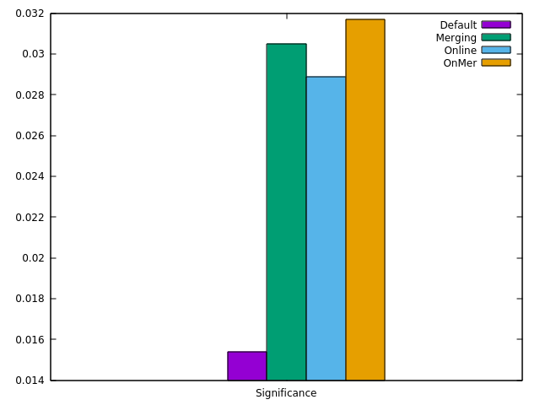
 | Default | Merging | Online | OnMer
All events | 2050114 | 431316 | 433517 | 358810
FTM events | 22 | 20 | 19 | 19
Significance | 0,0154 | 0,0305 | 0,0289 | 0,0317
Up to factor of 2 improvement in significance

Slide 15
Improvements for the timebased version
No merging in this case
The single photon peak was checked in this case – same improvement
It is faster than the master version – 95% time

Slide 16
Summary of the previous presentation
The Online algorithm with merging performs the best in case of resonances with many neutral particles in the final state
It performs the same, or a bit better for final states with charged particles
It is only 1.8-times slower than the default algorithm and the created files are much smaller
The neutral reconstruction and the energy cut can be turned off

