Slide 1
The PANDA Micro-Vertex-Detector
Group report / DPG EuNPC 2009
| Tobias Stockmanns for the PANDA Collaboration | HK 40.1

Slide 2
Content
Introduction to the PANDA physics program
The PANDA detector at HESR
The Micro-Vertex-Detector of PANDA
  Requirements
  Setup of the MVD
  Technical Developments
  Simulation Results
Summary / Outlook

Slide 3
Main Physics Program
PANDA – AntiProton Annihilations at Darmstadt
qq potential in the charmonium system
precision measurements of cc-states (not only J^{PC} = 1⁻⁻)
cc above DD-threshold ➔ measurement of D-mesons
Search for Hybrids qqg and/or Glueballs gg
Spectroscopy of new charm states
Charmed and multi-strange baryon spectroscopy
Electromagnetic processes (pp→e⁺e⁻, pp→γγ, Drell-Yan)
Properties of single and double hypernuclei
Properties of hadrons in nuclear matter
Notes:
EM Endzunstände
Spektroscopy von neuen Charmzuständen

Slide 4
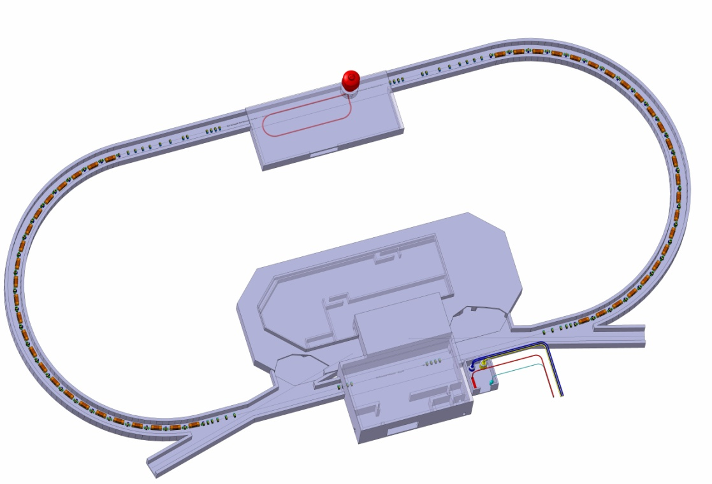
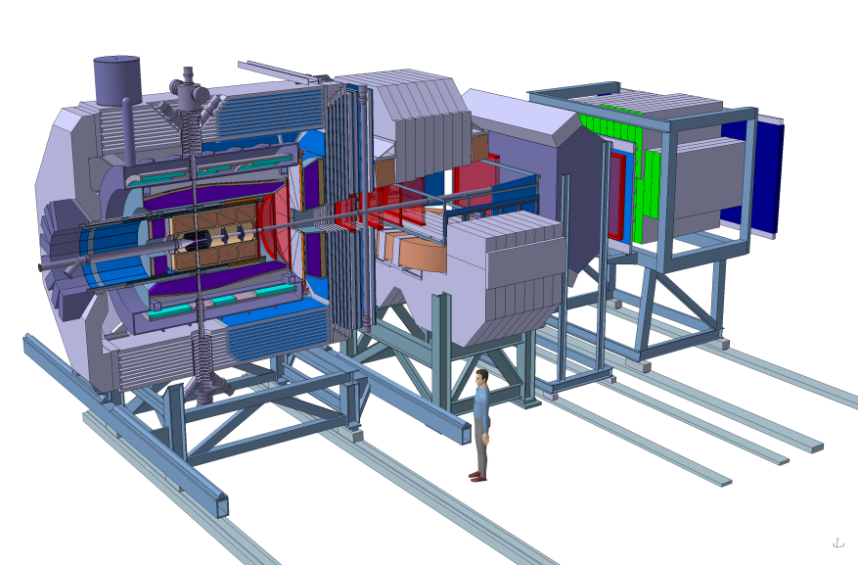
High Energy Storage Ring
Detector
Electron
cooler
E<8 GeV
Injection
Cooling: electron/stochastic
HESR
Pmax = 15 GeV/c
High resolution: L = 10³¹ cm⁻² s⁻¹ δp/p < 4x10⁻⁵
High luminosity: L = 2·10³² cm⁻² s⁻¹ δp/p < 10⁻⁴

Slide 5

PANDA Spectrometer
Detector requirements:
4π coverage (partial-wave-analysis)
high rates (2⋅10⁷ annihilations/s)
good PID (γ, e, μ, π, K, p)
momentum resolution (~1%)
vertexing for D, K⁰_{S}, Λ (cτ = 123 μm for D⁰, p/m ≈2)
efficient trigger (e, μ, K, D, Λ)
no hardware trigger (raw data rate ~TB/s)
Notes:
5

Slide 6
PANDA Spectrometer

Slide 7
PANDA Spectrometer
Pellet or cluster jet target
Dipole magnet for forward tracks
Solenoid magnet for high p _{t} tracks:
Superconducting coil & iron return yoke

Slide 8
PANDA Spectrometer
Silicon Microvertex
Central Tracker
Forward Drift Chambers

Slide 9
PANDA Spectrometer
Muon Detectors
Forward RICH
Barrel DIRC
Barrel TOF
Endcap DIRC
Forward TOF

Slide 10
PANDA Spectrometer
PWO Calorimeters
Forward Shashlyk EMC
Hadron Calorimeter

Slide 11

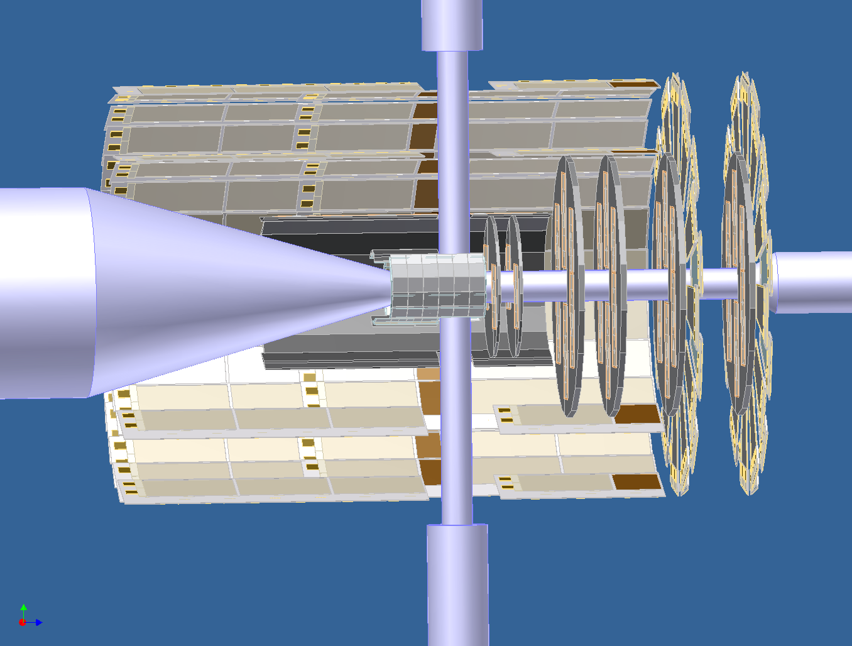
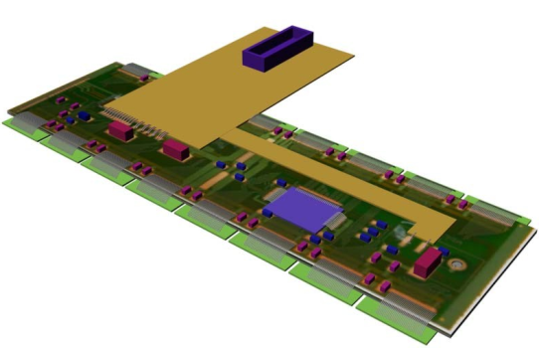
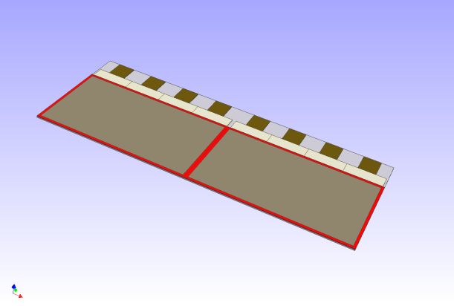
Micro-Vertex-Detector
30 cm
40 cm

Slide 12
Requirements MVD
Good spatial resolution in r-phi | ➔ | momentum measurement of soft pions from D* decays
Good spatial resolution specially in z | ➔ | vertexing, D-tagging

Slide 13
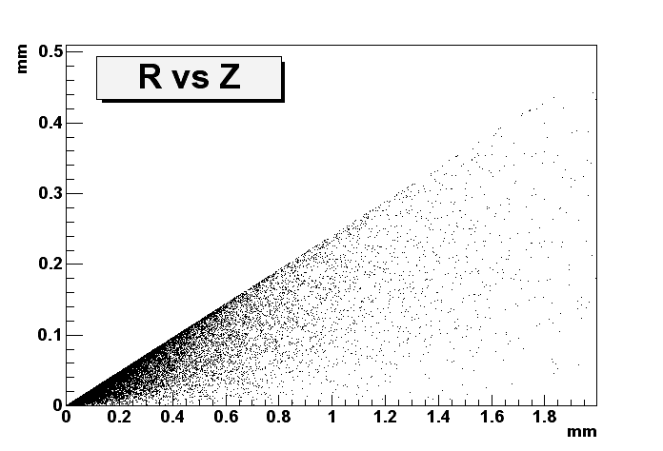
D-Meson decays
Beam P = 8 GeV/c
R
82%
23%
Z
Distribution of secondary vertex from D-meson decays for a beam kinetic energy 8 GeV/c.
➔ Need to optimize resolution in the Z direction!

Slide 14
Requirements MVD
Good spatial resolution in r-phi | ➔ | momentum measurement of soft pions from D* decays
Good spatial resolution specially in z | ➔ | vertexing, D-tagging
Good time resolution (O(20 ns)) | ➔ | ‘DC’-beam (2⋅10⁷ events/s)
Amplitude measurement | ➔ | improvement of resolution dE/dx to improve particle ID

Slide 15
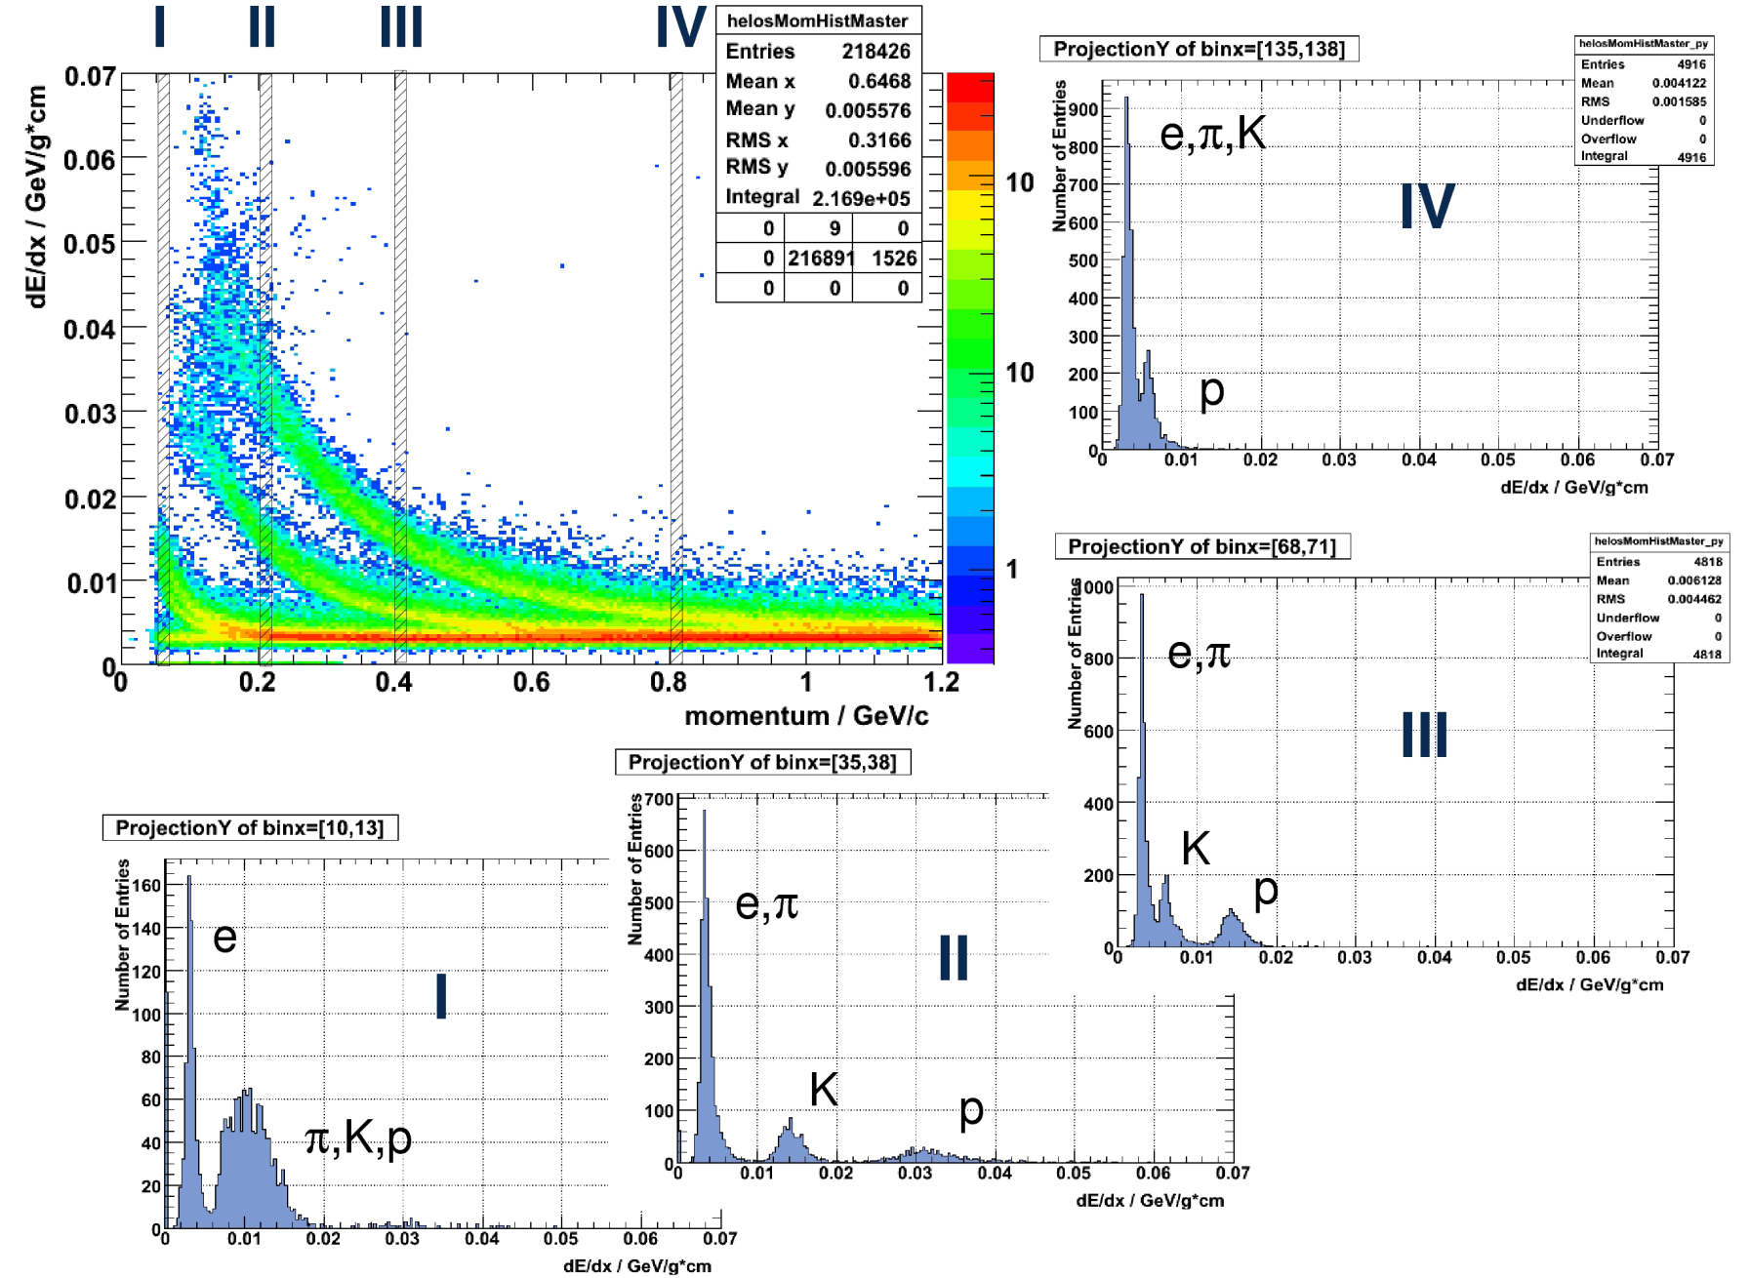
Particle Identification with MVD
800 MeV/c
400 MeV/c
200 MeV/c
50 MeV/c

Slide 16
Requirements MVD
Good spatial resolution in r-phi | ➔ | momentum measurement of soft pions from D* decays
Good spatial resolution specially in z | ➔ | vertexing, D-tagging
Good time resolution (O(20 ns)) | ➔ | ‘DC’-beam (2⋅10⁷ events/s)
Amplitude measurement | ➔ | improvement of resolution dE/dx to improve particle ID
Modest radiation hardness (O(10¹⁴ n_{eq} / cm²)) | ➔ | depends on target material

Slide 17
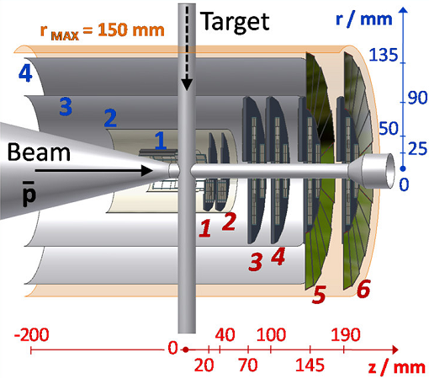
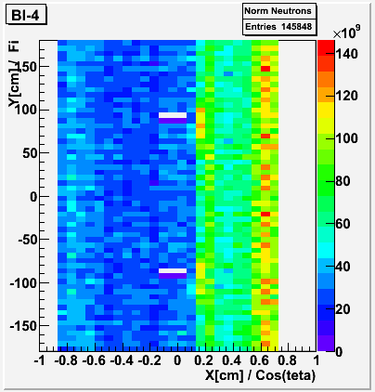
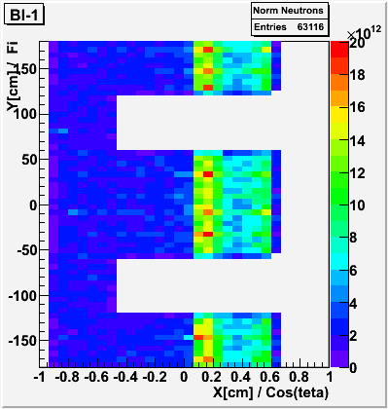
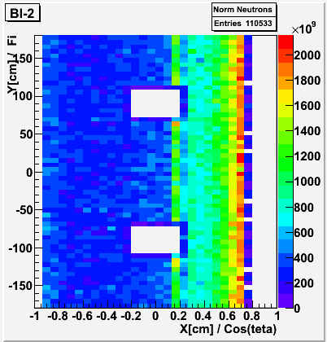
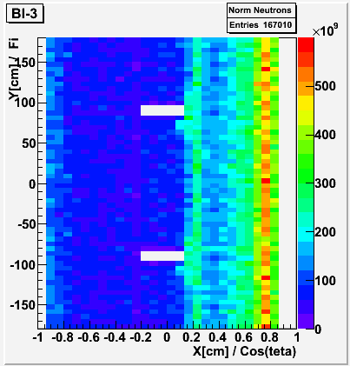
Radiation Damage Pixel Barrel
pp @ 5 GeV/c for one year operation

Slide 18
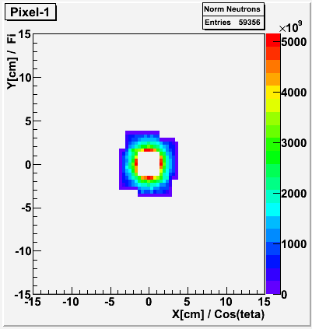
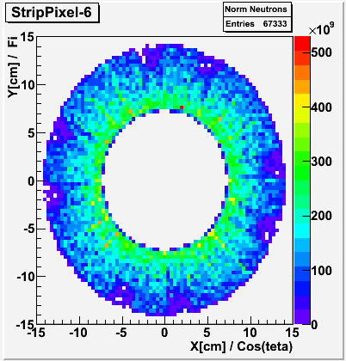
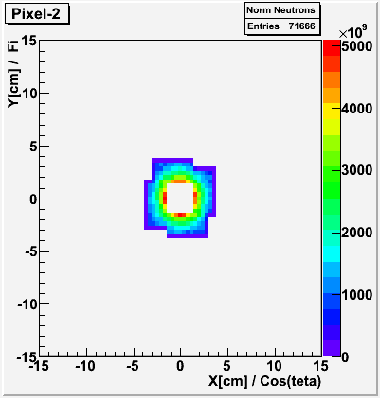
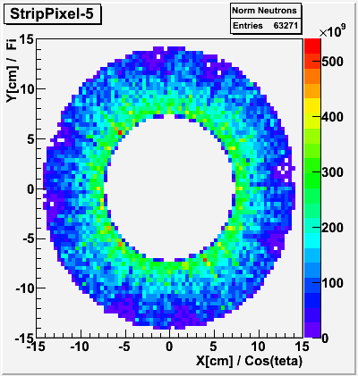
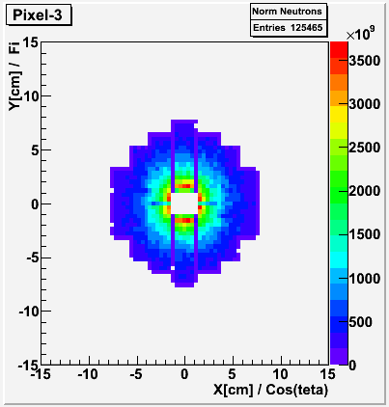
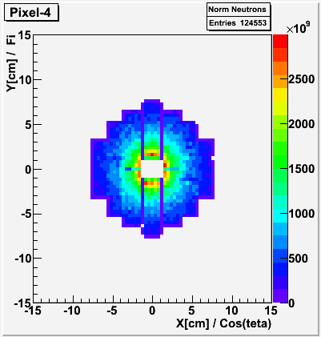
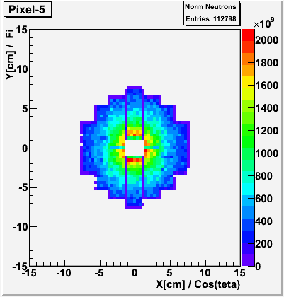

Radiation Damage Disks

Slide 19
Requirements MVD
Good spatial resolution in r-phi | ➔ | momentum measurement of soft pions from D* decays
Good spatial resolution specially in z | ➔ | vertexing, D-tagging
Good time resolution (O(20 ns)) | ➔ | ‘DC’-beam (2⋅10⁷ events/s)
Amplitude measurement | ➔ | improvement of resolution dE/dx to improve particle ID
Modest radiation hardness (O(10¹⁴ n_{eq} / cm²)) | ➔ | depends on target material
Triggerless readout | ➔ | no first level hardware trigger

Slide 20
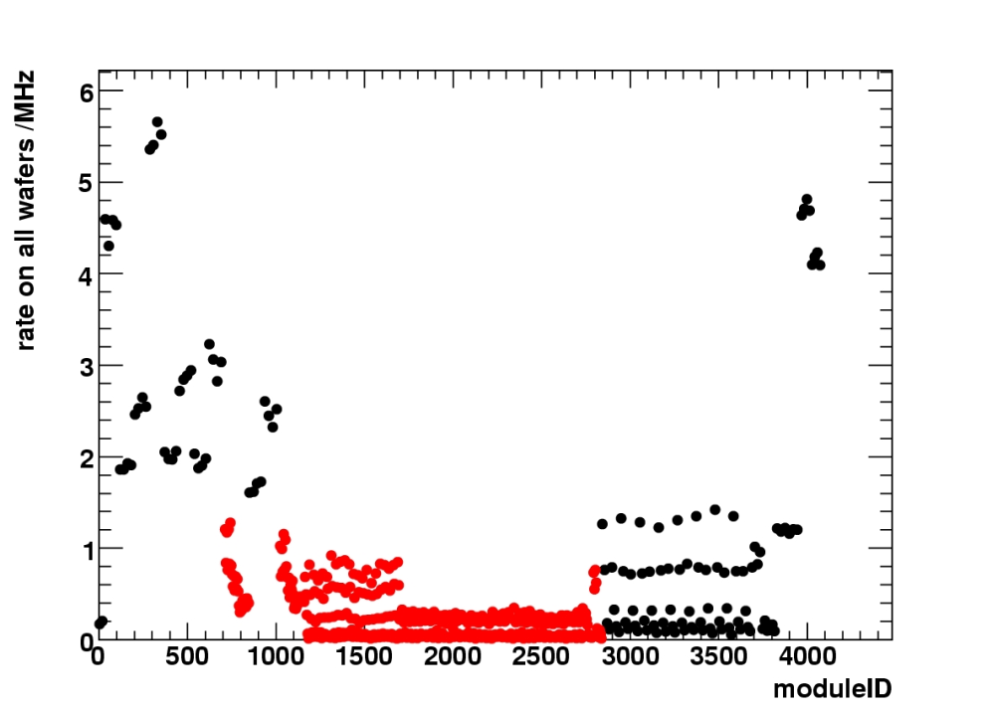
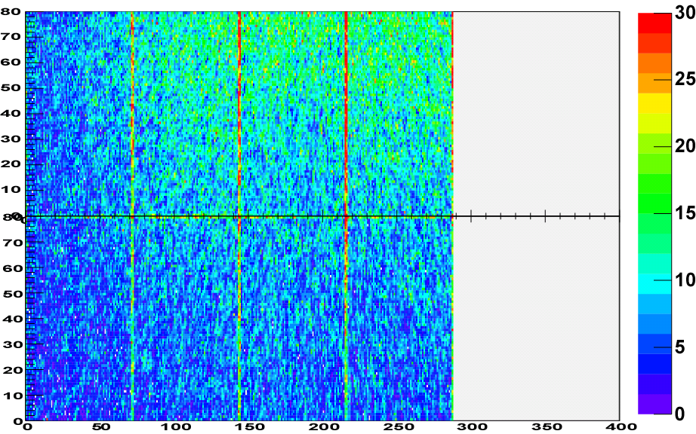
Simulated maximum data rate
Simulated maximum data rate for 4 GeV/c p on Cu:
  Pixel module (12 cm²): 32∙10⁶ s⁻¹➔ 1.3 Gbit/s
  Front-End chip (1 cm²): 5.5∙10⁶ s⁻¹➔ 220 Mbit/s
  (assuming 40 bit/hit)
Maximum hit rate of FE on module
Hit distribution on module with highest rates
Strips
Pixel
pixel row
hits [10⁶ s⁻¹]
pixel col

Slide 21
Requirements MVD
Good spatial resolution in r-phi | ➔ | momentum measurement of soft pions from D* decays
Good spatial resolution specially in z | ➔ | vertexing, D-tagging
Good time resolution (O(20 ns)) | ➔ | ‘DC’-beam (2 10⁷ events/s)
Amplitude measurement | ➔ | improvement of resolution dE/dx to improve particle ID
Modest radiation hardness (O(10¹⁴ n_{eq} / cm²)) | ➔ | depends on target material
Triggerless readout | ➔ | no first level hardware trigger
Low material budget | ➔ | low momentum particles energy resolution calorimeter

Slide 22
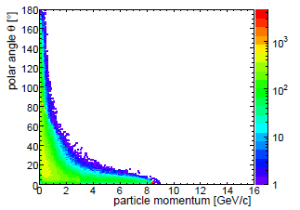
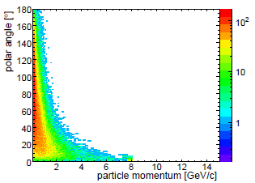
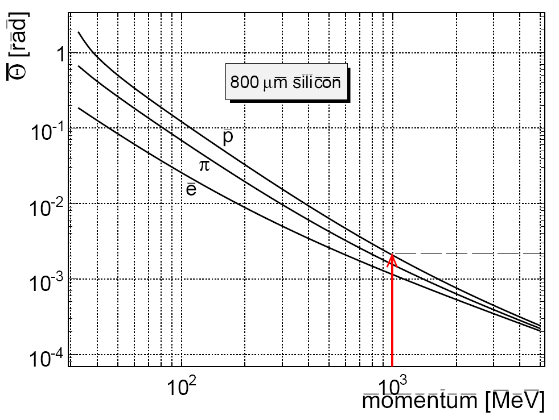
Momentum distribution and multiple scattering
pp @ 8 GeV/c
pAu @ 8 GeV/c
mean deflection angle
800 µm silicon
2 mrad ➔ 20 µm error / cm path
Multiple scattering dominates resolution for low momentum particles
1 GeV/c

Slide 23
Technical developments

Slide 24
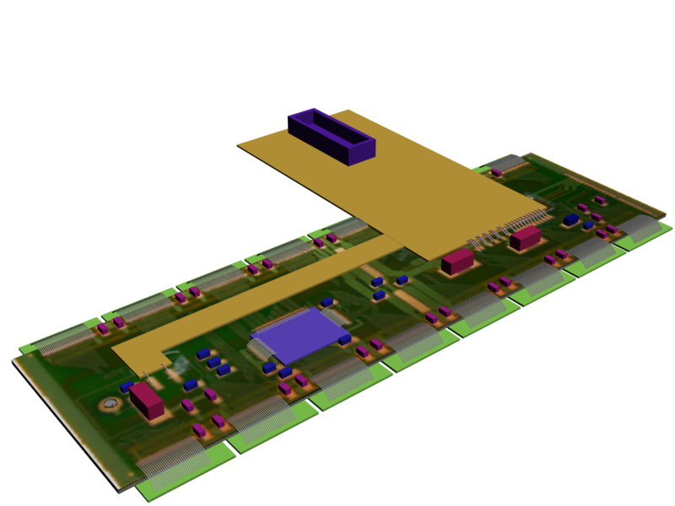
Hybrid Pixel Module
sensor:
epi-Silicon
  50, 75, 100 µm thick epi-Layer on CZ substrate
  thinned down to 75 – 150 µm
alt. oxygen enriched silicon
  thinned down to 150 – 200 µm
front-end chip:
custom development (ToPix)
  (100 µm)² pixels
  100 x 100 pixel matrix
  untriggered readout
  130 nm IBM process
ATLAS example
readout:
Module Controller Chip?
➔ D. Calvo HK40.2

Slide 25
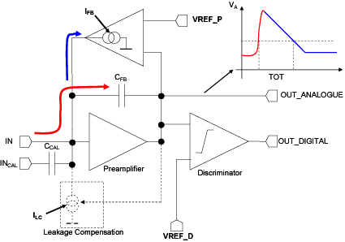
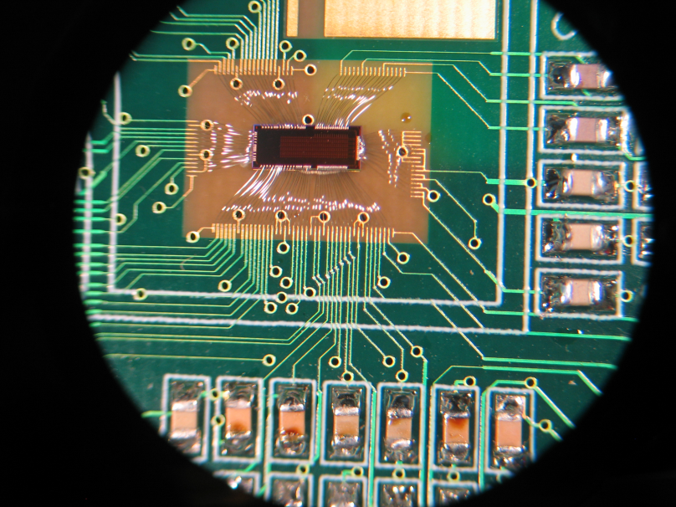
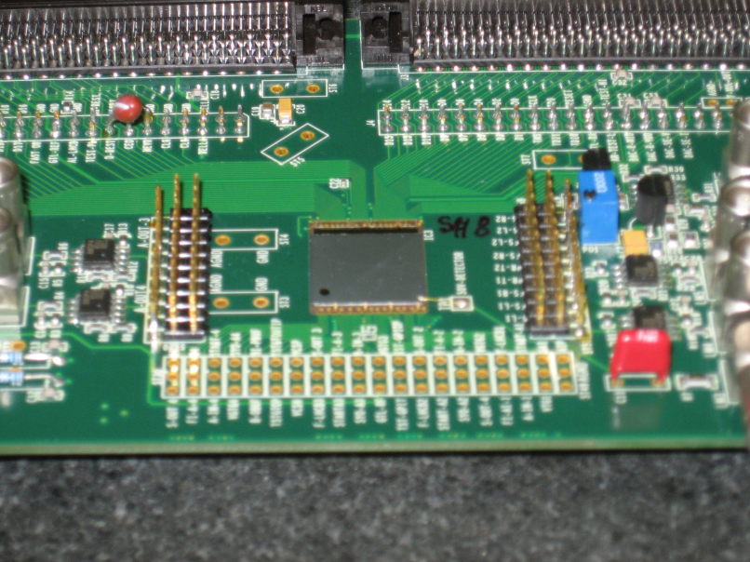
ToPix Development
ToPix2
320 readout cells (100 µm)²
5x2 mm² size
analogue + digital circuit
Epi-pixel sensor
bump bonded on ALICE FE
thinned down to:
  100 µm (49 µm)
  120 µm (75 µm)
  150 µm (98 µm)

Slide 26
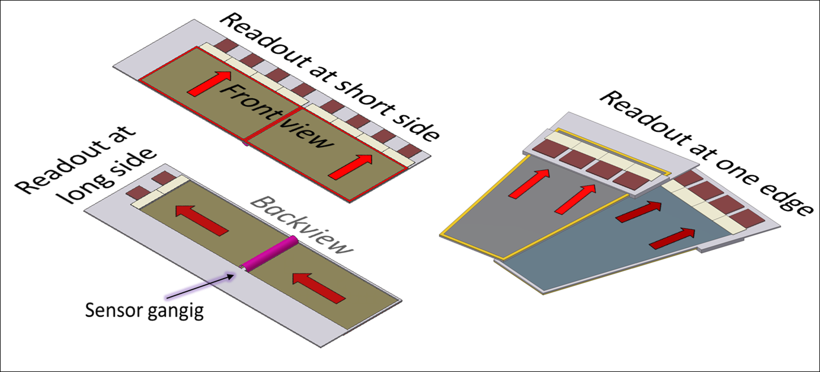
Strip Detector
rectangular sensor:
double sided silicon strip sensor
pitch: 130 µm (0.65 µm)
size box: 6.7 x 3.3 x 0.03 cm³
stereo angle 90°
Sensor ganging
trap sensor:
double sided silicon strip sensor
pitch: 70 µm
size box: 6.1 x 3.5 x 0.03 cm³ 15°
stereo angle 15°
front-end electronic:
custom development together with GSI
untriggered readout

Slide 27
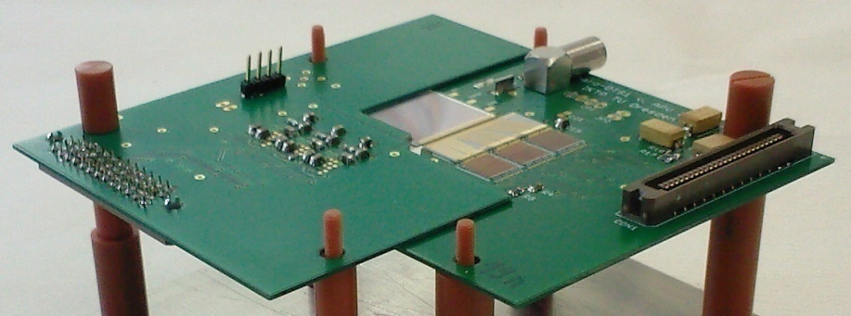
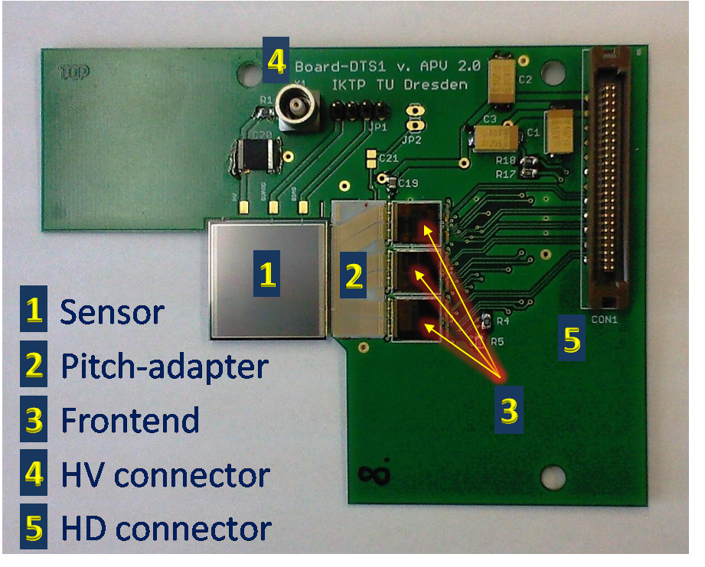
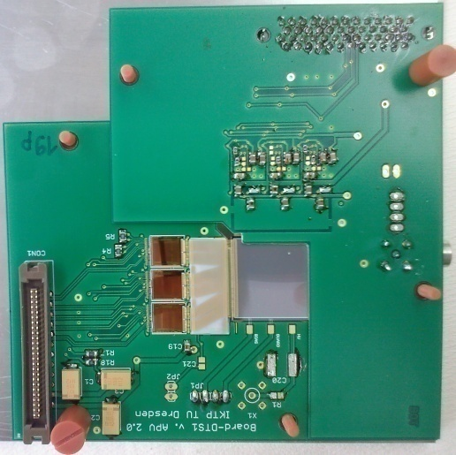
Hardware development
First small sensor prototype with APV readout

Slide 28
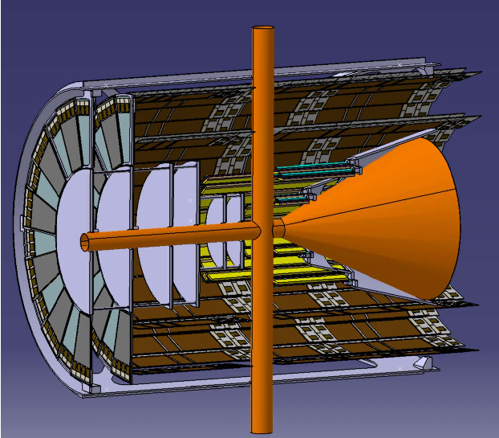
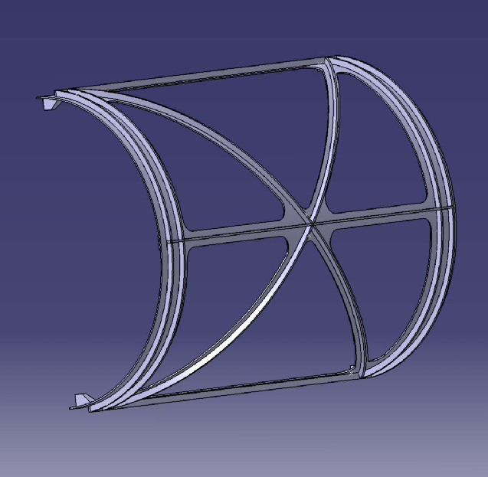
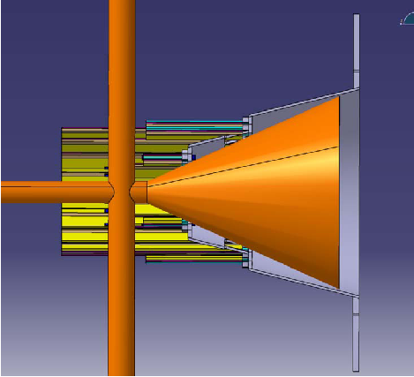
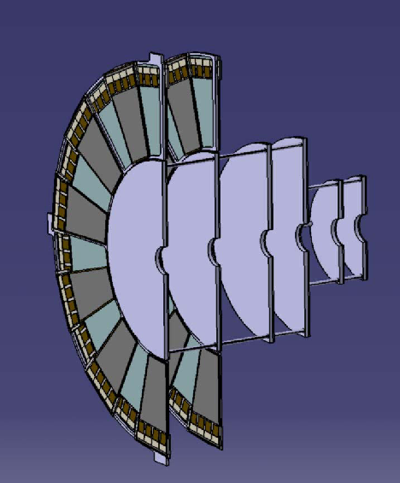
Pixel support structures

Slide 29
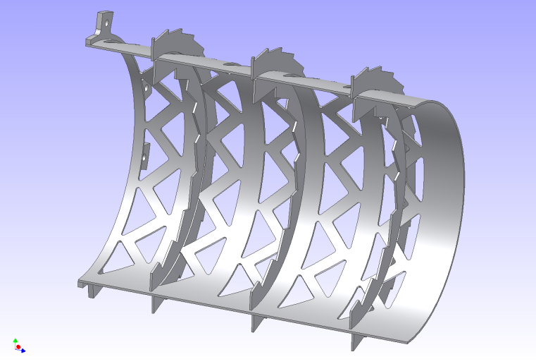
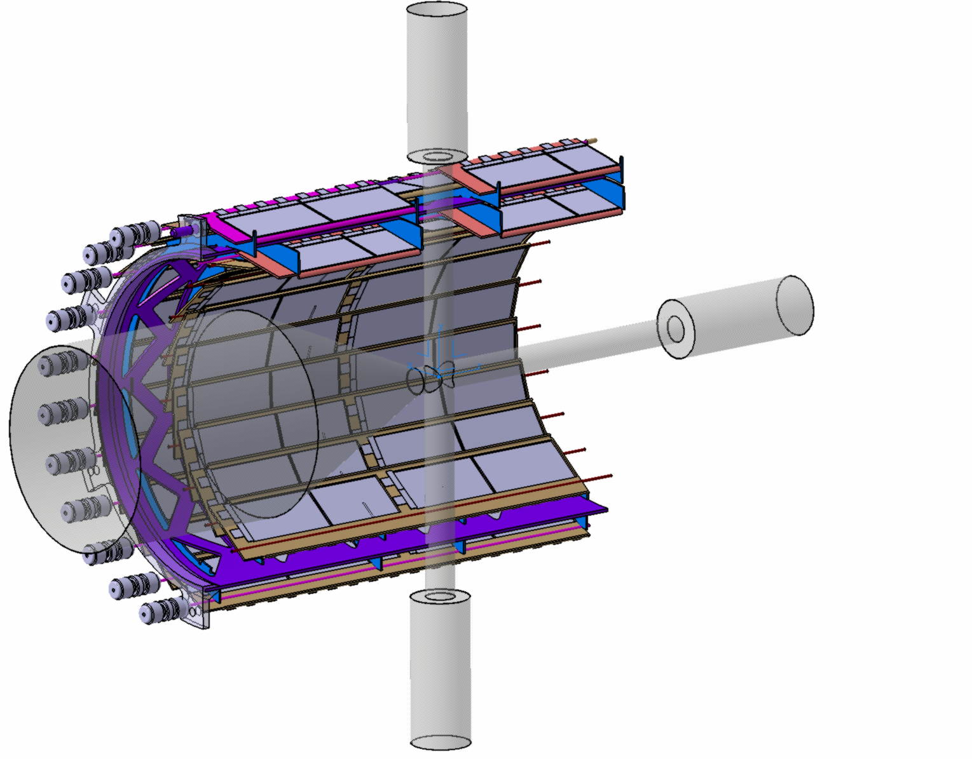
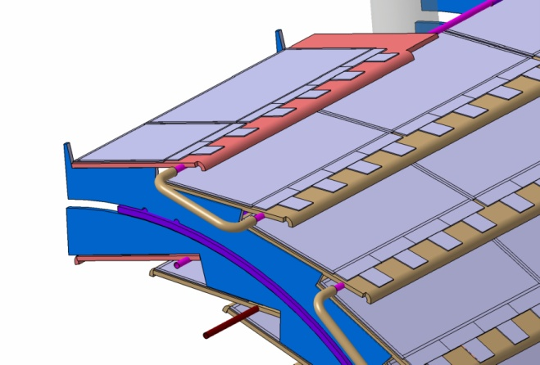
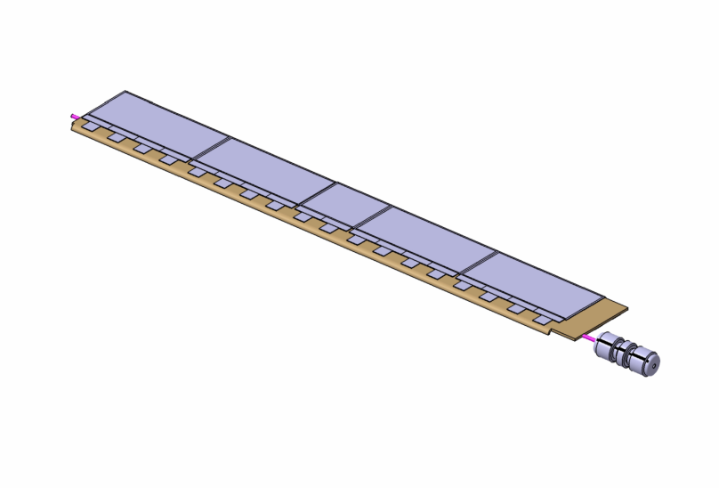
Support Structures Strips
      Strip barrel design

Slide 30
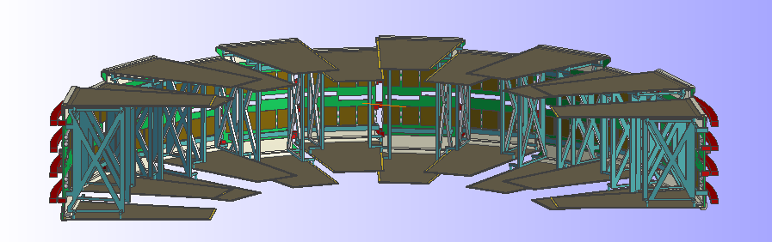
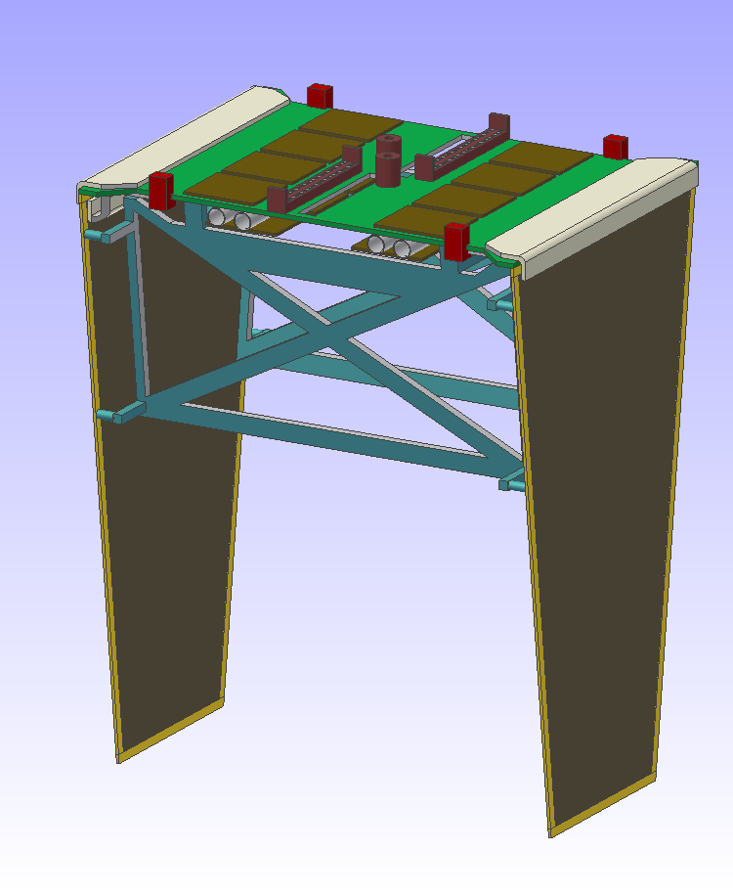
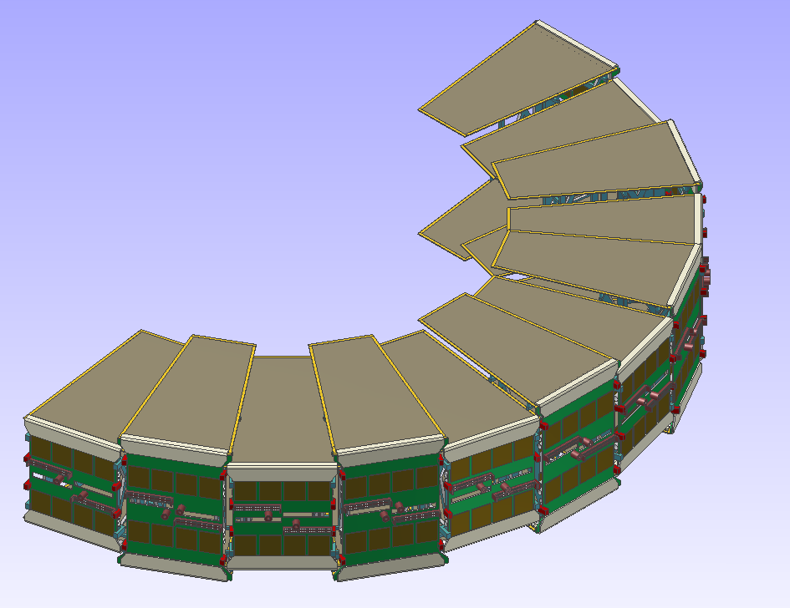
Concept for strip disks
  Disk layer / Forward part
Global
Support
➔ T. Würschig HK 40.3

Slide 31
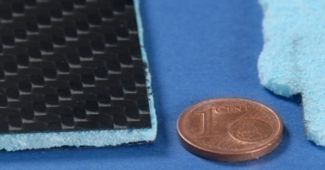
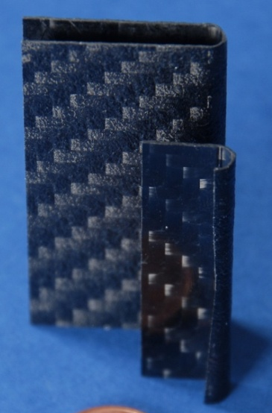
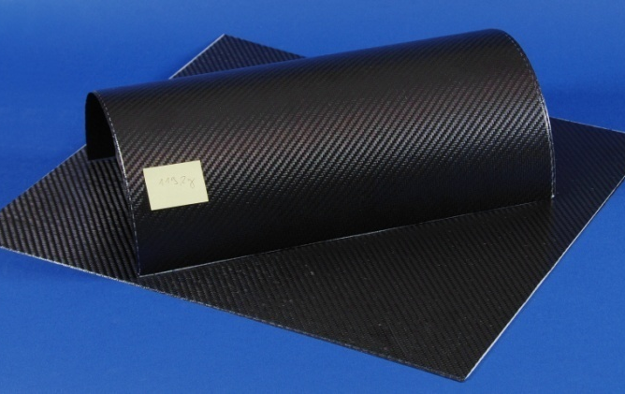
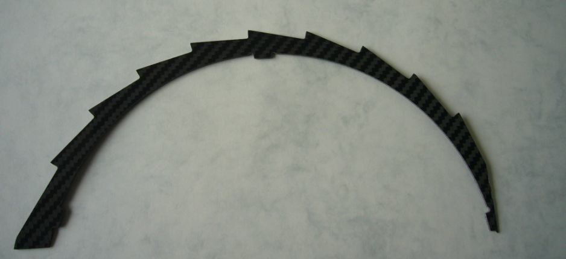
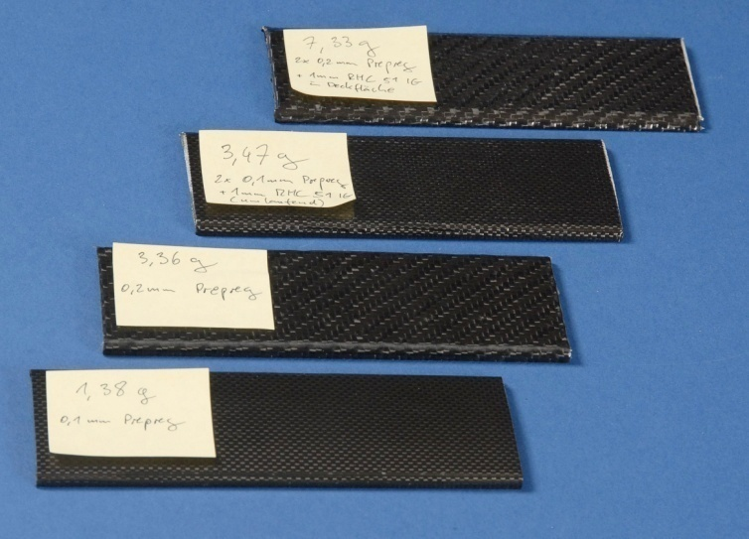
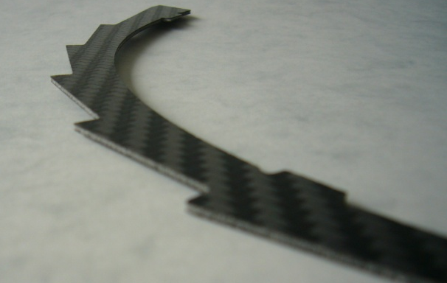
Use of carbon sandwich structure
  Stave support: Sandwich structure
  (Carbon – Rohacell – Carbon)
  Barrel support: Half-shell and saw-tooth support
  Carbon foam with high thermal conductivity

Slide 32
Simulation program

Slide 33
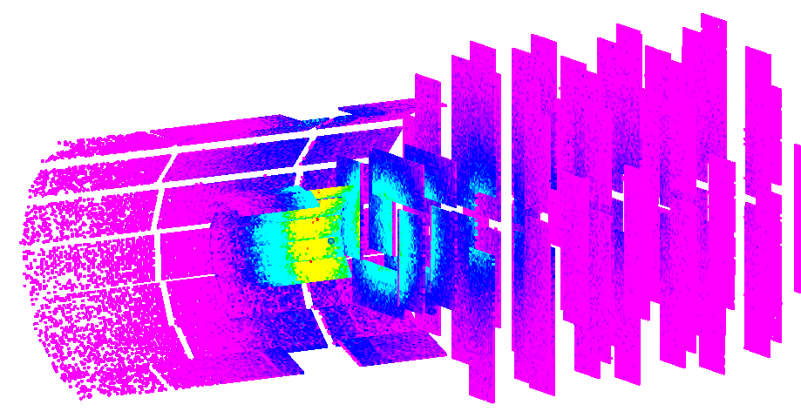


Simulation Studies of Mechanical Design
CAD Converter
translates CAD drawings (STEP-files) into ROOT geometries ➔ access to full pandaROOT simulation with realistic detector design
T. Würschig HK 40.3
S. Spataro HK 30.2 - Tue 14:00
M. Al-Turany HK 53.5 – Wed 15:00

Slide 34

Performance of MVD
Momentum resolution of PANDA detector with and without MVD
1 GeV/c pions
p
p_{t}
σ(p) [1GeV/c π] without MVD = 2.6 %
σ(p) [1GeV/c π] with MVD = 1.4 %
R. Jäkel PhD thesis in preparation

Slide 35

Performance of MVD
Track parameter resolution with and without MVD
z₀
1 GeV/c pions
d₀
R. Jäkel PhD thesis in preparation

Slide 36

Secondary vertex resolution
pp → D⁺D⁻
R. Jäkel PhD thesis in preparation
Fully reconstructed D⁺D⁻ pairs
Vertex resolution:
  35 µm in x and y
  77 µm in z (at 6.57 GeV/c beam momentum)

Slide 37
test systems

Slide 38

Test systems
M. Mertens HK30.5

Slide 39


Strip Test Station Bonn/Dresden
Test station: DTS1 (Lab setup)
  Evaluation of silicon strip sensors
  Modular setup allowing further prototype testing
F. Krüger HK 40.4

Slide 40



Beam Telescope Bonn
Test-beam setup in Bonn

Slide 41
Summary
The Micro-Vertex-Detector is one of the most challenging subdetectors within PANDA
It faces the highest radiation load, highest hit rates, very stringent requirements on the radiation length and by far the highest number of readout channels
In the course of the PANDA project a very sophisticated simulation software was (and is still) developed which allows us to optimize all different design parameters of the detector and do realistic simulations of the physics performance
The hardware development is on a good track and we think that we have the necessary technologies at hand which allows us to build this detector. Nevertheless there is still a lot of work ahead of us

