Slide 1
DPG Spring Meeting / European Physics Nuclear Conference Bochum HK 40.3 March 19, 2009 Design Optimisation for ( the Silicon Micro-Strip Part of ) the PANDA Micro-Vertex-Detector * Thomas Würschig on behalf of the PANDA MVD group * Work supported by BMBF and EU FP6

Slide 2
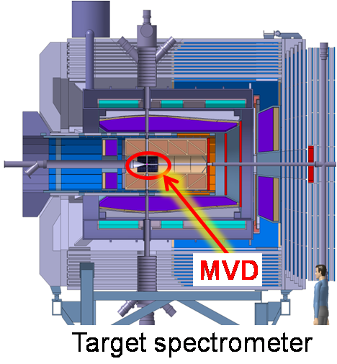
Introduction
Micro-Vertex-Detector (MVD)
Tracking detector for charged particles
Innermost detector in PANDA
Main tasks
Improvement of momentum resolution
High vertex resolution for primary interaction vertex and secondary vertices of short lived particles and delayed decays
Additional input for particle-ID
π⁺
π⁺
K⁻
D⁺
D±_{S} → ‾K⁰ x + K⁰ y
cτ = 147 μm
D± → ‾K⁰ x + K⁰ y cτ = 312 μm

Slide 3
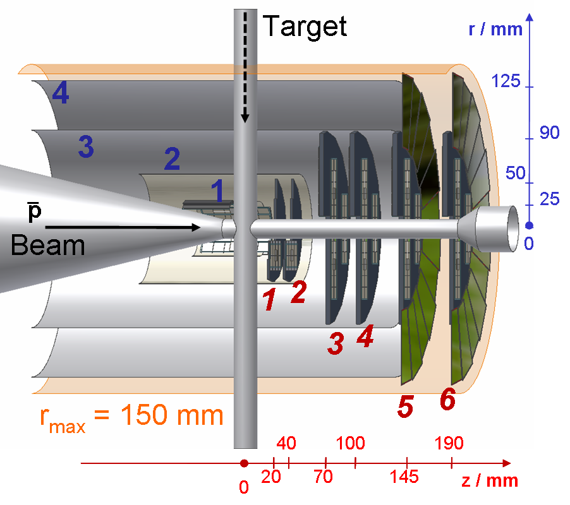
Motivation
General MVD layout fixed
Number of layers
Detector type
Overall geometry
Detailed implementation
Detector: shape, dimensions
Hybridisation
Support structure
Cooling, cabling and routing concept
Alignment … integration / interplay with other subsystems

Slide 4
Motivation
Extraction of design parameters in order to qualify
dedicated concepts in terms of physics performance
Design
Physics Performance
Design parameters enable optimisation of the detector

Slide 5
Design parameters
a
Innermost detector in PANDA:
Low material budget, notably in forward direction
→ Material mapping
→ Radiation lengths
→ Scattering effects
Tracking detector:
Maximum spatial coverage
Sufficient number of hit points
→ Number of hit points / track
Design goal: 4 points per track
1st point close to vertex
Last point close to outer tracker
b

Slide 6
Design parameters
c
Vertex resolution:
Number and position of track points (w.r.t. vertex)
Spatial resolution of single track points
→ Size of readout structure
→ Sensor arrangement …
Additional input for PID:
Analogue information for single hit points
→ Energy deposition
( → Calculation of hit position … see above)
→ Resolution
→ d_{eff} (sensor thickness, incident angle of track)
→ Signal-to-Noise as function of d_{eff} …
d

Slide 7
Design parameters
Basic Parameters
Number of hit points / track (N_{trk-pt})
Spatial distribution of (N_{trk-pt} / track)
Spatial distribution of material load
Mapping of scattering effects
Count rate studies
Single hit resolution
… …
Track resolution
Vertex resolution
Simulation of physics channels
(R. Jäkel, HK 25.7)
Physics Results

Slide 8
Design parameters
Basic Parameters
Number of hit points / track (N_{trk-pt})
Spatial distribution of (N_{trk-pt} / track)
Spatial distribution of material load
Mapping of scattering effects
Count rate studies
Single hit resolution
… …
Track resolution
Vertex resolution
Simulation of physics channels
(R. Jäkel, HK 25.7)
Set of complementary
parameters,
interdependent
w.r.t. optimisation
… no parameter can be
studied independently … !
Physics Results

Slide 9
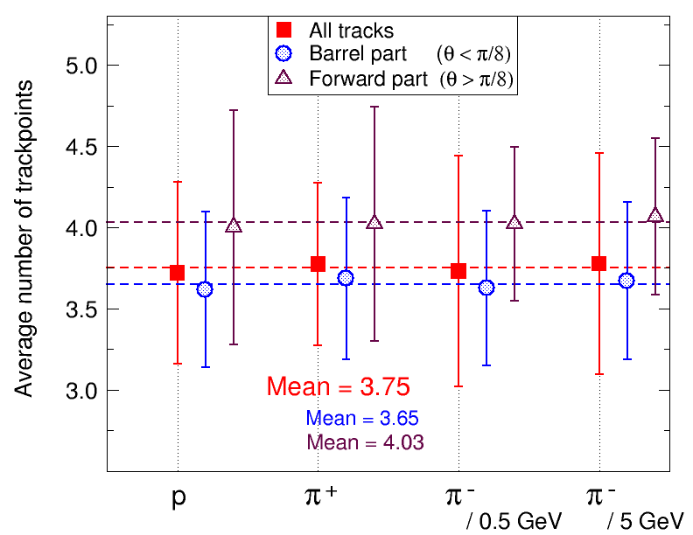
Track-point studies
Comparison for different particles and excess energy
45°)
Implementation
of realistic CAD model
Simulation includes:
Full material budget
Magnetic field
45°)
Average number of MVD hit points / track
(N = 500,000)

Slide 10
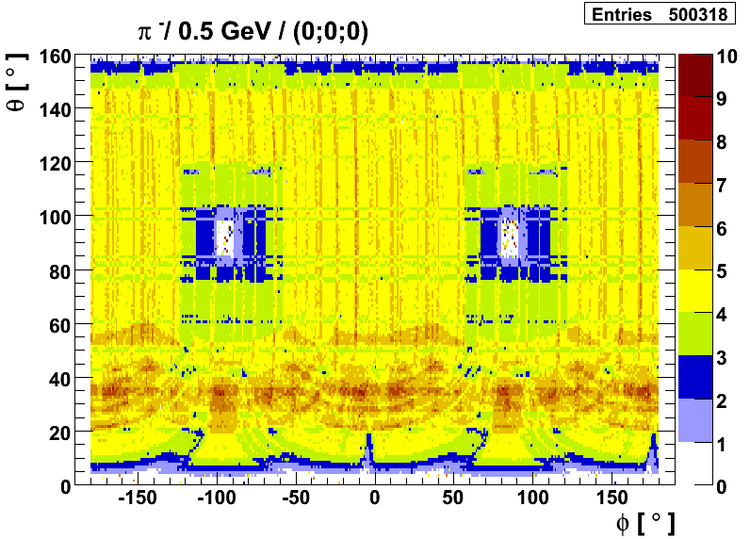
Track-point studies
Spatial distribution of MVD points / track
Inhomogeneities: (a) Target pipe, (b) module positioning, (c) strip-sensor gap in barrel layers, (d) sensor overlap, ...
(a)
(b)
(c)
(d)

Slide 11
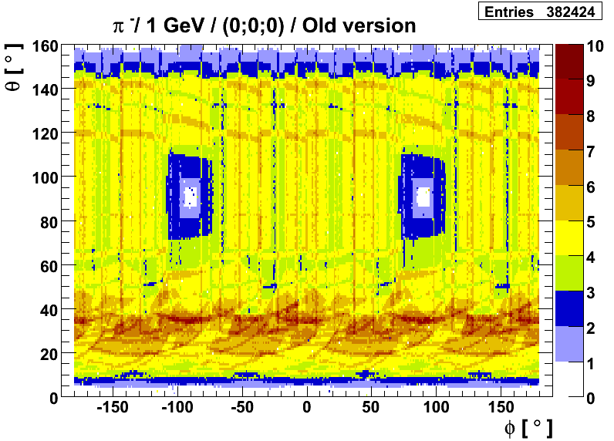
Track-point studies
Detector optimisation:
Comparison of different implementations
/ M-10-1010
Visualisation and correction of gaps
Reduction of material: Limitation of track points
Homogenous distribution in the barrel part

Slide 12
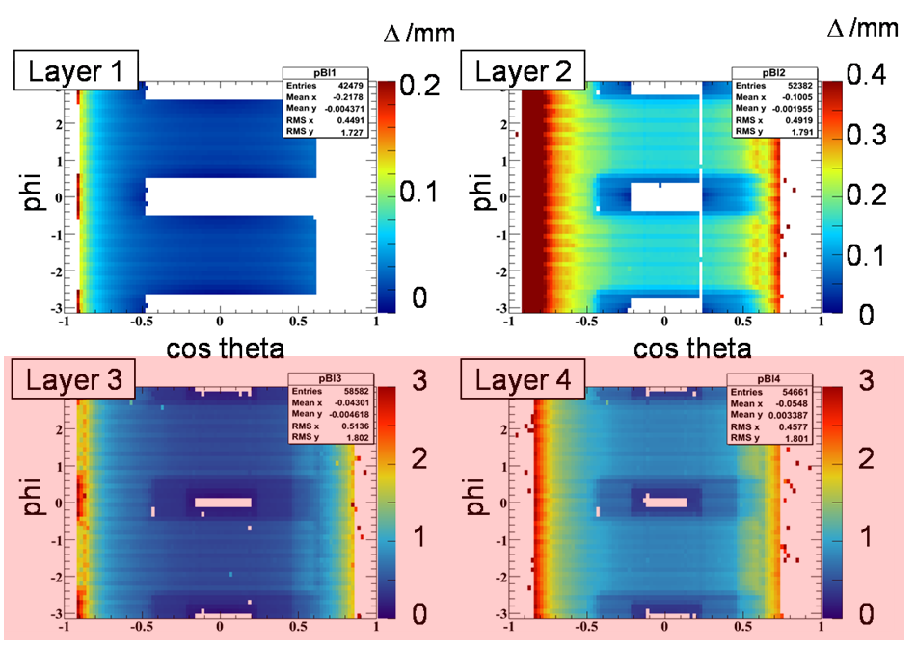
MVD layer: Point resolution
Study of multiple scattering with particle propagator
Geane (based on Geant3)
Example:
π⁺, 0.5 GeV / c
→ Barrel layer
Plotting the
deviation due
to scattering (Δ)

Slide 13
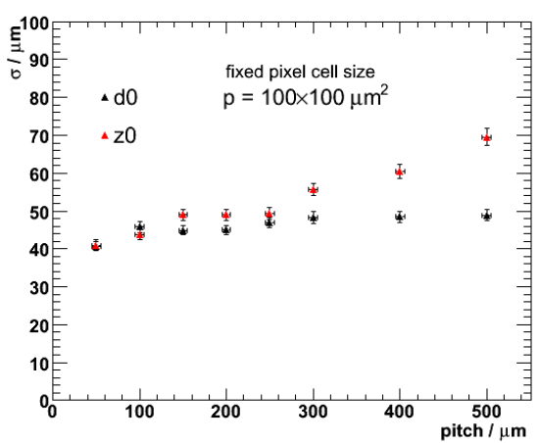
Vertex resolution studies
Single track vertex resolution for different readout structures (pixel cell size/ strip pitch)
Example:
π⁻, (0.2 … 3) GeV / c
→ Fixed pixel cell size
→ Variation of strip pitch
Analysis:
→ Vertex resolution
parameters (d₀, z₀)
No significant improvement below 250 μm strip pitch due
to scattering in precedent layers

Slide 14
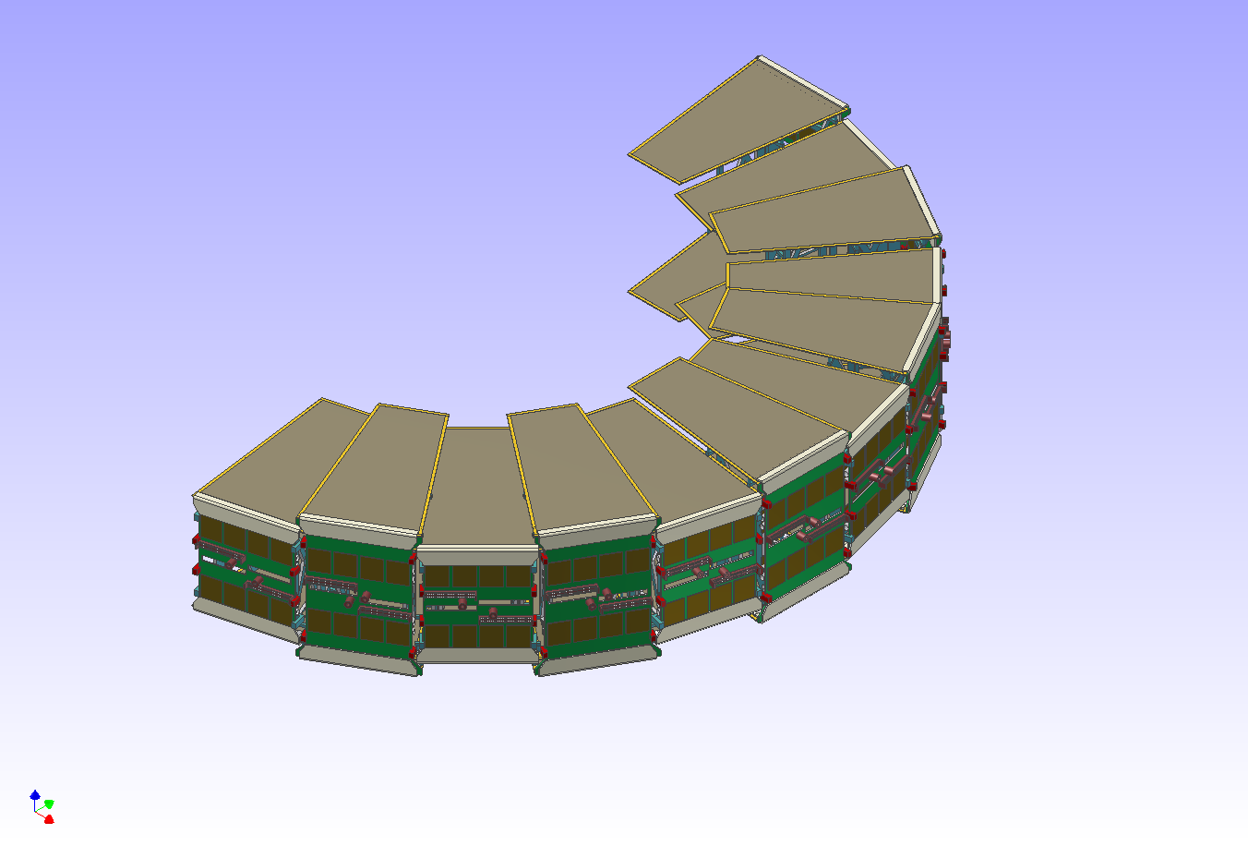
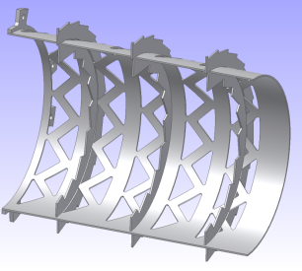
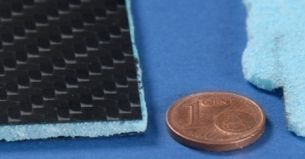
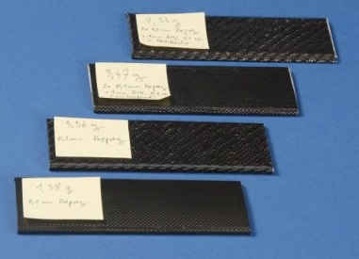
Impact on MVD strip part
Validation of sensor size and readout pitch
Barrel part:
Rectangular shape, stereo angle 90°, pitch: 130 μm
Forward part:
Trapezoidal shape, stereo angle 15°, pitch: 70 μm
Disk concept
Barrel support

Slide 15
Summary
Overall MVD layout fixed
Work on detailed implementation started
Design parameters to verify physics performance of detector → Detector optimisation
Tools for studies and analysis available (Physics and engineering simulations)
→ Set of input parameters must be chosen carefully
Physics guidance of engineering implementation
ensure an optimised detector development

Slide 16
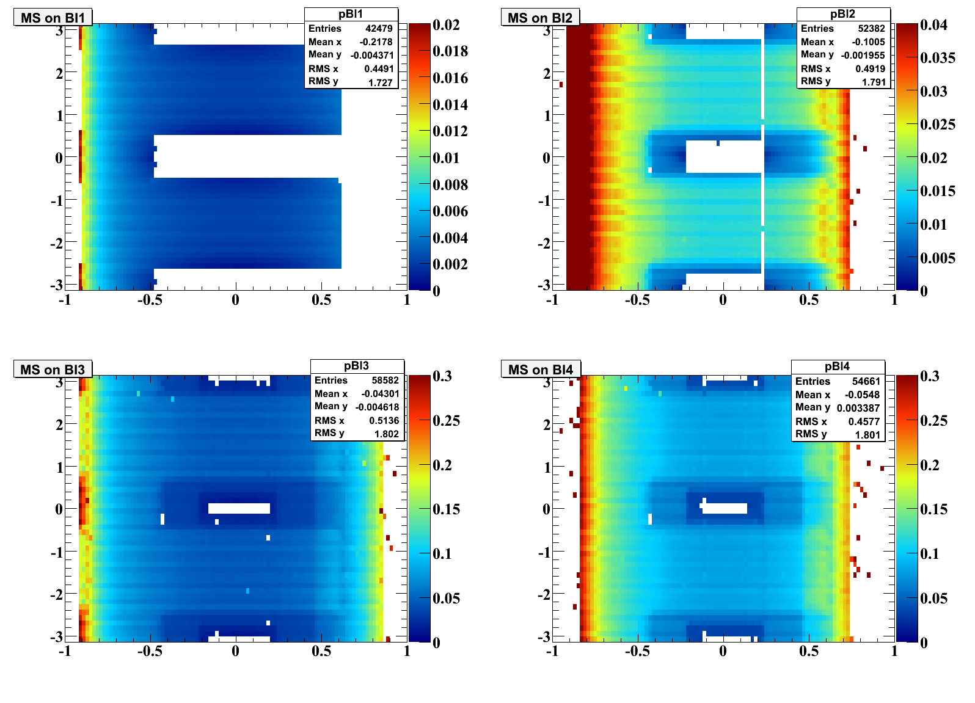
MVD layer: Point resolution
Barrel layer
Δ /mm
Δ /mm
Layer 1
0.2
0.1
0
Layer 2
0.4
0.3
0.2
0.1
0
phi
phi
cos theta
cos theta
Layer 3
3
2
1
0
Layer 4
3
2
1
0
phi
phi

Slide 17
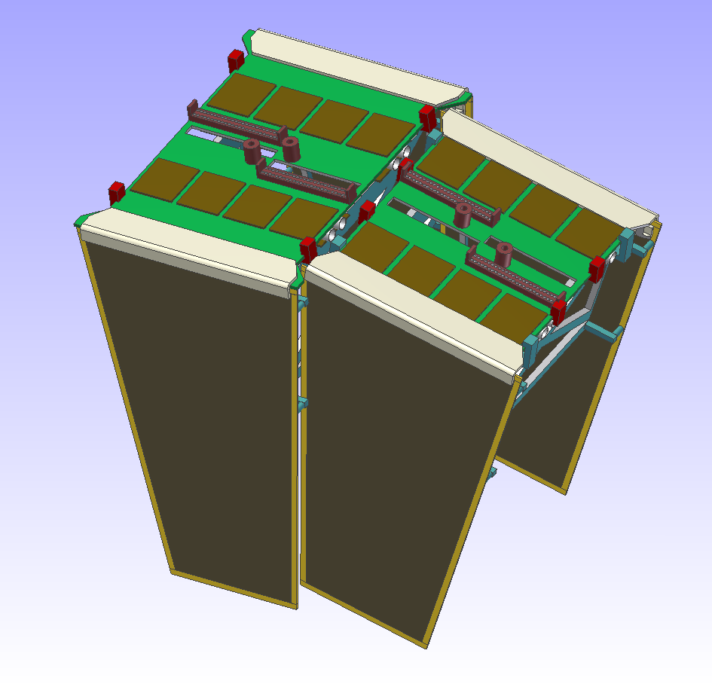
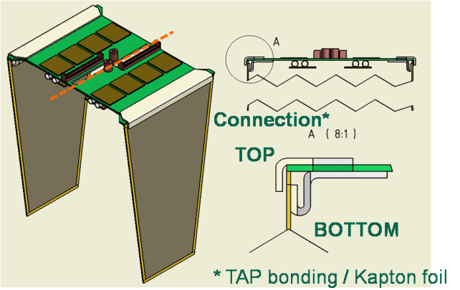
Impact on MVD strip part
Modified concept for forward strip disks

Slide 18
Design parameters
Most typical example for optimisation…
Spatial
coverage
Material
budget
versus

Slide 19
Design parameters
Design
Number of hit points / track (N_{trk-pt})
Spatial distribution of (N_{trk-pt} / track)
Spatial distribution of material load
Mapping of scattering effects:
Point resolution in MVD detector layers
Count rate studies
Resulting temperature on sensors
Single hit resolution
Track resolution
Vertex resolution: f (readout structure)
Complexity
Physics Performance

Slide 20
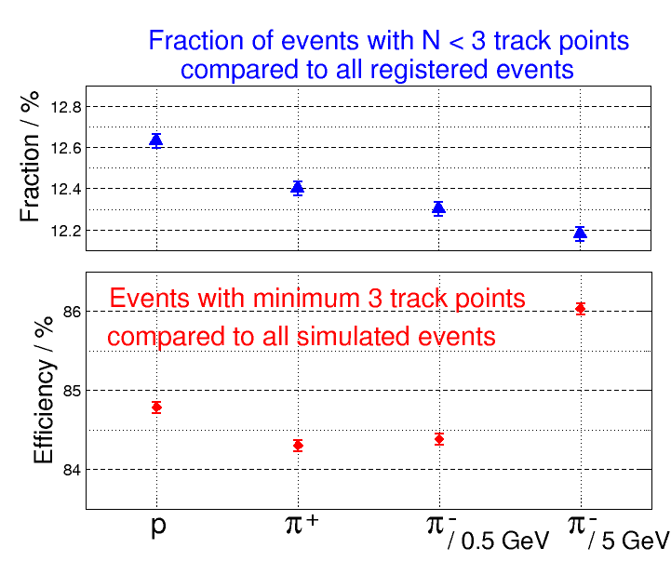
Track-point studies
Comparison for different particles and energy
No severe changing, in particular no asymmetry for charge conjugated particles
45°)
~ (12…13)%
45°)
~ (84…86)%

Slide 21
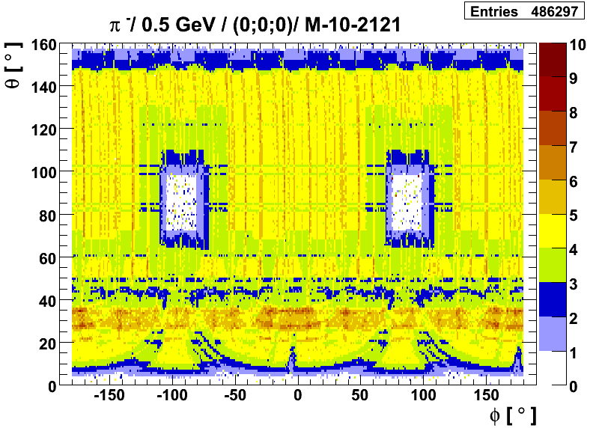
Track-point studies
Results: Optimisation process for different CAD models
Visualization of appearing or corrected gaps and overlaps
Homogenous distribution with N_{trk-pt} > 3 in the barrel part
/ M-10-1010

Slide 22
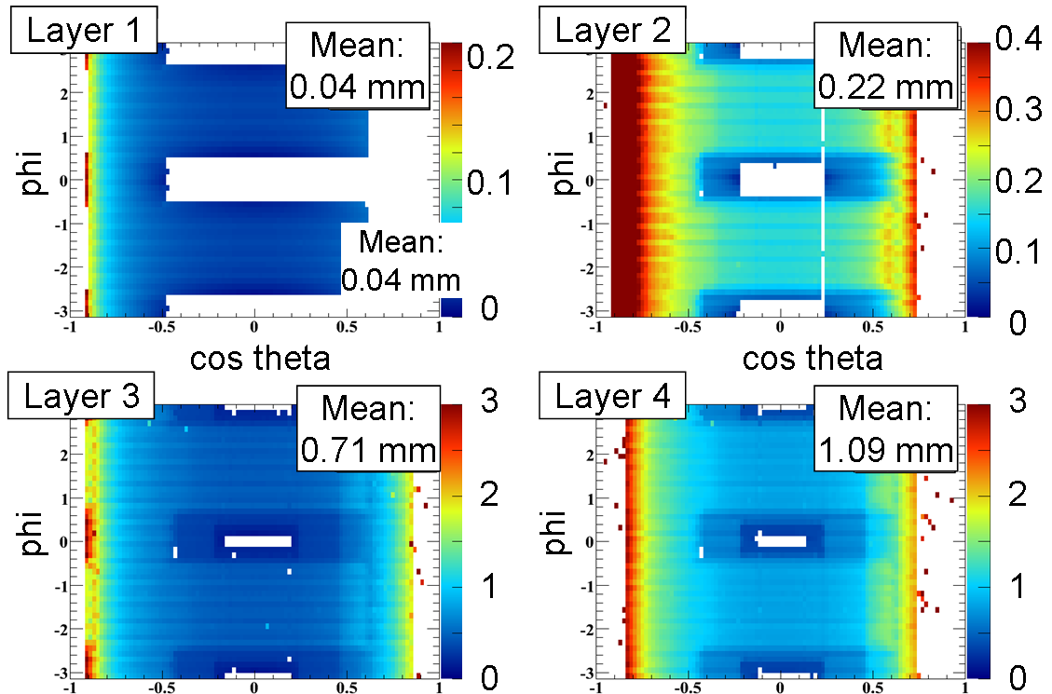
MVD layer: Point resolution
Results: Barrel layer (π⁺, 0.5 GeV / c)
Scattering effect in outer strip barrel layers reaches
1 mm (r.m.s.)

Slide 23
MVD layer: Point resolution
Layer 5
Mean:
1.93 mm
Layer 6
Mean:
1.62 mm
(a)
(b)
(c)
(d)

Slide 24
Detector optimisation
Alignment &
Positioning
Frontend
Electronics
Cooling
Integration /
Interplay with
other subsystems
Design
Cabling
Geometrical
Restriction
Mechanics
Physics Performance
Physics simulations
& measurements
Engineering simulations
& measurements

Slide 25
Detector optimisation
Alignment &
Positioning
Frontend
Electronics
Cooling
Integration /
Interplay with
other subsystems
Design
Cabling
Geometrical
Restriction
Mechanics
Physics Performance
Physics simulations
& measurements
Engineering simulations
& measurements

Slide 26
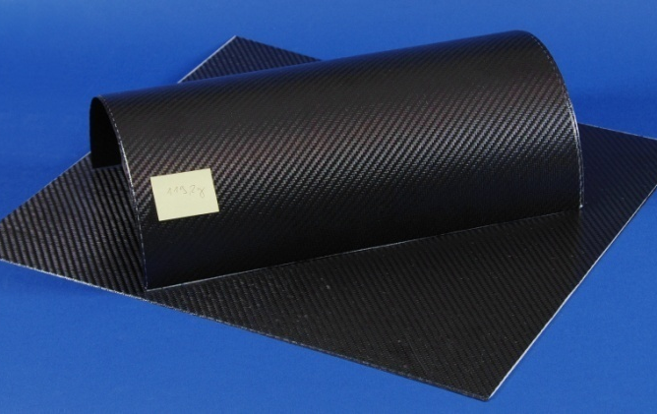
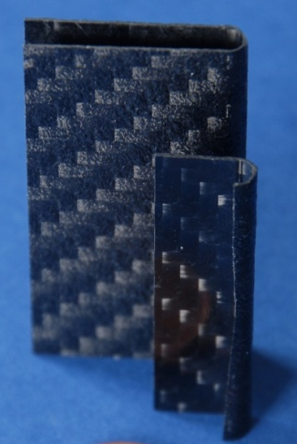
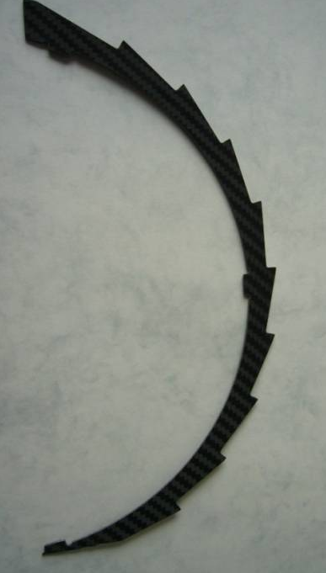
Impact on MVD strip part
Concept of carbon support structure for barrel part

