Slide 1
MVD TDR Workshop Torino, Mai 23-25, 2011 Thomas Würschig TDR Status
→ 1 draft ready
Introduction chapter 1.3: MVD layout
Mechanics: Update / Open questions
Simulations
General: Introduction of model into simulations
Detector simulation: Coverage / Radiation length / Count rates
→ discussion ...
→ What I can
do/provide ...

Slide 2
TDR contributions
Central parts of thesis may be used ...either directly, slightly modified or as input for editors of other sections....
Download: http://panda-wiki.gsi.de/pub/Mvd/ MvdPublic/Thesis-TWuerschig.pdf.zip

Slide 3
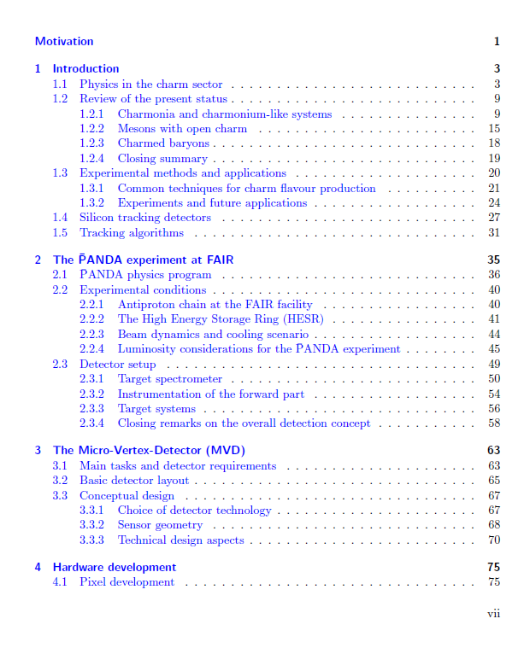
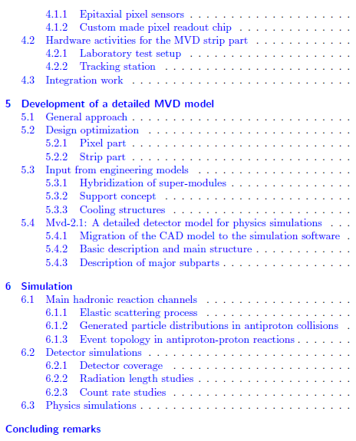
TDR contributions

Slide 4
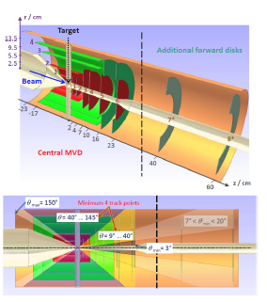
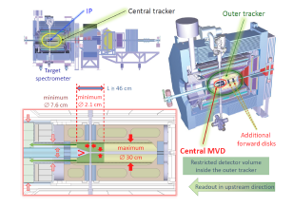
MVD layout (TDR intro part)
What is in ... → Basic detector geometry

Slide 5
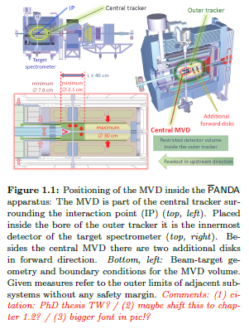
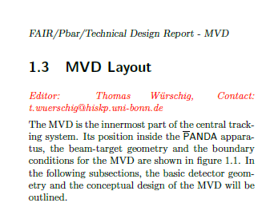
MVD layout (TDR intro part)

Slide 6
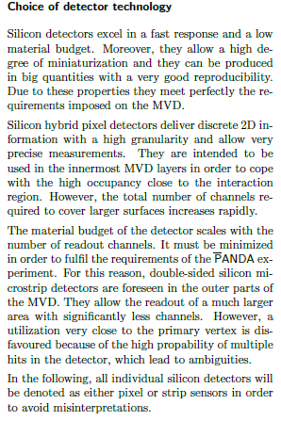
MVD layout (TDR intro part)
What is in ... → Basic detector geometry → Conceptual layout - Choice of detector technology
( ... Silicon hybdrid pixel + double-sided silicon microstrip detectors ...)

Slide 7
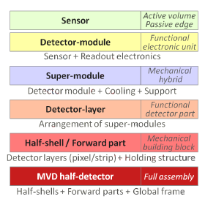
MVD layout (TDR intro part)
What is in ... → Basic detector geometry → Conceptual layout - Choice of detector technology - Hierarchy

Slide 8
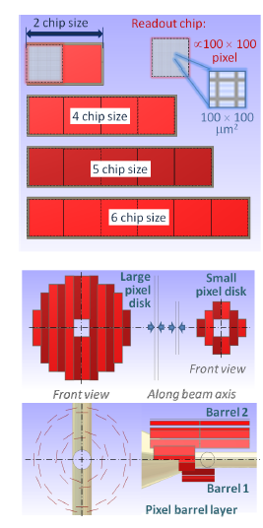
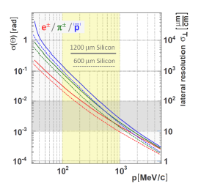
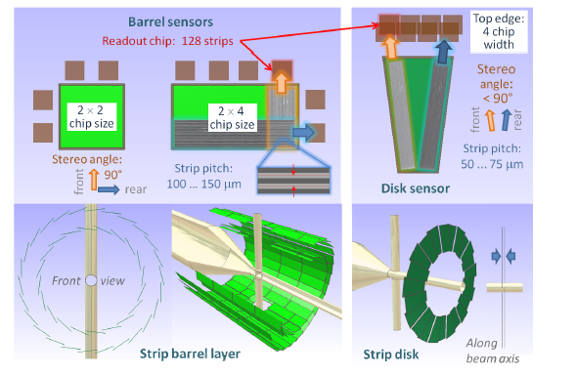
MVD layout (TDR intro part)
What is in ... → Basic detector geometry → Conceptual layout - Choice of detector technology - Hierarchy - Sensor geometry

Slide 9
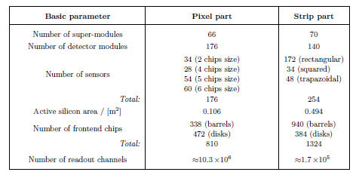
MVD layout (TDR intro part)
What is in ... - Sensor geometry TABLE (...sure)

Slide 10
MVD layout (TDR intro part)
What is in ... - Sensor geometry TABLE (...?)
...

Slide 11
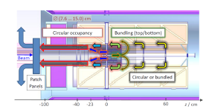
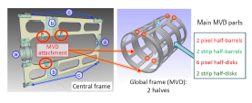
MVD layout (TDR intro part)
What is in ... → Basic detector geometry → Conceptual layout - Choice of detector technology - Hierarchy - Sensor geometry - Mechanics and detector integration

Slide 12
MVD layout (TDR intro part)
What is in ... → Basic detector geometry → Conceptual layout - Choice of detector technology - Hierarchy - Sensor geometry - Mechanics and detector integration

Slide 13
MVD layout (TDR intro part)
What is in ... → Basic detector geometry → Conceptual layout - Choice of detector technology - Hierarchy - Sensor geometry - Mechanics and detector integration
... Something else .... ?

Slide 14
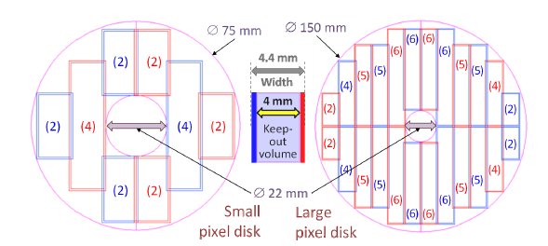
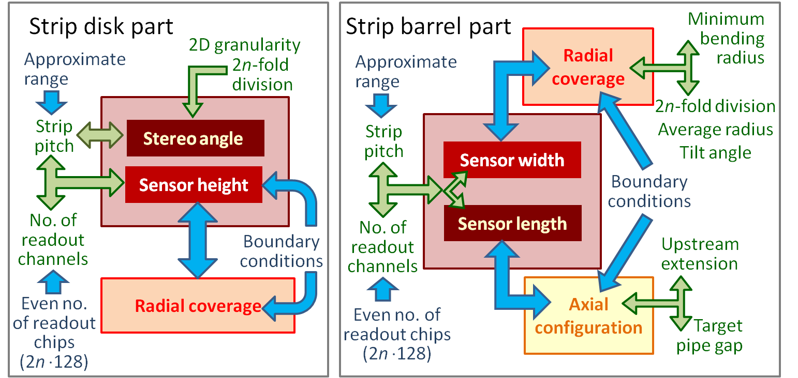
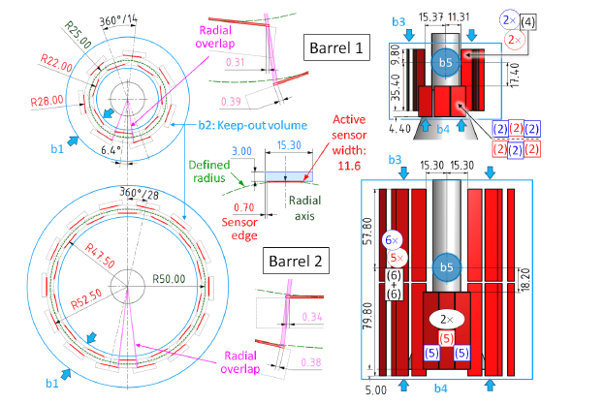
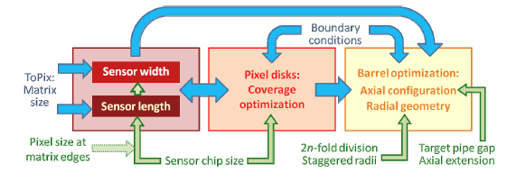
MVD layout (TDR intro part)
What is not in → too much details on optimization ...

Slide 15
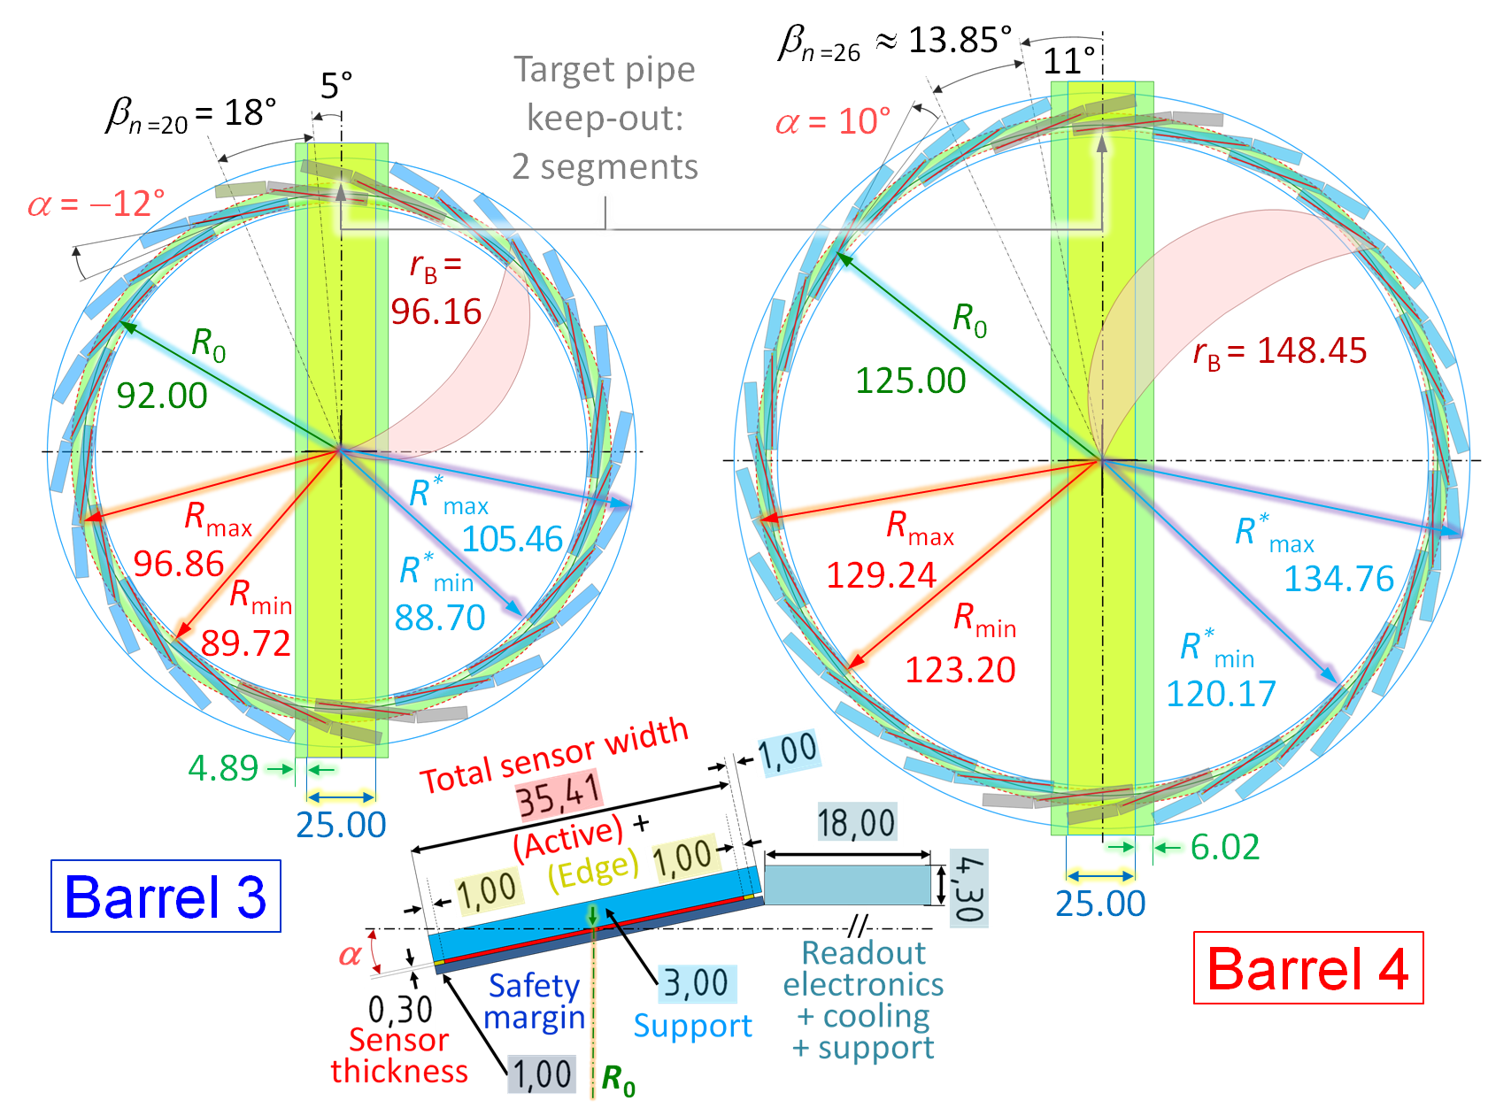
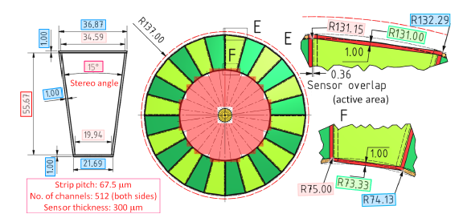
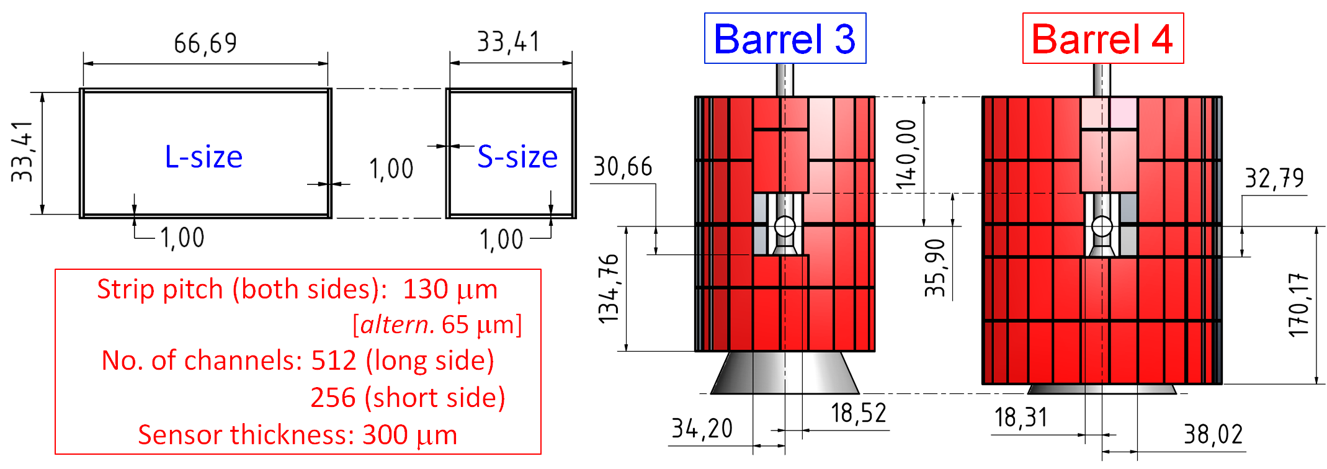
MVD layout (TDR intro part)
What is not in → too much details on optimization ...

Slide 16
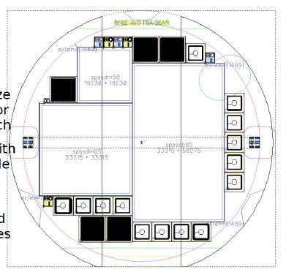
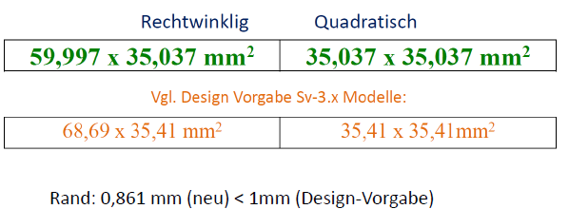
Mechanics (Update strip part)
Sensor sizes of prototypes slightly modified ...due to technical reasons
Pitch:
65 μm
Thicknes:
280 μm

Slide 17
Mechanics (Update strip part)
Sensor sizes of prototypes slightly modified ...due to technical reasons → Adaptation:
(A)
1 x L + 1 x S (104 mm)
→ 2 x L
(120 mm):
Gap to TP (34 mm -12 mm )
16 mm...
6 mm space left to TP:
... Ok ? ... Cooling pipes
(A)
(A)

Slide 18
Mechanics (Update strip part)
Sensor sizes of prototypes slightly modified ...due to technical reasons → Adaptation:
Or (A‘)
1 x L + 1 x S (104 mm)
→ 2 x L
(95 mm):
Bigger gap to TP + 45 mm
(A‘)
(A‘)

Slide 19
Mechanics (Update strip part)
Sensor sizes of prototypes slightly modified ...due to technical reasons → can be accommodated
(B)
4 x L (275 mm)
→ 4 x L + 1 x S
(275 mm)
(C)
1 x L + 1 x S (310 mm)
→ 4 X L + 2 x S
(310 mm)
(B)
(C)

Slide 20
Mechanics (open issues...)
Cooling
Specified power dissipation: < 1 W /cm²
Number of cooling lines: Barrel 3: 2 x (5 IN + 5 OUT) / Length: 2 x 30 cm + 5 cm Barrel 4: 2 x (7 IN + 7 OUT)* / Length: 2 x 35 cm + 5 cm Disks: Maximum number: 2 x (12 IN + 12 OUT) ... but this is surely too high ... * See next slide
Number of FE / cooling circuit: Barrel 3: max. (24 + 24) FEE → 48 W Barrel 4: max. (28 + 28) FEE → 56 W Disks: min. 16 FEE → 16 W x n ....

Slide 21
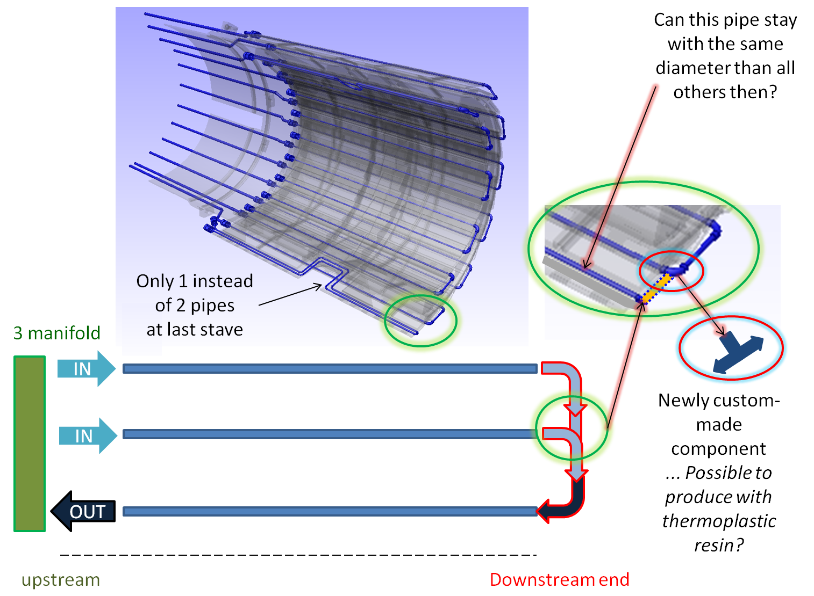
Cooling concept

Slide 22
Mechanics (Update strip part)
Sensor sizes of prototypes slightly modified ...due to technical reasons → can be accommodated
... Readout: probably 1 shared frontend at edges of 2 sensors ...

Slide 23
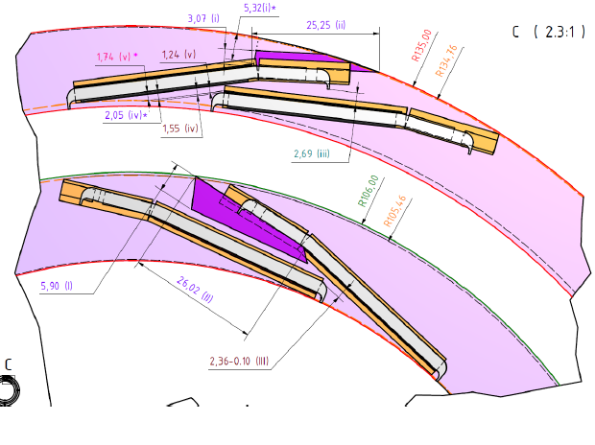
Mechanics (Update strip part)
Start of prototyping barrel stave support → Carbon fibre /foam structure ...start with barrel 3 ... →Length adapted to new sensor prototypes
Waiting for (final) drawings... ZAT ...
Radial
margins ....

Slide 24
Mechanics (Update strip part)
Start of prototyping barrel stave support → Carbon fibre /foam structure ...start with barrel 3 ... →Length adapted to new sensor prototypes
Waiting for (final) drawings... ZAT ...
Radial
margins ....

Slide 25
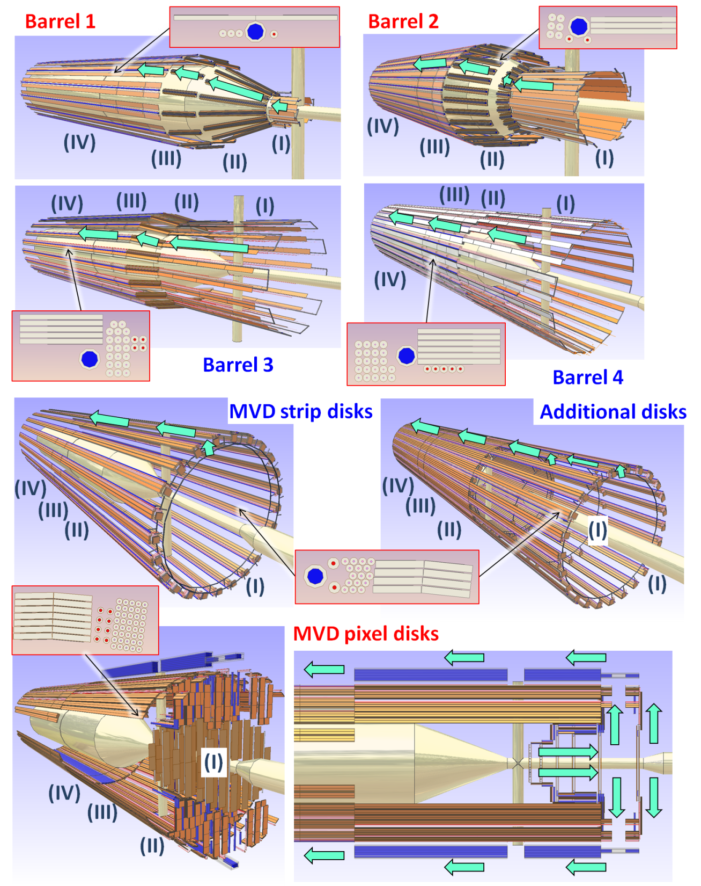
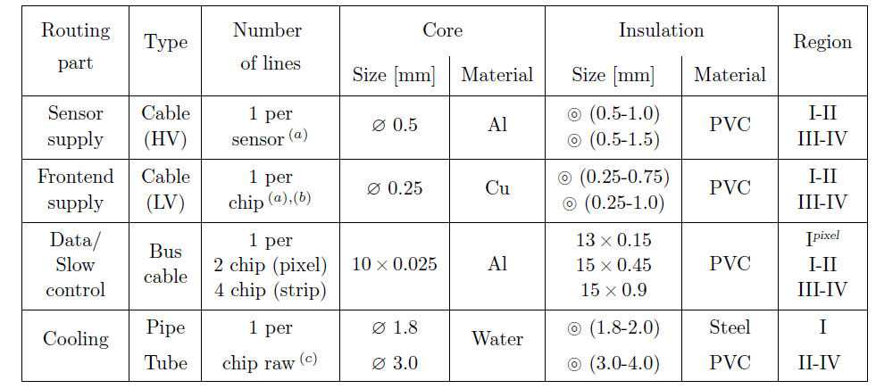
Mechanics (TDR part)
Routing scheme (integration section) → Short individual subchapter ?!
...including this table ... Or in:
general intro part for cables

Slide 26
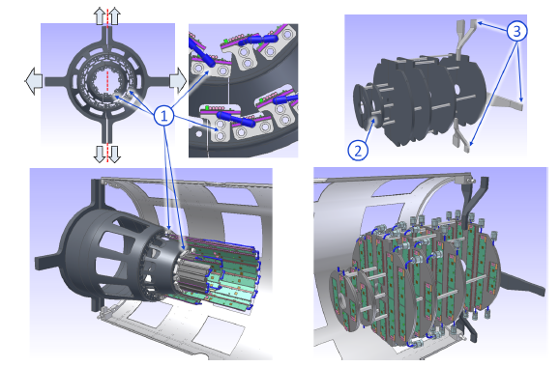
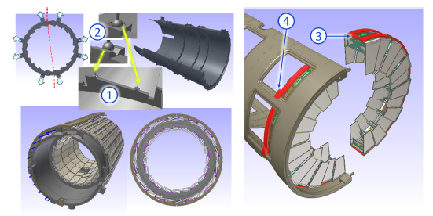
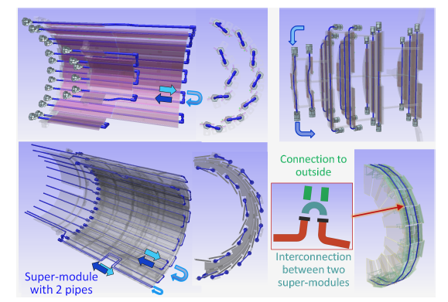
Mechanics (TDR part)
General introduction: support concept → in analogy to JINST article !?
Common section cooling, at least as an intro part?! ...then maybe can be split ...

Slide 27
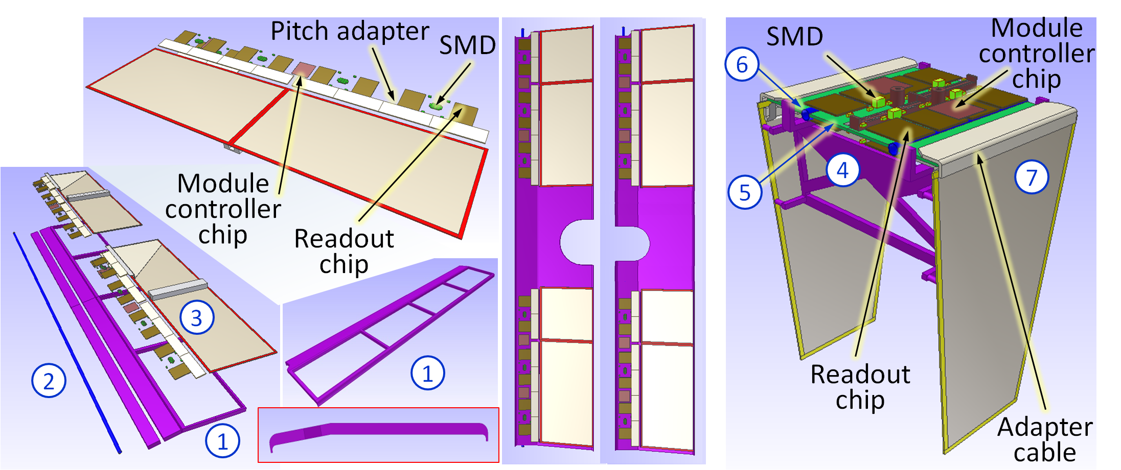
Mechanics/Strip part (TDR)
Hybridization

Slide 28
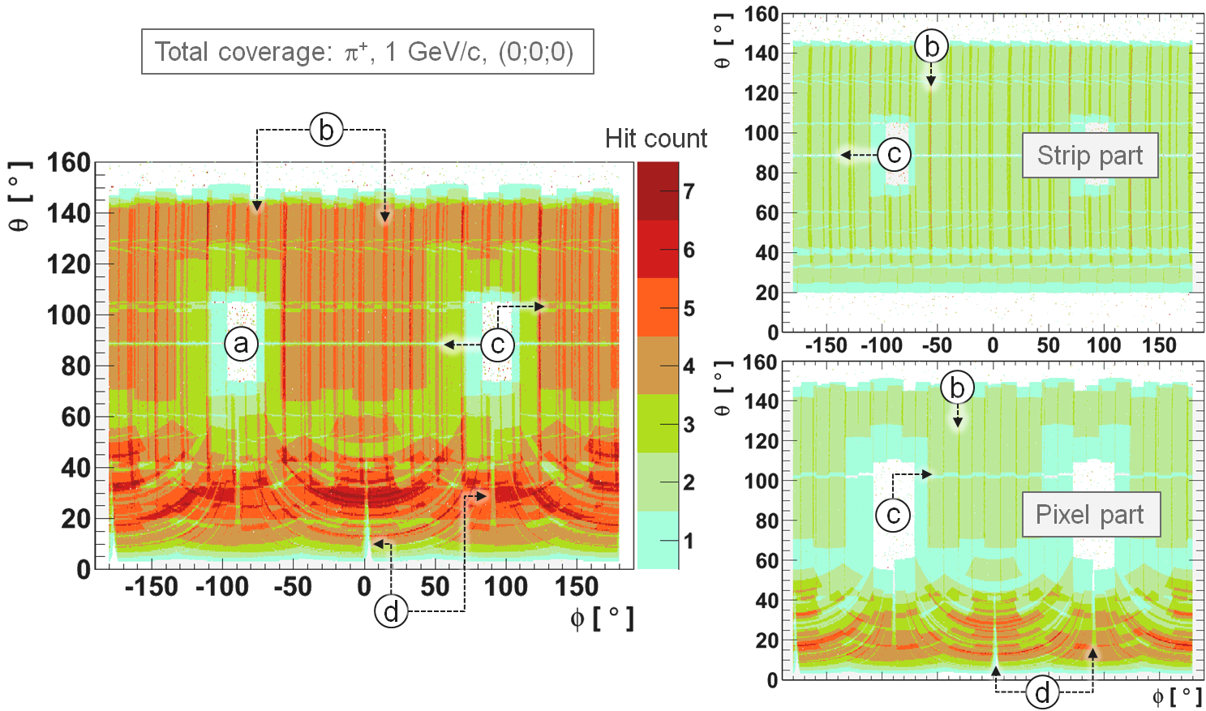
Simulation: Coverage

Slide 29
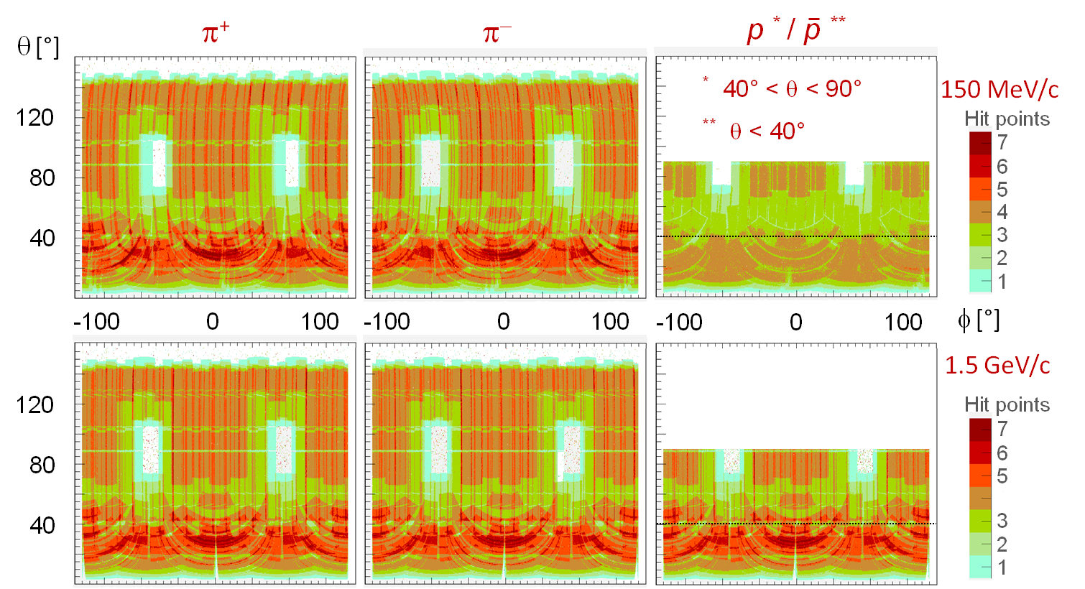
Simulation: Coverage

Slide 30
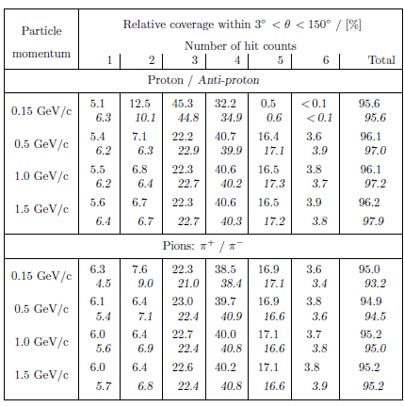
Simulation: Coverage

Slide 31
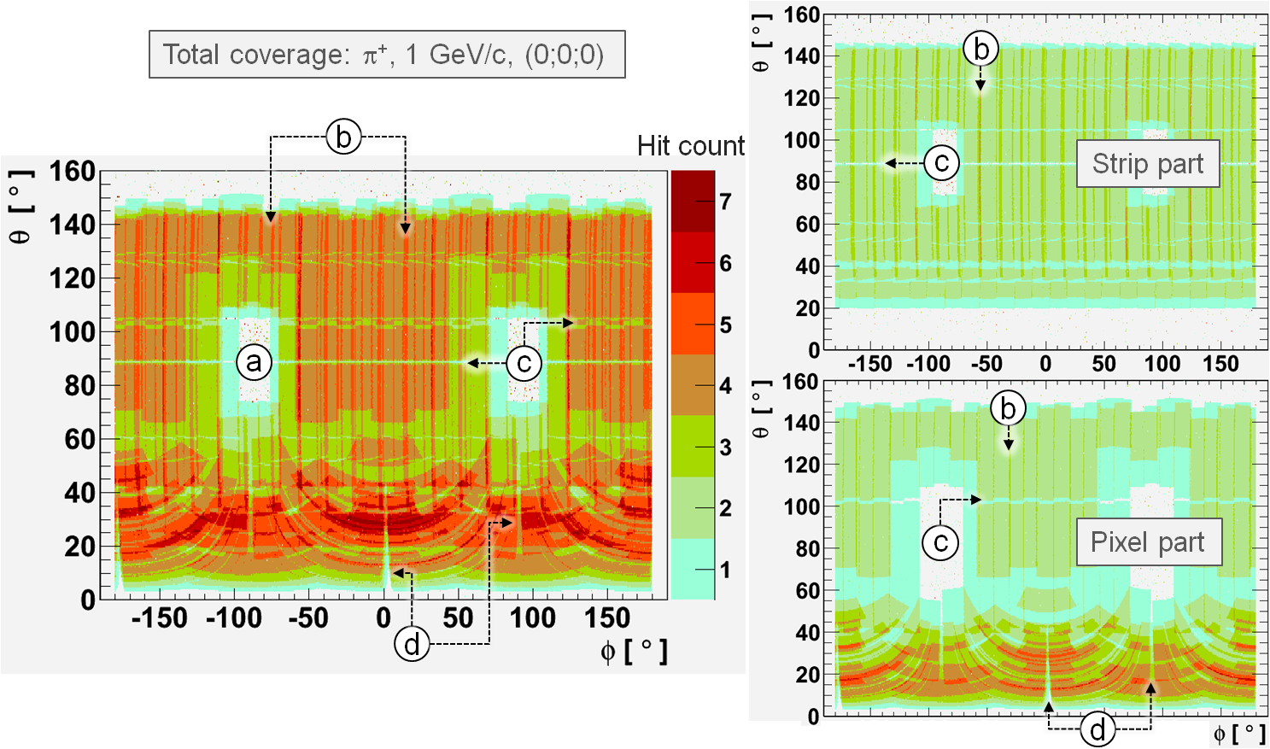
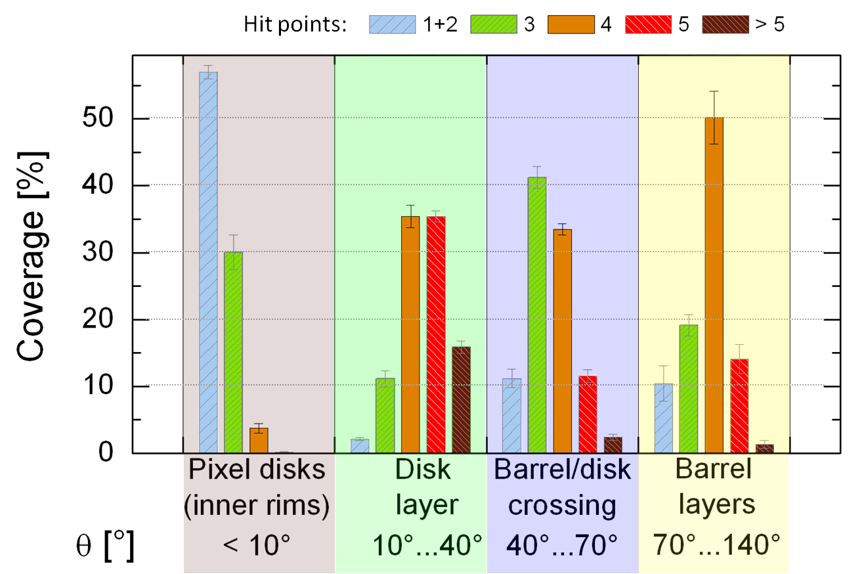
Simulation: Coverage

Slide 32
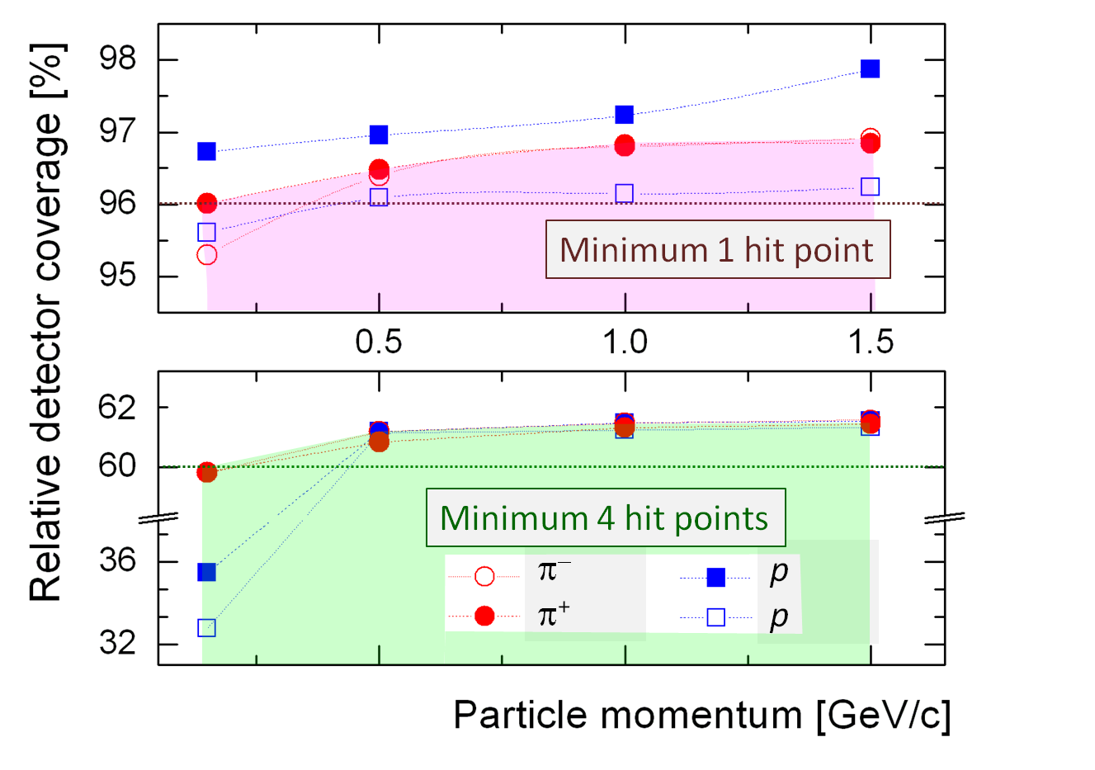
Simulation: Coverage

Slide 33
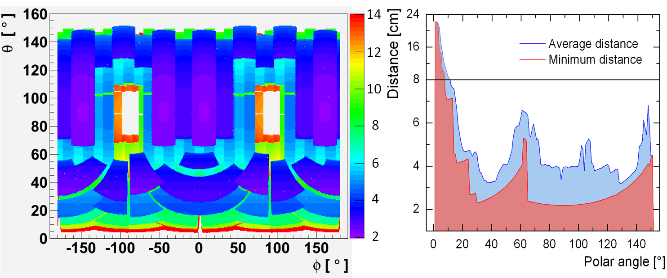
Simulation: Coverage
Distance from IP to first hit point

Slide 34
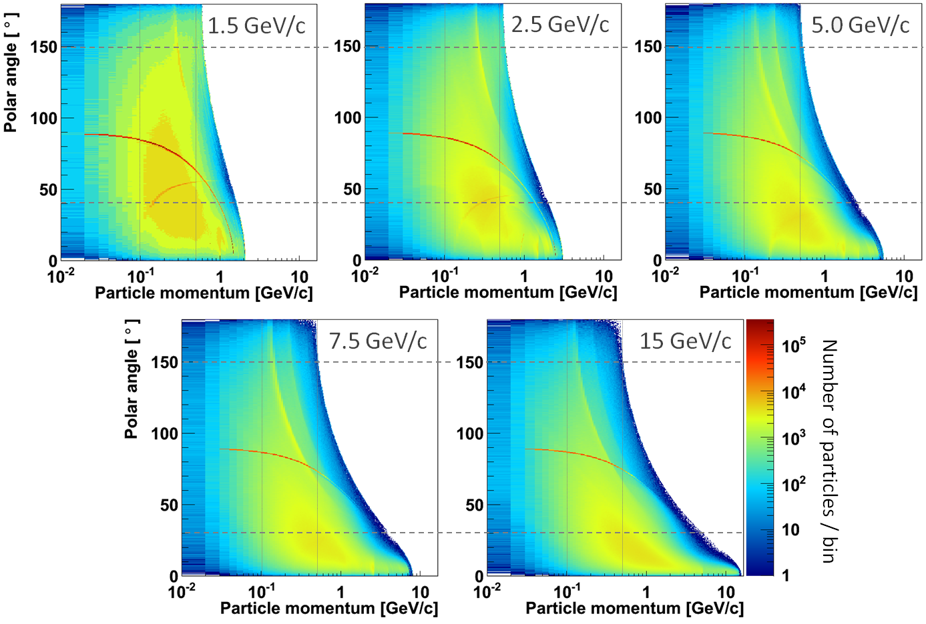
Simulation: Particle distribution (DPM)

Slide 35
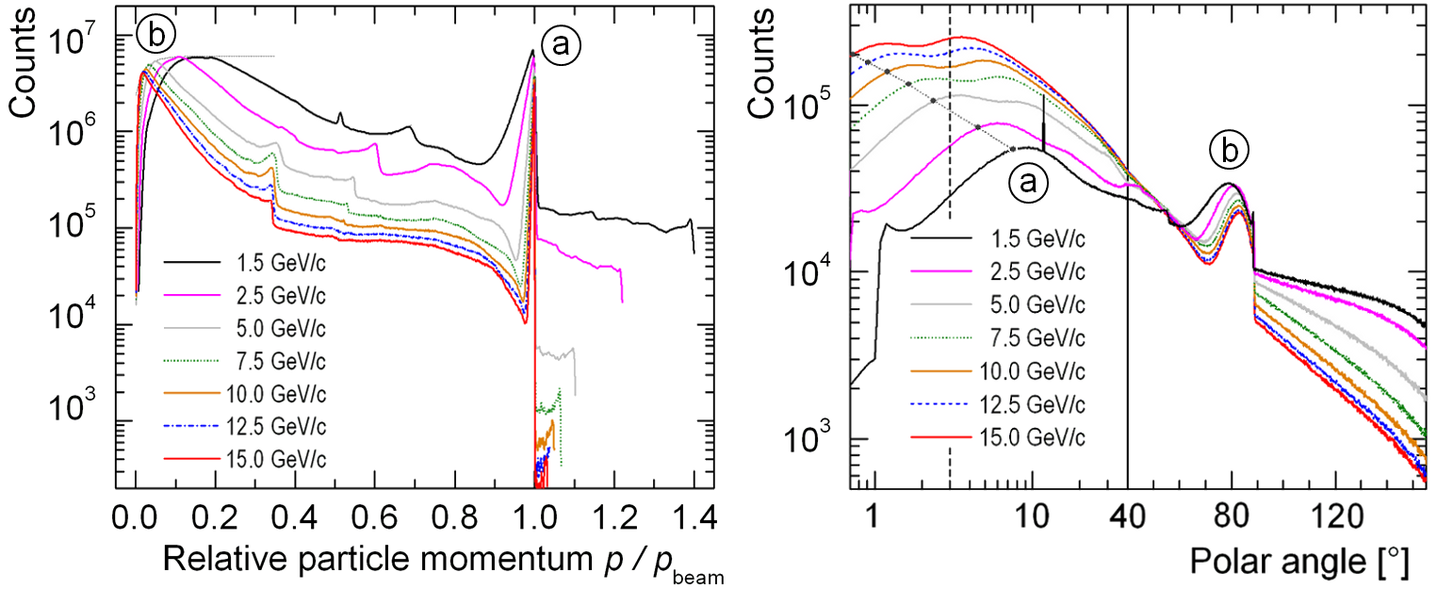
Simulation: Particle distribution (DPM)

Slide 36
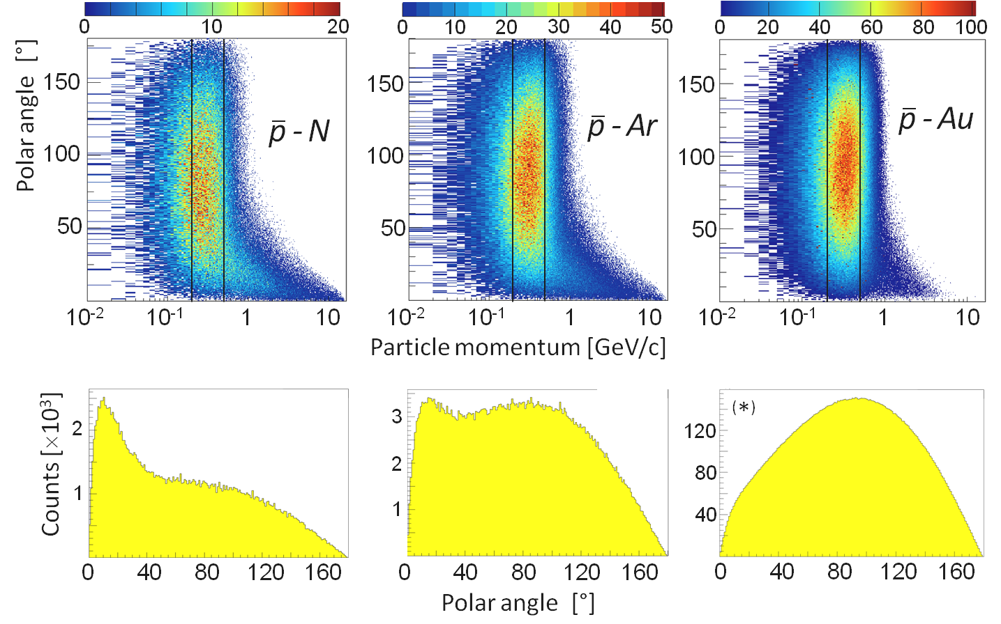
Simulation: Particle distribution (UrQMD)

Slide 37
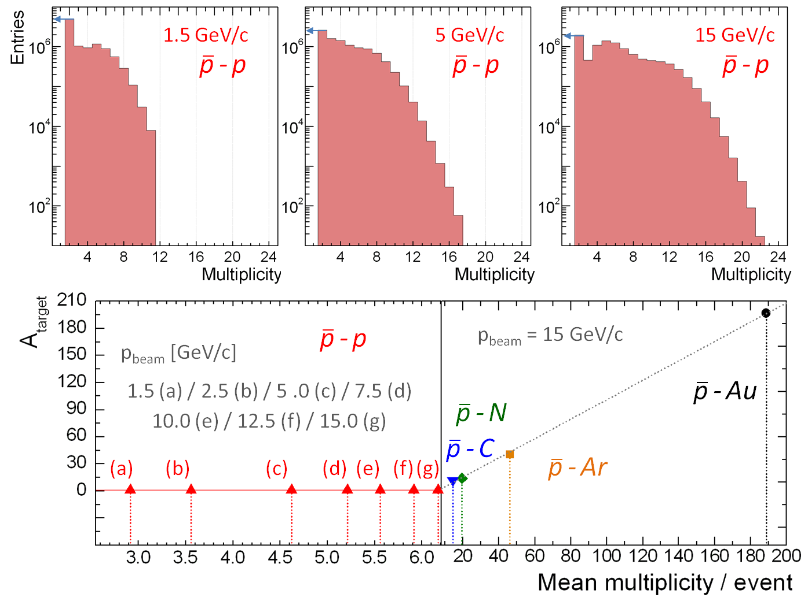
Simulation: Particle distribution (DPM+UrQMD)
Take into account for any estimate on data load (...later):
N_{data} ~ M ⋅ N_{Δt} ⋅ n(Ω) ⋅ p
M ... Multiplicity per event
N_{Δt} ... Number of
Events within Δt
N_{Δt} ~ L
Luminosity
n(Ω) ... Occupancy in the covered area
M_{max}
< M >

Slide 38
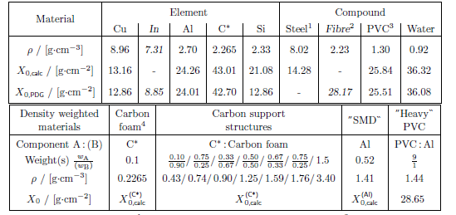
Simulation: Material budget
Silicon

Slide 39
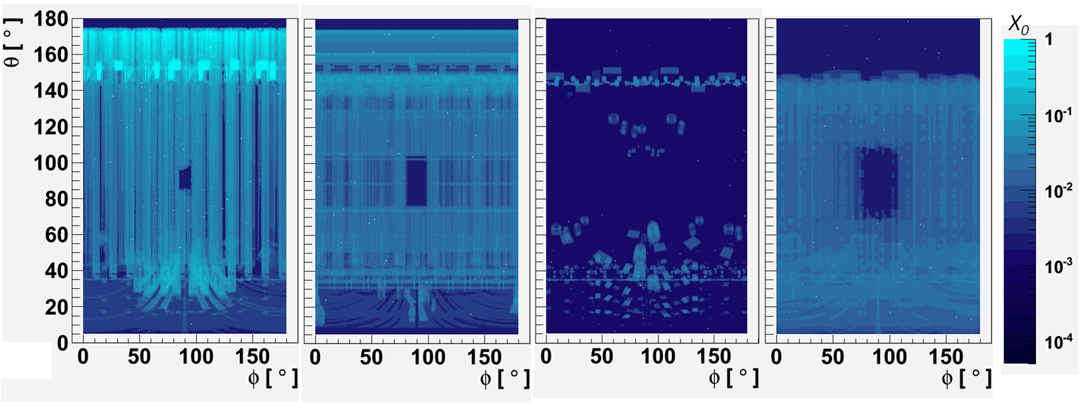
Simulation: Material budget
Routing
Support
Components
Silicon
X/X₀

Slide 40
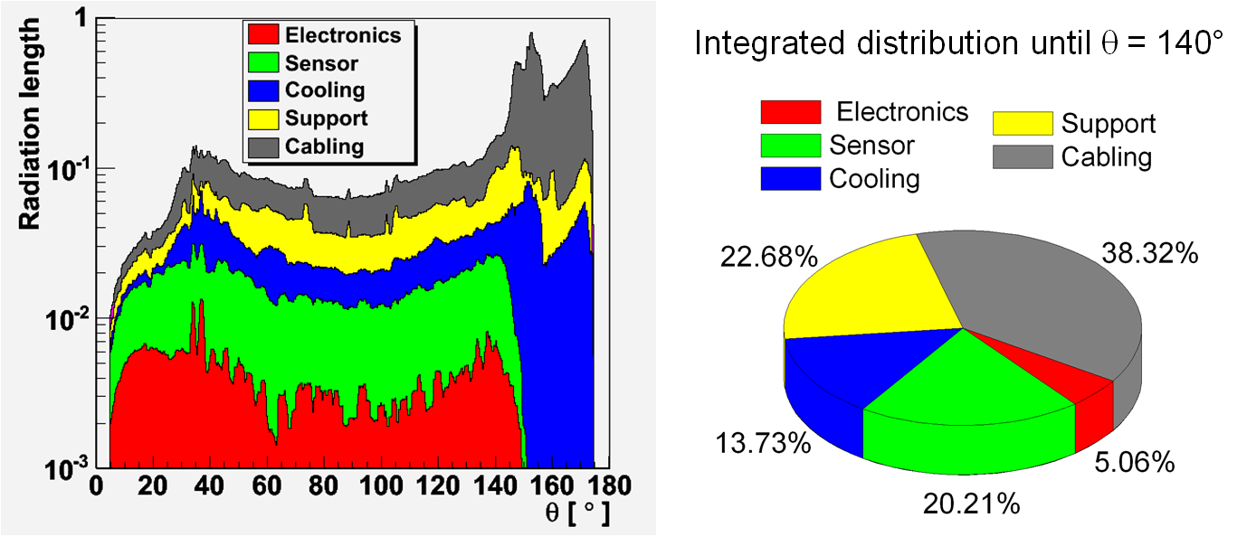
Simulation: Material budget

Slide 41
Simulation: Material budget

Slide 42
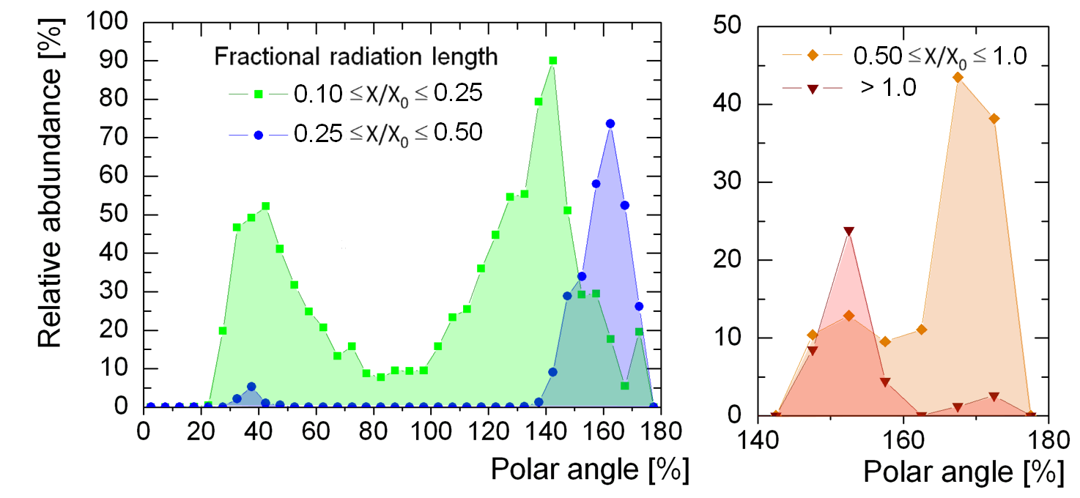
Simulation: Material budget

Slide 43
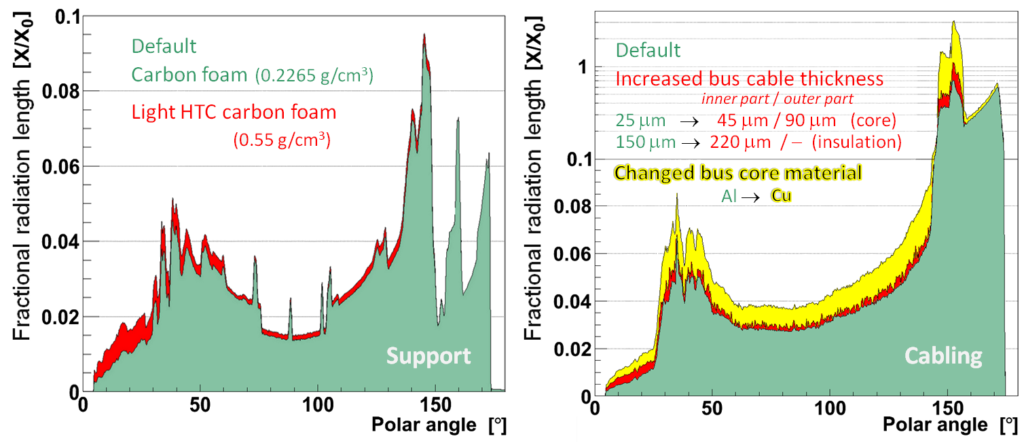
Simulation: Material budget

Slide 44
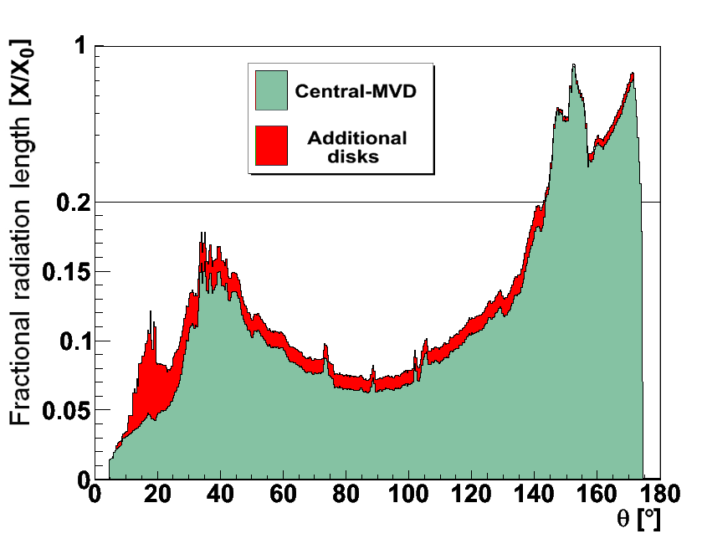
Simulation: Material budget

Slide 45
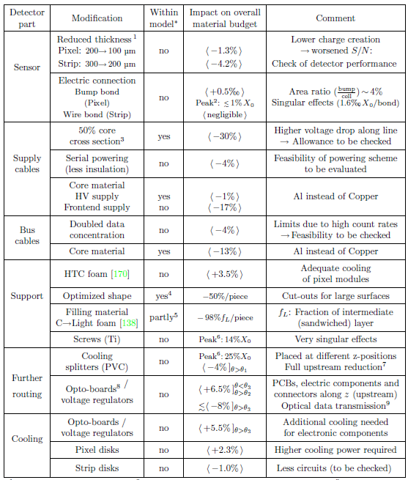
Simulation: Material budget

Slide 46
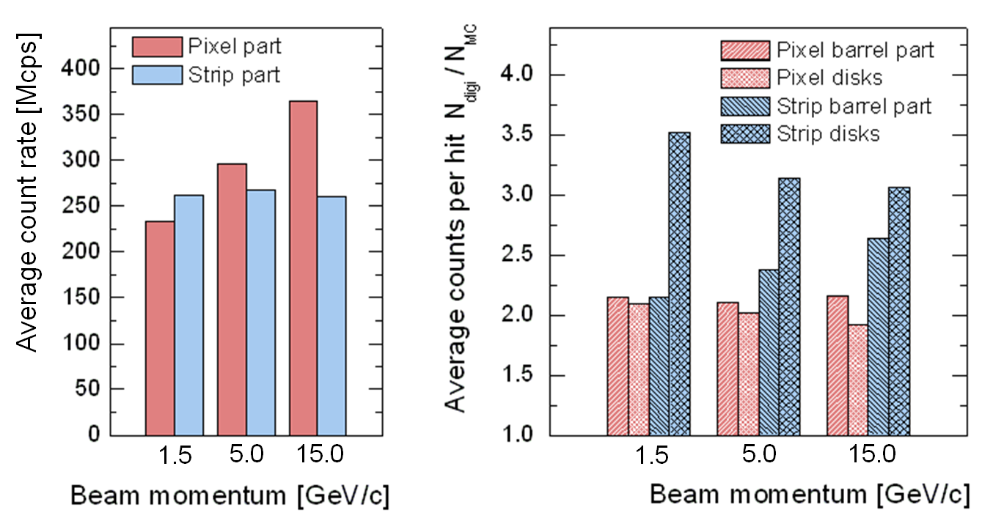
Simulation: Count rates

Slide 47
Simulation: Count rates

Slide 48
Simulation: Count rates

Slide 49
Simulation: Count rates

Slide 50
New model: Forward part
Modified concept for forward part implemented

