Slide 1
MVD Assembly
Two half frame done – Dimension Tested
Ancillaries for Frames done – Dimension Tested
Frame Assembly & Final Machining – must be done
Special & Precision Screws - must be done
Fixing Point of the Sub-Structures – Defined
Fixing Point for Strip Disk must be defined
MVD Assembly Sequence – Defined
Open Items: Services Routing, Patch Panels

Slide 2
MVD Integration
MVD Aligned & Fixed on Central Frame
Ref. Bosses: two options → gluing/machining
Open Item: Central Frame Definition
Critical Point: Cross Pipe Position/Geometry
MVD Final Survey
Position of target point must be defined
MVD Services Routing
Tests must be defined
Patch Panel Position must be defined
Open Item: Services Routing Outside the Magnet

Slide 3
MVD Pixel-Mechanics
Barrel & Disks Geometry Defined
Barrel & Disks Assembly Procedure Defined but NOT TESTED
Barrel & Disks Cooling Tubes Assembly Defined & Tested Assembly Tooling to be defined

Slide 4
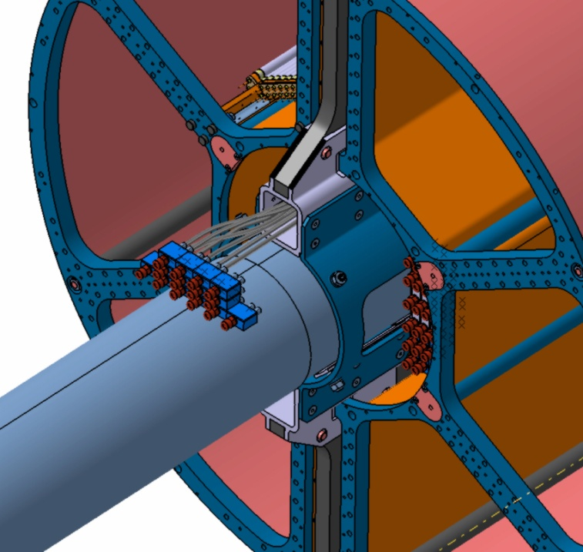
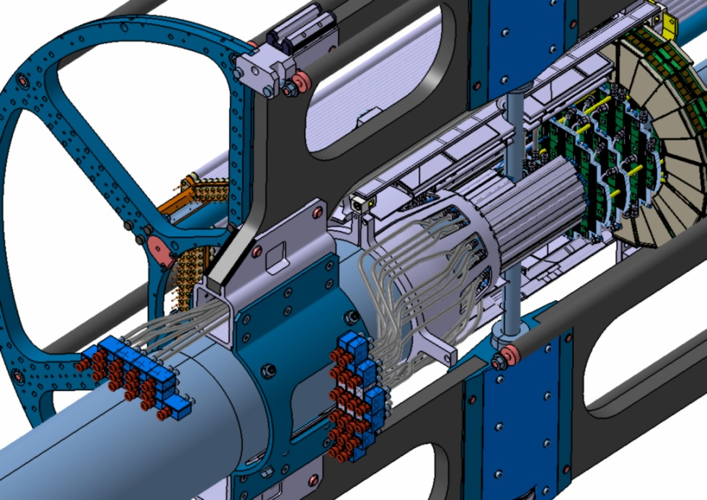
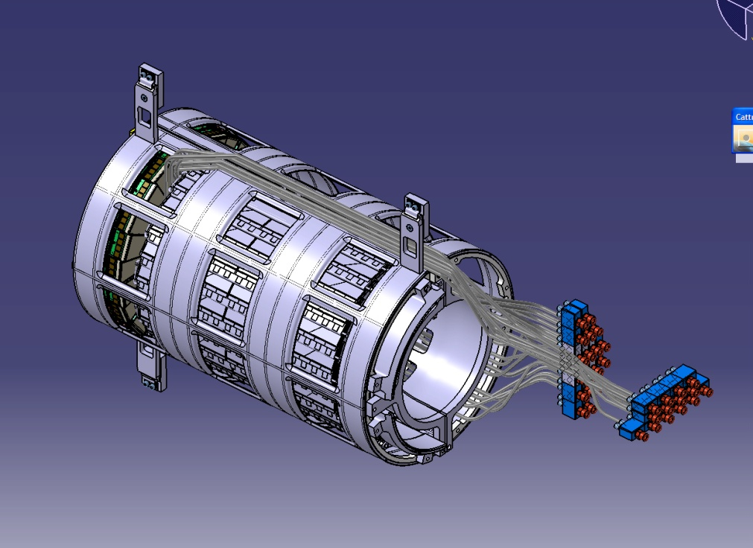
Services Routing - Patch Panels Very preliminary
PATCH PANELS OUTSIDE STT/TPC VOLUME – PIXEL DISKS
PATCH PANELS INSIDE STT/TPC VOLUME – BARREL (PIXEL+STRIP)
DIFFERENT PATH
FOR CABLES AND TUBES
CRITICITY!!!

Slide 5
Services Routing - Patch Panels Very preliminary

Slide 6
Services Routing - Patch Panels Very preliminary

Slide 7
Services Routing - Patch Panels Very preliminary

Slide 8
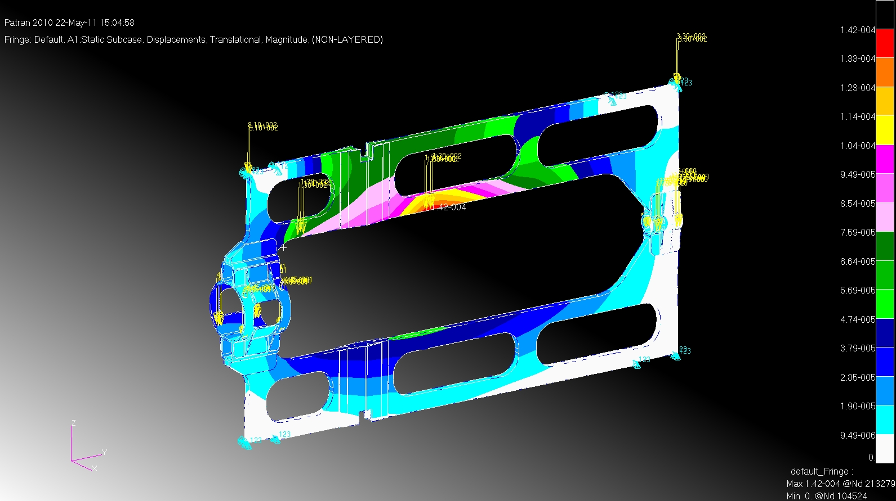
CENTRAL FRAME DEFINITION
CENTRAL FRAME DESIGN – TARGET: RIGIDITY → TARGET: MAX DEFORMATION < 50μm
1ST STEP – CURRENT DESIGN → 142 μm MVD SUPPORT AREA
STATIC LOAD (CROSS PIPE+MVD+STT)
M55J/ROHACELL/M55J+TITANIUM (CONNECTING PART )

Slide 9
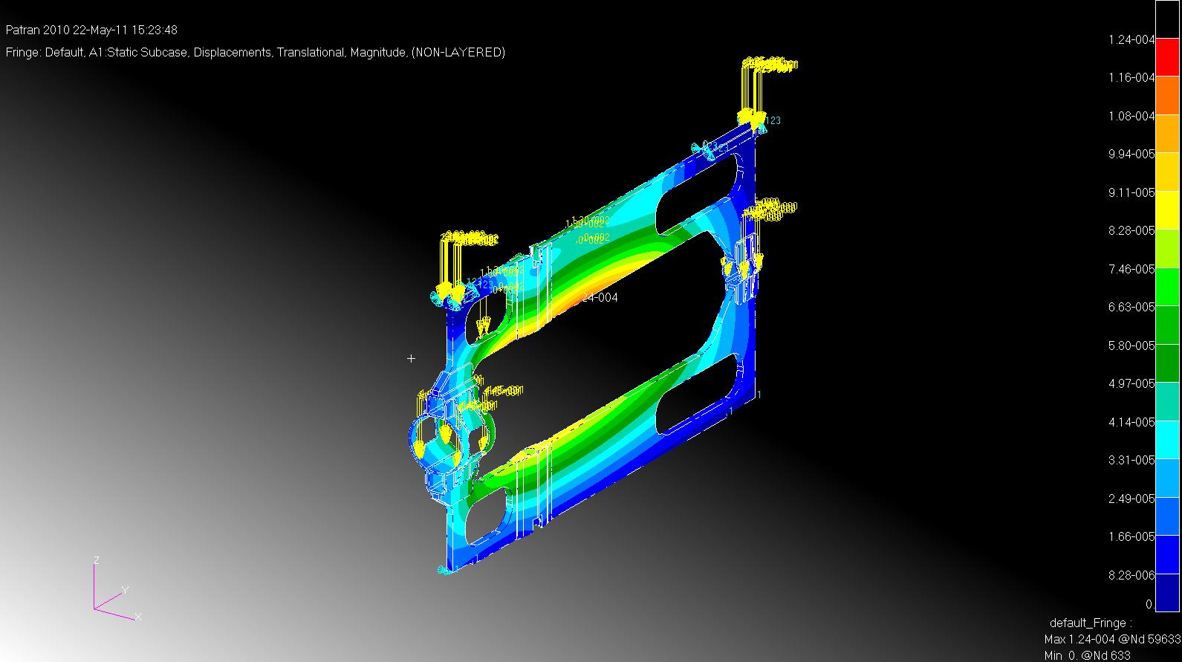
CENTRAL FRAME DESIGN – TARGET RIGIDITY → TARGET DEFORMATION < 50μm
2nd STEP – CENTRAL WINDOWS REMOVED→ 124 μm MVD SUPPORT AREA
STATIC LOAD (CROSS PIPE+MVD+STT)
M55J/ROHACELL/M55J+TITANIUM (CONNECTING PART )

Slide 10
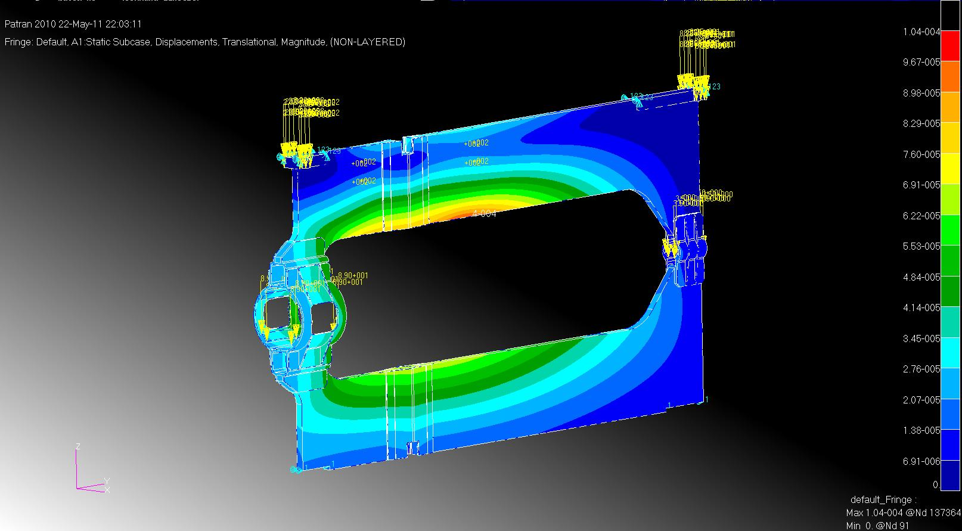
CENTRAL FRAME DESIGN – TARGET RIGIDITY → TARGET DEFORMATION < 50μm
3rd STEP – ALL WINDOWS REMOVED→ 104 μm MVD SUPPORT AREA
STATIC LOAD (CROSS PIPE+MVD+STT)
M55J/ROHACELL/M55J+TITANIUM (CONNECTING PART )

Slide 11
CENTRAL FRAME DEFINITION
NEXT STEPS: RIBS EMBEDDED INTO THE STRUCTURE
STRESS INDUCED TO THE CROSS-PIPE
CONNECTING PARTS MADE BY EPM203 (EPOXY/GLASS)
OR CYANATE/CARBON FIBRE

Slide 12
Mechanics TDR
DONE & WRITTEN
Frame:
Geometry, description.
Structural constraint.
Feasibility.
Barrel:
Geometry (sensors distribution)
Physical constraint.
Support and frame connection.
Disks:
Geometry (sensors distribution)
Physical constraint.
Frame connection.
TO BE DONE
Assembly sequence.
Assembly tools.
End stave electronics boards support definition.
Mechanical integration with strip parts (barrel & disks)

Slide 13
MVD Pixel-cooling
carbon foam tested
disks cooling Defined & tested, small disks to be optimized
barrel cooling Defined &tested, to be optimized
Open Item: test with master bond glue
cfd simulation
cooling plant-first drafs of pixel parts

Slide 14
Cooling TDR
DONE & WRITTEN
Pixel cooling system:
Pixel power
Thermal request
Working condition
Test on carbon foam (Young modulus and thermal conductivity at different radiation fields)
Disks cooling system:
Description
Fem analyses and test results on prototype
Pressure drop
Barrel cooling system:
Description
Fem analyses and test results on prototype
CFD simulation
Cooling plant:
Description
Pixel modularity
First drafts
TO BE DONE
Tests with Master Bond glue
Cooling for the End stave electronics boards
Strip part integration in the cooling plant
Final design of the cooling plant

