Slide 1
The Central Straw Tube Tracker In The PANDA Experiment
Peter Wintz (IKP - FZ Jülich), for the PANDA collaboration
11th International Conference on Low Energy Antiproton Physics,
June 10-15, 2013, Uppsala, Sweden

Slide 2
Outline: PANDA - Straw Tube Tracker
PANDA physics
Central Straw Tube Tracker (STT)
Minimal material budget
High-rate tracking and PID
Online event reconstruction (→ next talk)
Test systems and results
Simulation studies
Summary

Slide 3
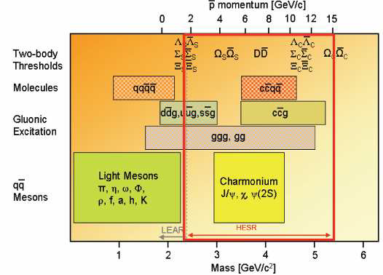
_
→ Talks by A. Gillitzer (Tue), A. Sanchez (Wed), M. Maggiora, B. Kopf (Thu)
The PANDA Physics Program
_
_
PANDA investigates pp and pA annihilation in the charm quark mass regime
Hadron spectroscopy (m, Γ, J^{PC}, BR)
Charmonium states
Open charm mesons (D-mesons)
Exotic states (glueballs, hybrids, multi-quarks)
Strange and charmed baryons
Hadrons in nuclear medium
J/ψ − absorption, D meson mass shift
Hypernuclei (_{Ξ}−^{A}Z, _{ΛΛ}^{A}Z), YY-interaction
Structure of the nucleon
Electromagnetic formfactors
Generalized Distribution Amplitudes
Transverse nucleon spin (full PWA)
PANDA Physics Performance Report
arXiv:0903.3905 (216pp)
2.25 < √s < 5.47 GeV

Slide 4
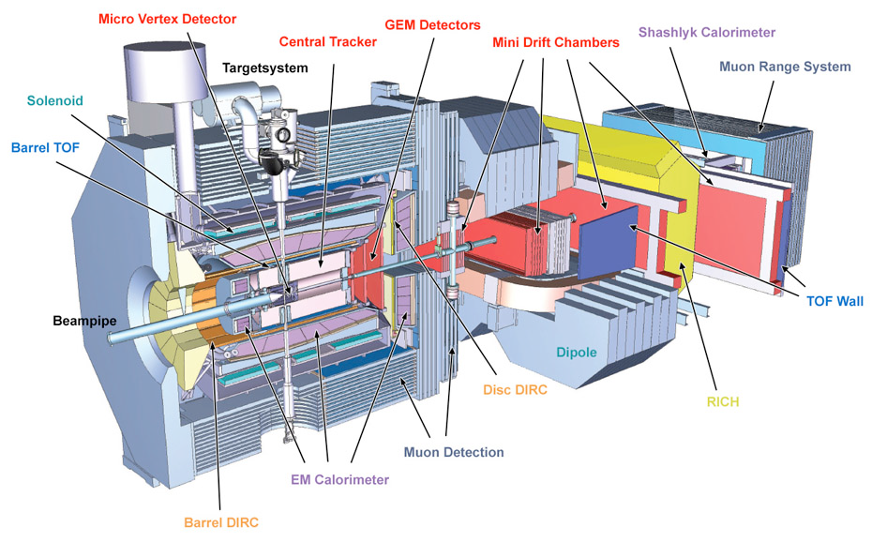
_
The PANDA Detector System In HESR
→ Talk by D. Calvo
d
d
Forward spectrometer,
2Tm dipole magnet
Target
spectrometer,
2T solenoid
13m

Slide 5
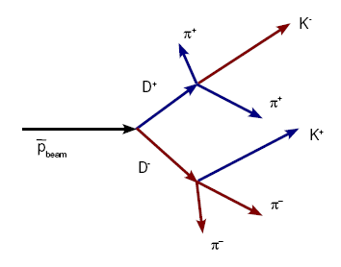
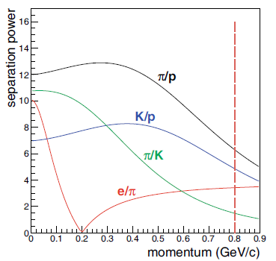
Tracking At PANDA
Variety of event topologies, all particle species involved
particle multiplicities up to 6 and higher, on average ~150 tracks / 2µs
broad momentum range ~ 100 MeV/c - 8 GeV/c
displaced vertices O(100µm) - O(10cm)
4π solid angle coverage (PWA)
High momentum & spatial resolution: σ_{p}/p~1-2%, vtx ~50µm
Particle identification: p/K/π <1 GeV/c (exclusively)
Readout of (quasi-) continuous data stream
fast online track & event reconstruction, w/o t₀, evt. deconv.
flexible software triggering, specific reactions → data storage
→Tracking system: MVD (vertex) + Central Tracker (large-vol) + GEMs (forwd)
Simulation

Slide 6
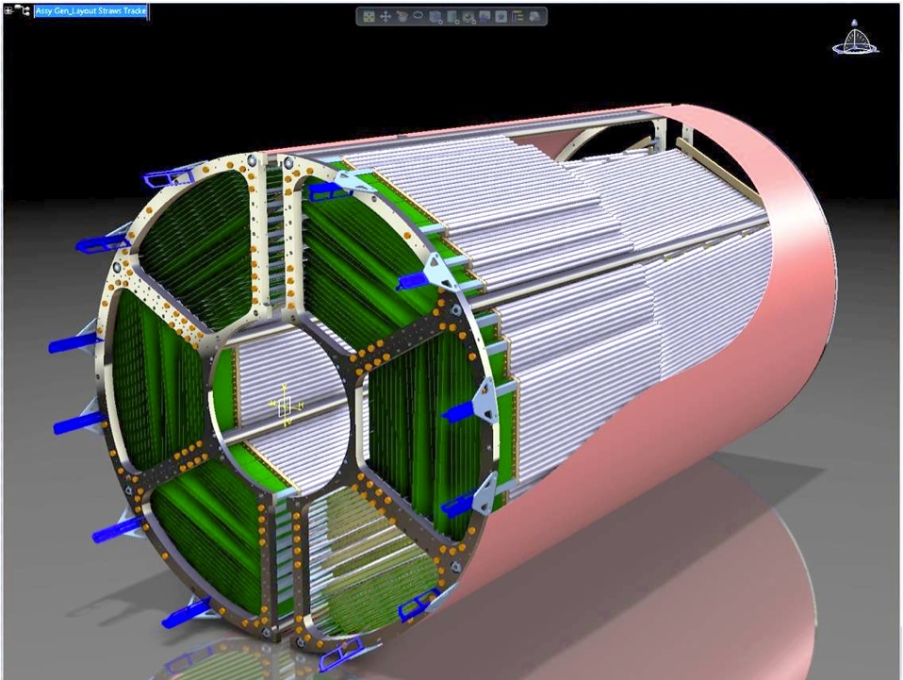
Central Straw Tube Tracker (STT)
4636 straw tubes in 2 separated semi-barrels
23-27 radial layers in 6 hexagonal sectors
15-19 axial layers (green) in beam direction
4 stereo double-layers: ±3° skew angle (blue/red)
Volume: R_{in} / R_{outr}= 150 / 418 mm, L~ 1650 mm
Inner / outer protection skins (~ 1mm Rohacell/CF)
Ar/CO₂ (10%), 2 bar, ~ 200ns drift time (2 T field)
Time & amplitude readout
σ_{rϕ} ~ 150 µm, σ_{z} ~ 2-3 mm (isochrone)
σ(dE/dx) < 10% for PID (p/K/π < 1 GeV/c)
σ_{p} /p ~ 1-2% at B=2 Tesla (STT + MVD)
X/X₀ ~ 1.25% (~ ²/₃ tube wall + ¹/₃ gas)
STT x-y view
STT 3d-view

Slide 7
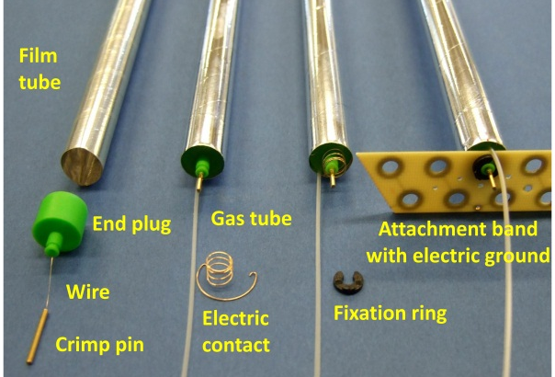
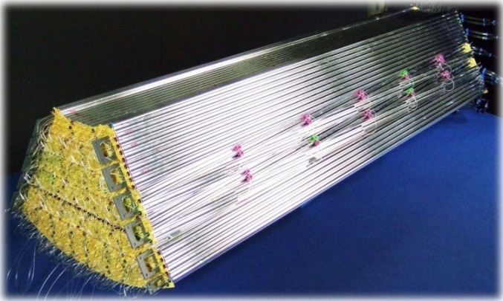
Straw Tubes
Material budget at lowest limit (2.5 g per assembled straw)
thinnest Al-mylar film, d=27µm, ∅=10mm, L=1400mm
thin-wall endcaps (ABS), wire fixation (crimp pins), radiation-hard
self-supporting modules of pressurized straws (Δp=1bar)
close-packed (~20 µm gaps) and glued to planar multi-layers
replacement of single straws in module possible (glue dots)
strong stretching (230kg wires, 3.2tons tubes)*, but no reinforcement needed
Straw components
Full hexagon sector
IKP FZ Jülich
* Sum for 4600 straws in the PANDA-STT
IKP FZ Jülich

Slide 8
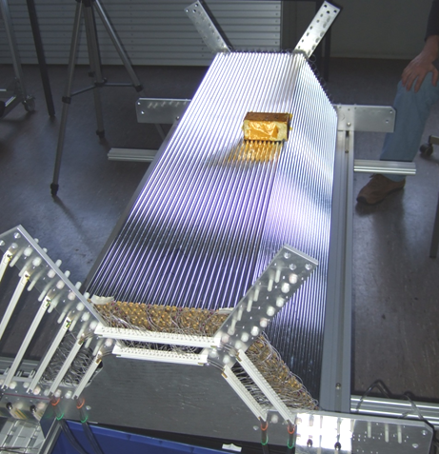
Self-Supporting Straw Modules
.. technique first developed for COSY-STT (planar double-layers, in vacuum!)
.. upgraded for PANDA-STT (barrel geometry with 3d stereo-layers, quad-layers)
3kg Pb brick on 27µm
Mylar
Pressurized, close-packed straw layers show a strong rigidity ..

Slide 9
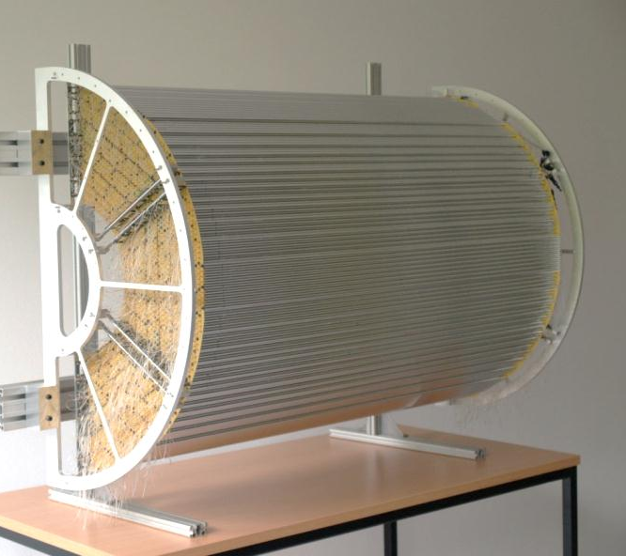
STT Mechanical Prototype
Full hexagon sector, overpressure 1 bar
STT mechanical prototype, one semi-barrel
Even more confidence in the self-supporting straw modules through the years ..
.. 3×3kg!

Slide 10
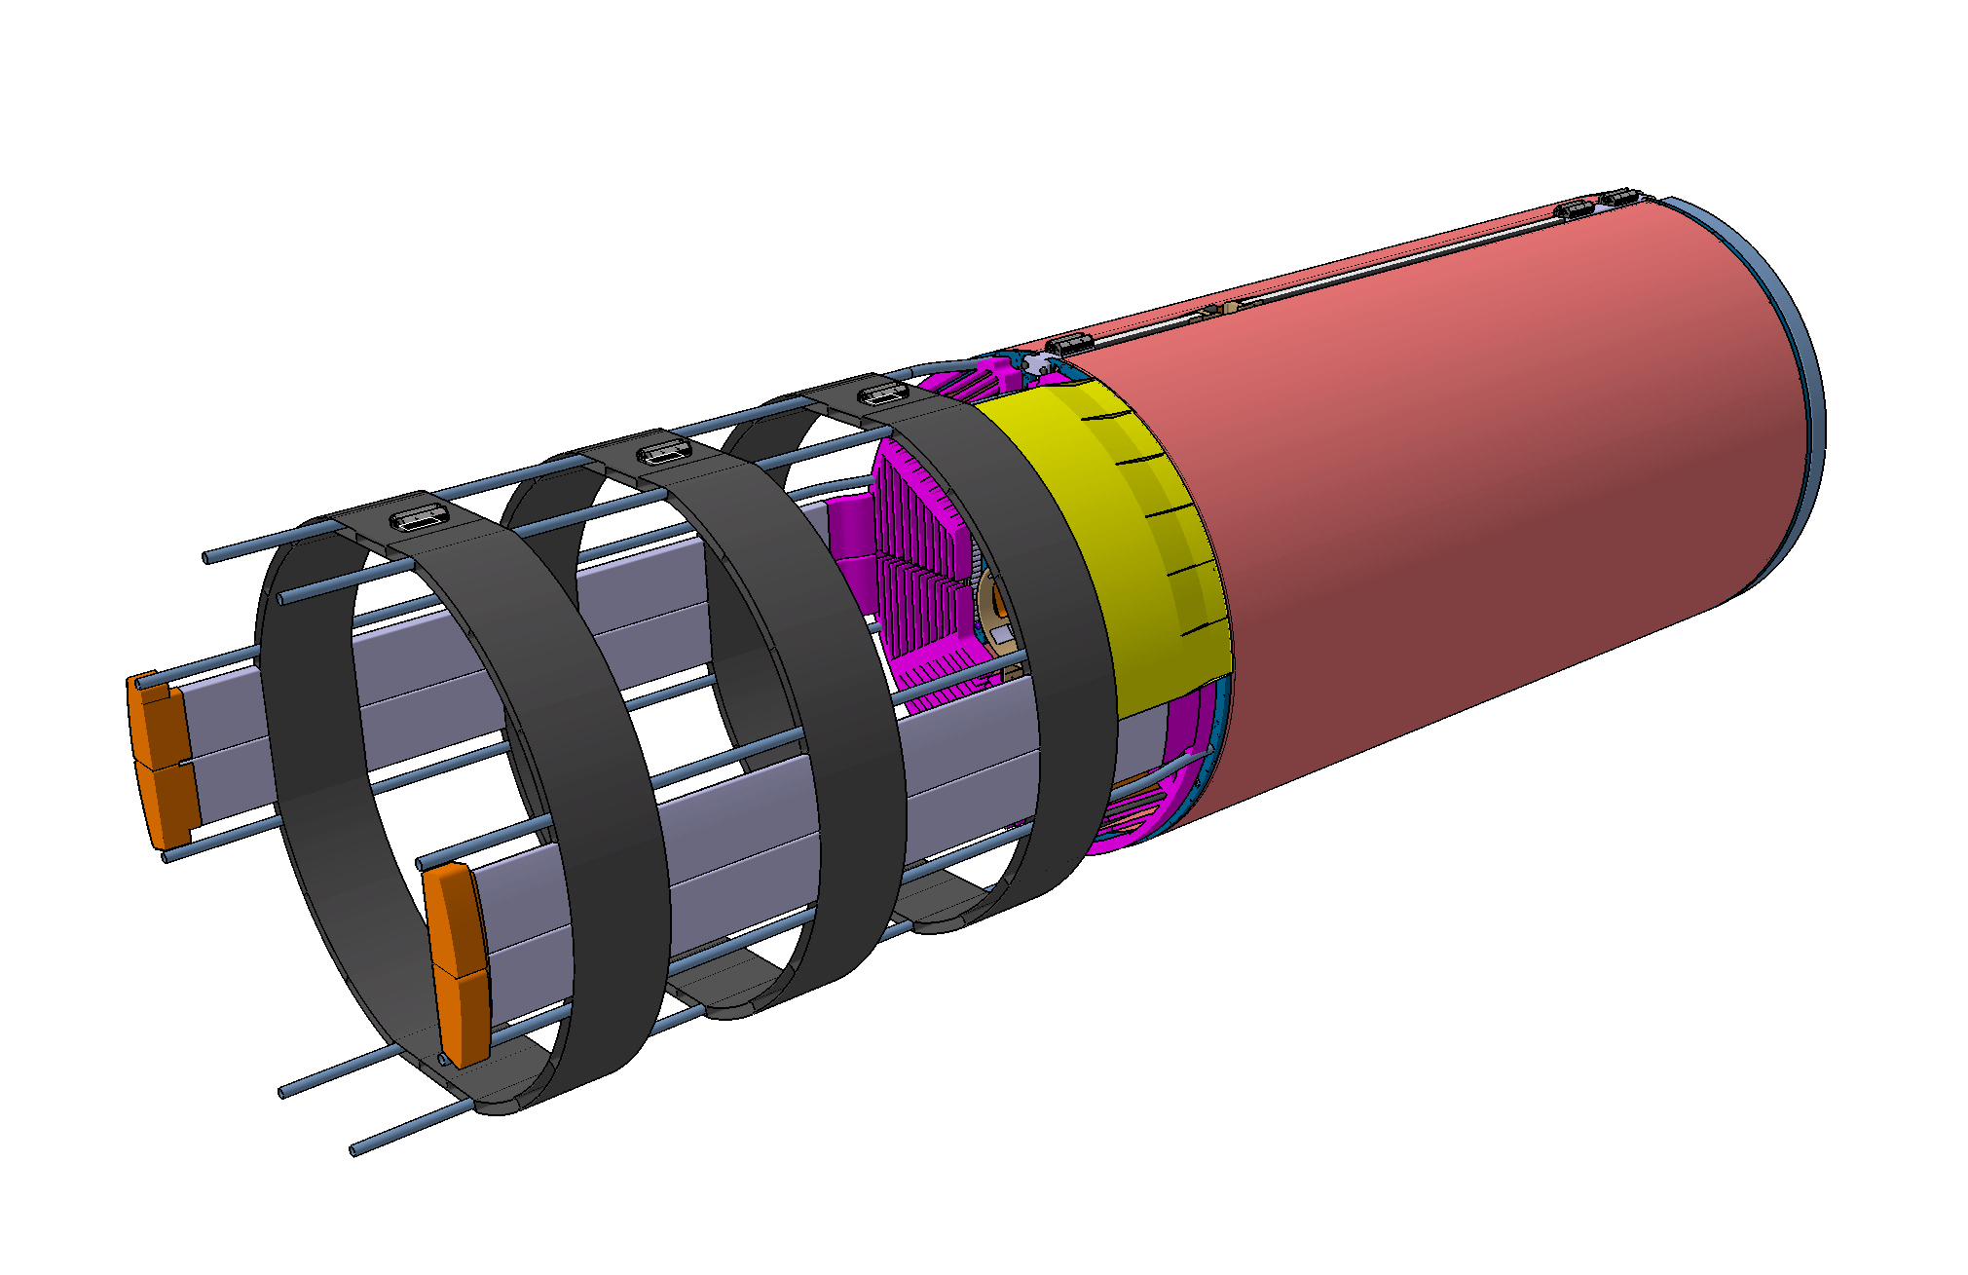
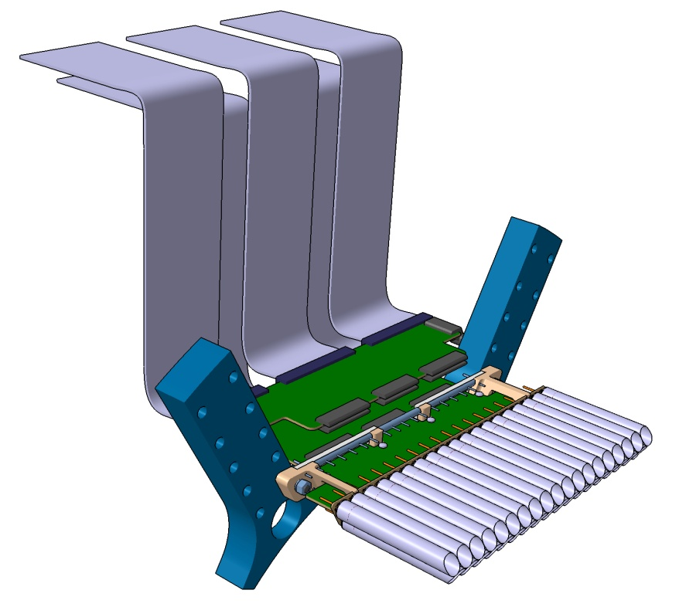
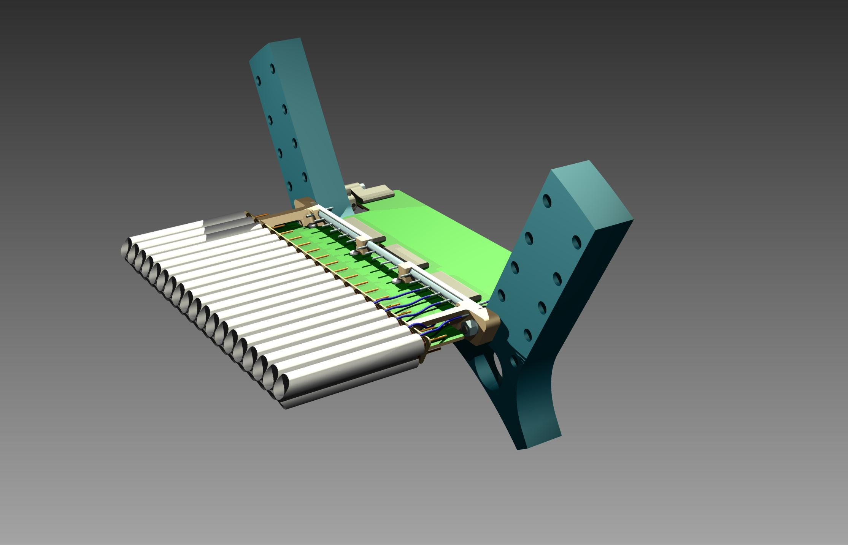
Mechanical Frame Structure
ELECTRONICS CARDS PROTECTION SKIN (Kevlar)
ELECTRONICS CARDS
STRAW TRACKER OUTER
PROTECTION SKIN (Kevlar)
CABLE ROUTING TRAY SUPPORT STRUCTURE (CRFP)
Sketch of frontend part
ANALOG READOUT
CARD
GAS MANIFOLD
STRAW MODULE
SUPPORT
CABLES ROUTING TRAY (Aluminum)
ELECTRONICS PATCH PANELS (Aluminum)
MECHANICAL FRAME (UPSTREAM)
INFN Frascati
MAIN GAS PIPES (Rilsan)
HIGH VOLTAGE DISTRIBUTION
STRAW MODULE

Slide 11
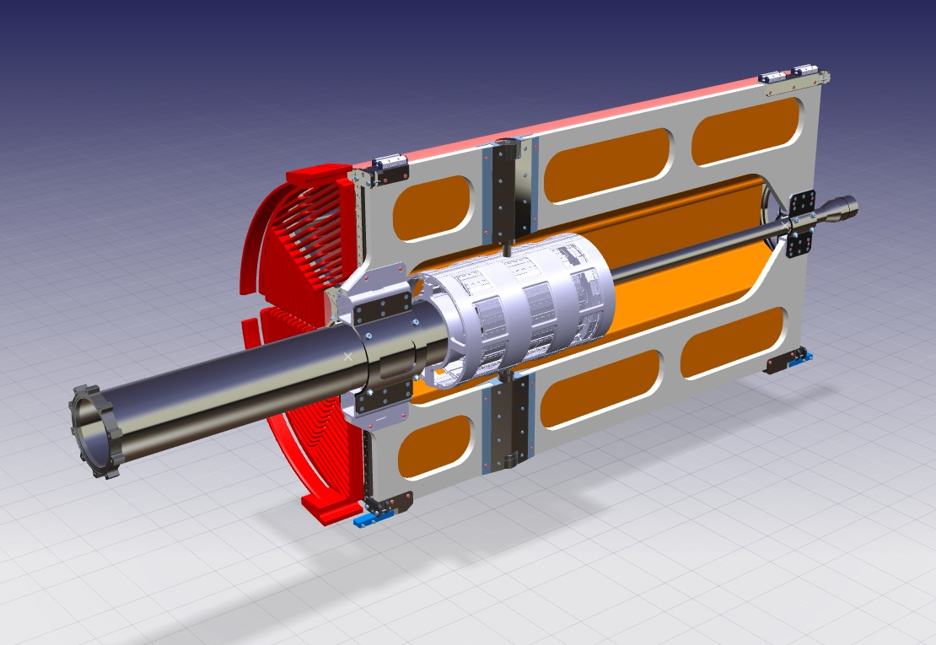
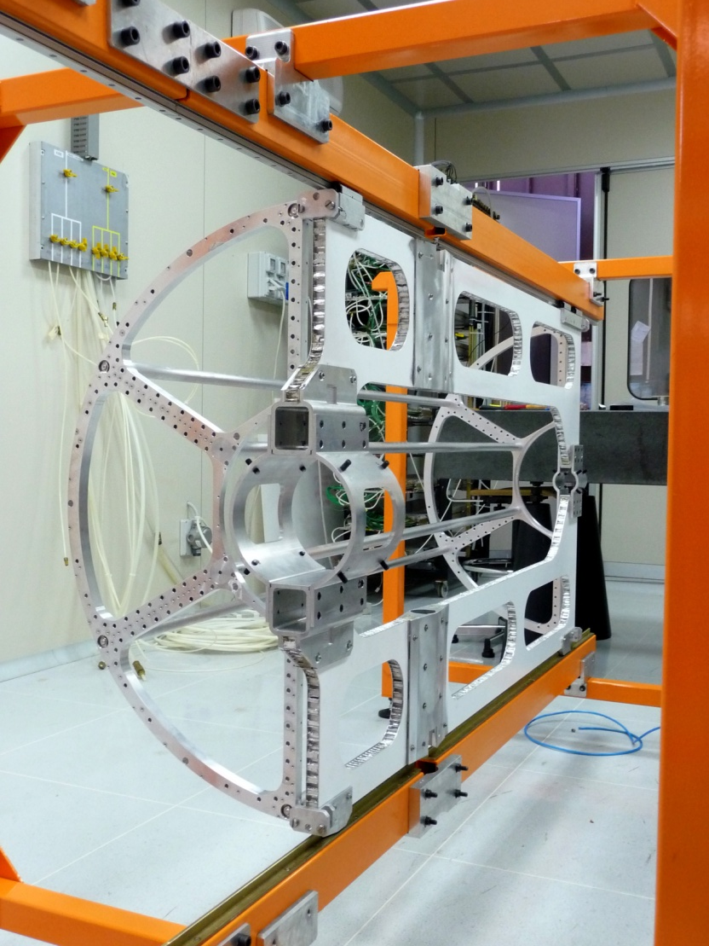
Final Assembly Scheme
Central frame structure to support all central components
beam pipe + MVD + STT semi-barrels
Rail system for insertion into the PANDA target spectrometer
INFN Frascati + Torino

Slide 12
STT Readout
2 Concepts to measure drift time + signal amplitude (for dE/dx)
Amplitude sampling: LE-Time + Q
Amplifier-shaper boards frontend at detector
Pulse sampling by FADC (240 MHz), pulse analysis and readout by FPGA
Amplitude by time-over-threshold*: LE-Time + ToT(Q)
Ampl.-Shaper-Discr. (ASIC-chip) frontend at detector
Time Readout Boards (TRB), TDC in FPGA
Requirements
~ 2fC sensitivity (thresh. ~ 1.2×10⁴ e⁻)
~ 1ns time resolution, ~ 200ns drift time range for Ar/CO₂(10%) at 2 T field
< 10% dE/dx resolution for PID
Hit rates: ~ 800 kHz/straw (max), ~ 400 kHz (avg.) at full luminosity
FEE must be radiation-hard, low power consumption, minimum space
*ToT used for PID at
ATLAS-TRT & HADES-MDC
Design by AGH Krakov
(CMOS 0.35µm)

Slide 13
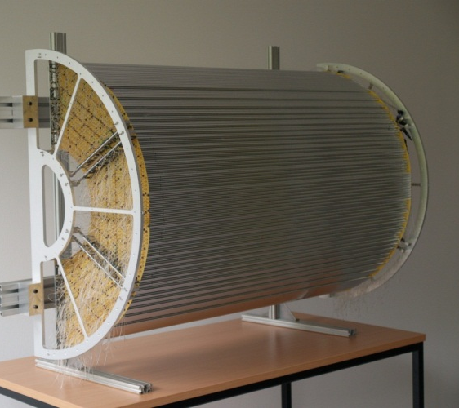
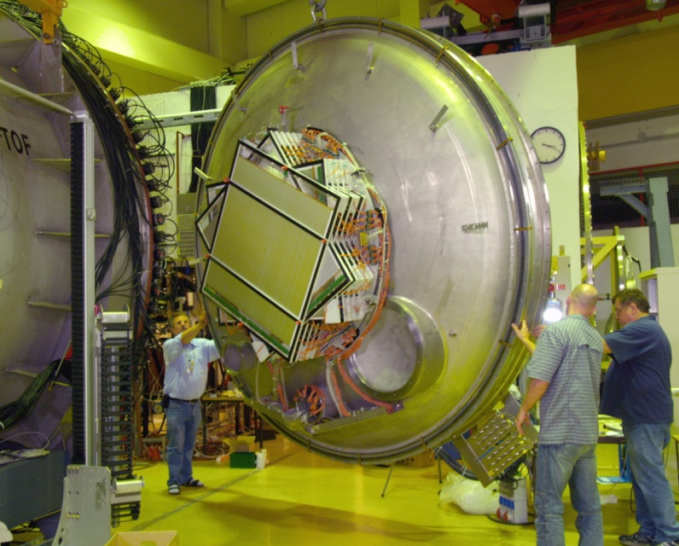
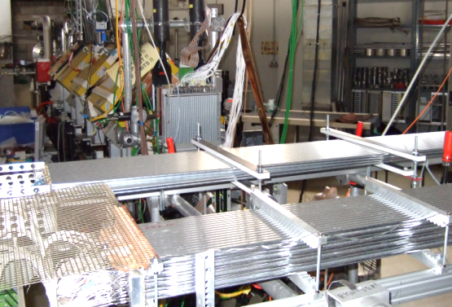
Test Systems
STT semi-barrel (1:1) for assembly techniques
Mechanical central frame structure on rail system
STT detector in COSY-TOF experiment
“Global“ test system for PANDA-STT (straw technique)
Spatial resolution: σ ~ 140µm (2700 straws)
Operated (4 yr) in evacuated time-of-flight barrel (25m³)
Leakage on permeation level (molecular flow thru mylar)
Straw setups for in-beam tests (p/d-beam)
Aging tests done, charge loads ~1.2 C/cm (~ 5yrs PANDA)
High-rate readout tests ongoing, 1-2 MHz/straw
Beam momentum 0.6 - 3 GeV/c (dE/dx range ~ 3× mips)

Slide 14
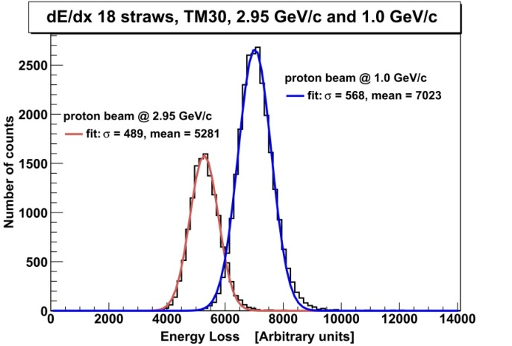
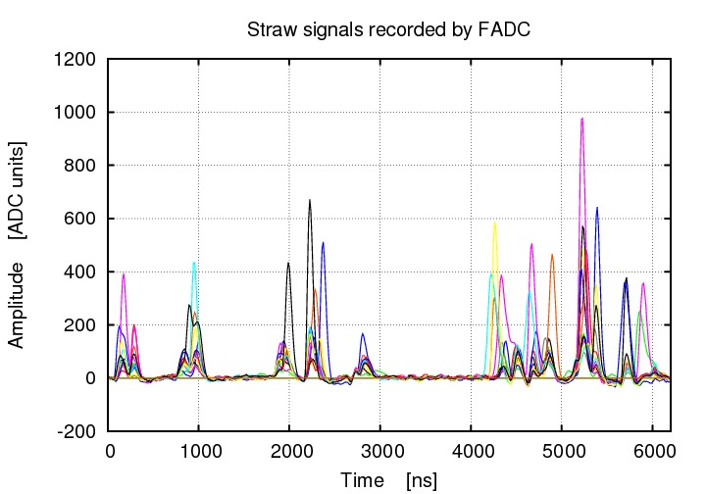
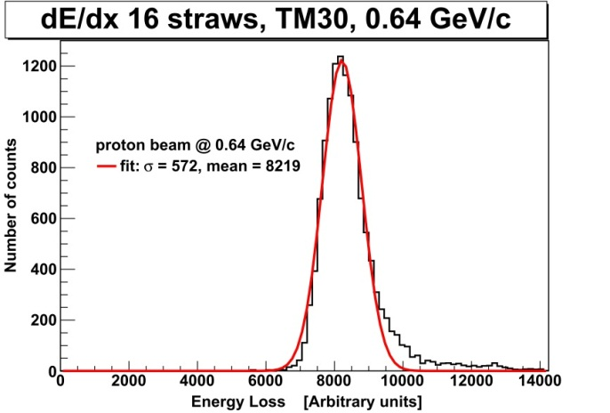
FADC Energy-Loss Measurements
dE/dx resolutions measured in beam with FADC
σ_{dE/dx} = 7.0% - 9.3% (0.6, 1.0, 2.9 GeV/c protons)
30% truncation factor (Landau-tail)
< 19 straw hits per track → 25 layers at PANDA-STT
σ_{dE/dx} ~ 7.0 % feasible with PANDA-STT
σ ~ 150µm spatial resolution measured
High-rate FPGA analysis & readout ongoing
1-2 MHz/straw

Slide 15
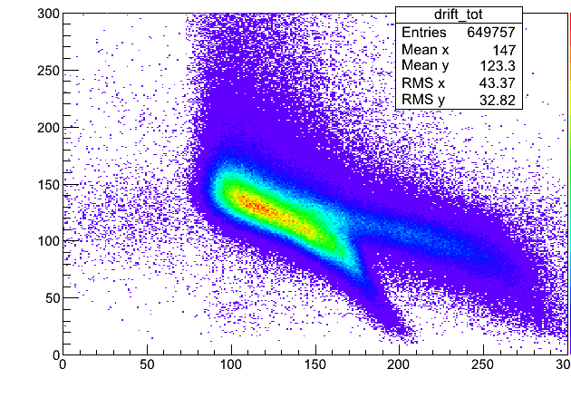
Time-Over-Threshold Method
ASIC testversion with analog out, first in-beam test 2012
gain (3-24mV/fC), peak time (20/40ns), ion tail cancell., BL stability, ..
Next ASIC version in production: 100 chips× 8 ch, few param. optimisations
Calibration of ToT ↔ dE/dx with ⁵⁵Fe-source (simple) and beam protons
need >4 different beam momenta to get ToT ↔ dE/dx relation and resolution
⁵⁵Fe-signals, 220(110)e⁻/200µm,
pulse integral + ToT measuremt
dQ/Q resolution ~ 10%
Beam on straws, TRB readout
50mV threshold
ToT
(25mV)
ToT
(50mV)
Pulse
integral
backgrd
Time over Threshold (ns) →
25mV threshold
Charge (pC) vs ToT(ns)
Time (ns)→

Slide 16
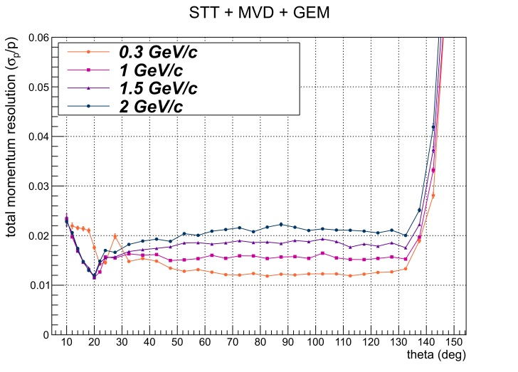
Simulation Studies
Single track simulation (MVD+STT+GEM, B=2T)
Momentum resolution 1-2% for θ < 140°
Test of tracking system with benchmark channels
vertex resolutions and reconstructed
mass of D-mesons
$\overline{p}p→{π^{+}π}^{−}$ ${π^{+}π}^{−}$
$\overline{p}p→η_{c}→φφ→K^{+}$ $K^{−}$ $K^{+} K^{−}$
$\overline{p}p→{Ψ(3770)→D}^{+}D^{−}$ $→K^{−}{π^{+}π^{+}K}^{+}{π^{−}π}^{−}$
D-meson reconstruction numbers

Slide 17
Summary
The PANDA-STT provides a complete measurement of charged particles: space, momentum, pid, (time)
Test measurements and benchmark channel simulations confirm the required performance
Technical design report of the STT was approved in 2012
Funding process will be completed soon (Germany, Italy, Poland, Romania)
Straw mass production during 2013-2016 (> 50% spares)
Electronic readout optimisation in parallel, beam test times at COSY
Comissioning of the detector setup with beam in 2016/2017 at COSY
Shipping to FAIR and installation in PANDA 2017
Technical design report of the PANDA-STT, Eur.Phys.J.A49 (2013) 25

