Slide 1
PANDA Magnets
Template for presentations concerning the magnet design at PANDA

Slide 2
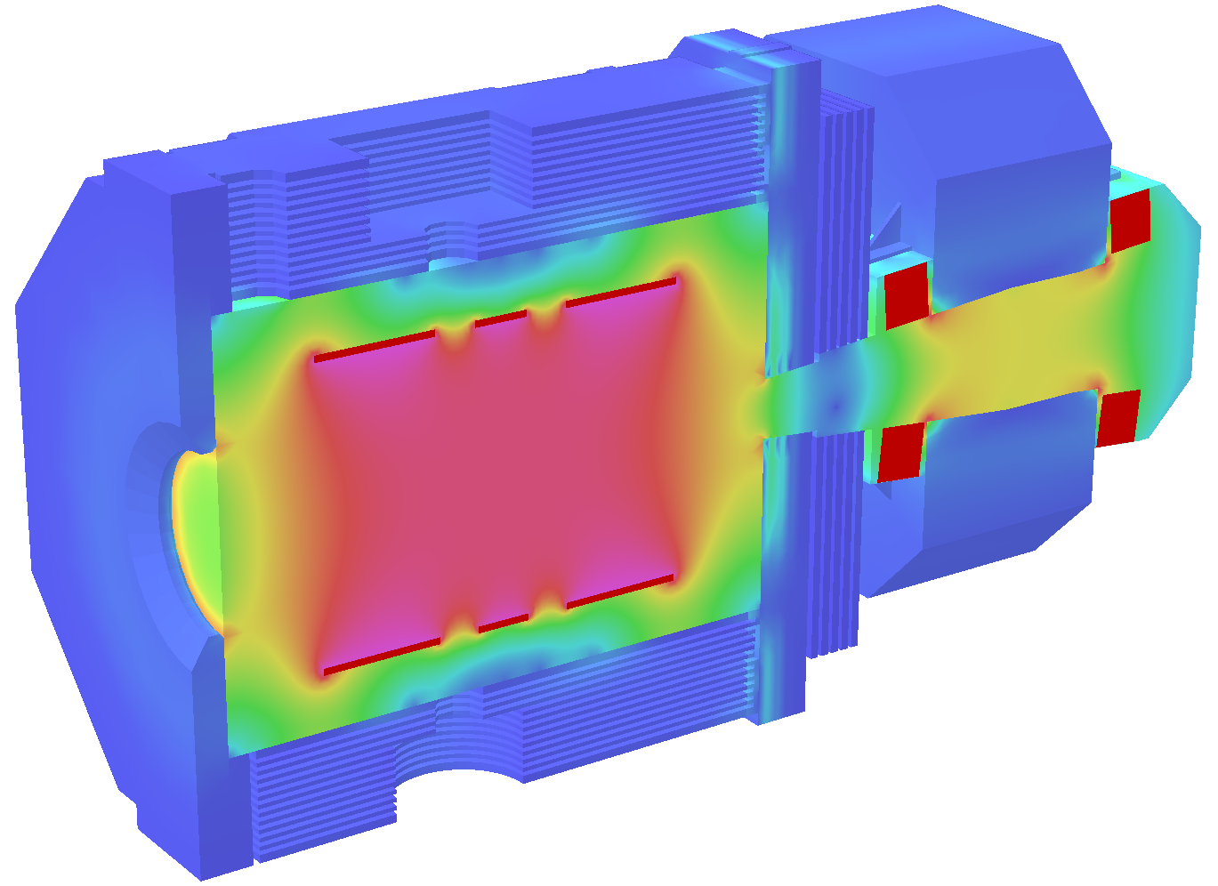
Spectrometer Magnets at PANDA
Prerequisite for momentum reconstruction and PID
Ideal combination
2T central solenoid field
1T forward dipole field
Technical Design Report (reviewed May 2009): arXiv:0907.0169

Slide 3
Superconducting Solenoid
Central field 2.0 T
Field homogeneity ≤2%
Norm. radial field integral ≤2 mm
Inner bore 1.9 m
Cold mass parameters
Length 2.7 m
Energy 20 MJ
Current 5000 A
Weight 4.5 t
Cable cross section 3.4 × 2 mm²
Current density 59 A/mm
Yoke parameters
Length 4.9 m
Outer radius 2.30 m
Iron layers 13
Total weight 300 t
Challenges
2T field
4m x 1.9m free space
High field homogeneity
Target pipe intersection
Access on both sides
Movement by 20m
Muon range system

Slide 4
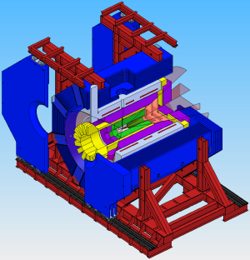
Superconducting Solenoid
Flux Return Yoke
shape homogeneous field
muon range system
barrel: 13 layers
forward doors: 5 layers
opening doors
accommodate target
retractable to parking position (20m)
reproducible positioning

Slide 5
Superconducting Solenoid
Coil
Internally wound on mandrel
Al stabilised Rutherford cable
split coil: 3 sections allowing target intersection
indirect cooling
Cryostat
asymmetric warm bore
mounting structure for detectors

Slide 6
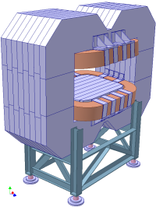
Large Aperture Dipole
2Tm for particles scattered in 0 – 10º (5º vertical)
Allows momentum resolution <1%
Large aperture (1x3m) and short length (2.5m)
Ramping capability due to lamination
Field integral 2 Tm
Bending variation ≤ ±15%
Vertical Acceptance ±5°
Horizontal Acceptance ±10°
Ramp speed 1.25%/s
Total dissipated power 360 kW
Total Inductance 0.87 H
Stored energy 2.03 MJ
Weight 220 t
Dimensions (H × W × L) 3.88 × 5.3 × 2.5 m³
Gap opening (H × W) 0.80 − 1.01 × 3.10 m²

